Slide 1
Solutions for minor problems network problems troubleshooting
Dimitar Dimitrov – student from 10B

Slide 2

Internet connection problem
The most common problem is lack of internet connection .
Solution: Restart the router or check the cable connections .

Slide 3

Slow internet connection
The reasons may be the provider .
Solution: Restart the device and check for current updates .

Slide 4
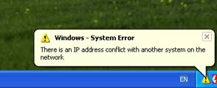
IP conflicts
An IP conflict occurs when two devices have the same IP.
Solution: Restart device or manually set a new IP address .

Slide 5
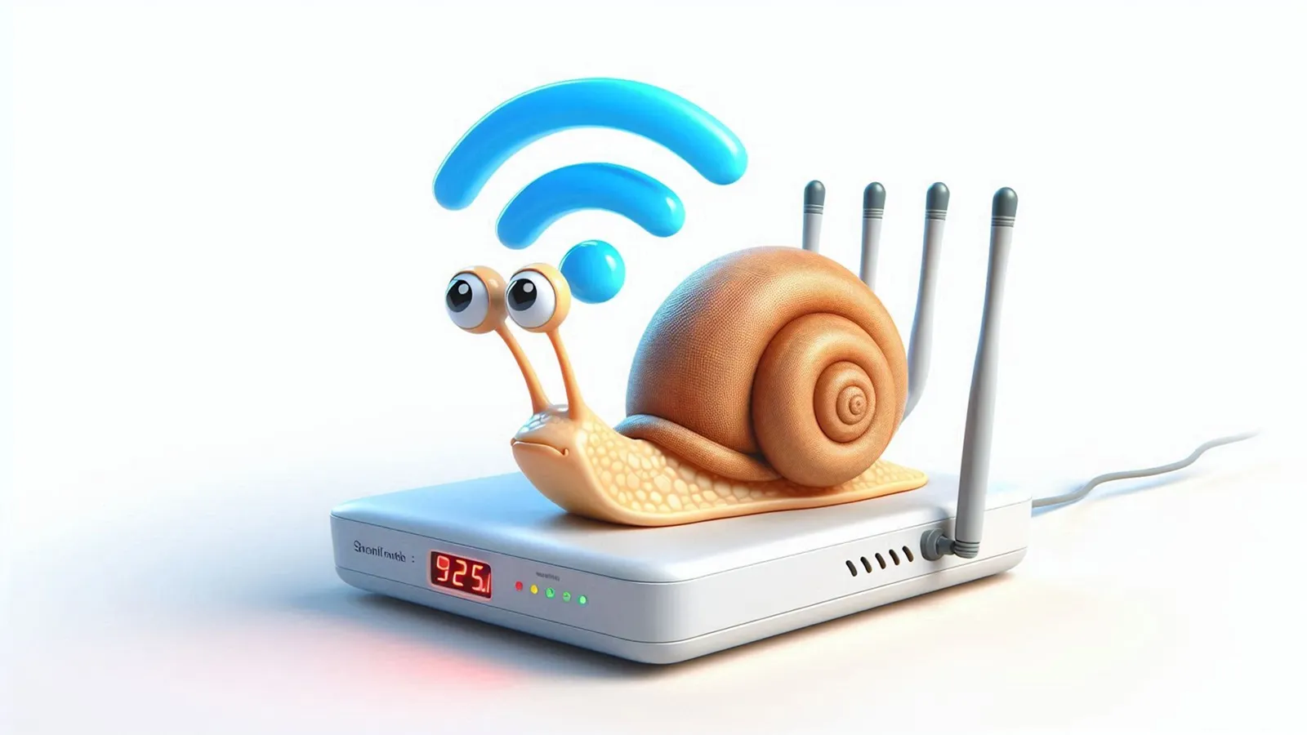
Wi-Fi signal is weak.
A weak signal may be due to long distance or obstacles .
Solutions: Moving the router or using Wi-Fi boosters .

Slide 6
Network connectivity failed
Poor connectivity can be due to DNS or network settings issues
Solution: Check DNS configurations and update network settings

Slide 7
Cable connection failure
Physical damage to the cables can lead to network outages.
Solutions: Replace defective cables and check for proper connection

Slide 8
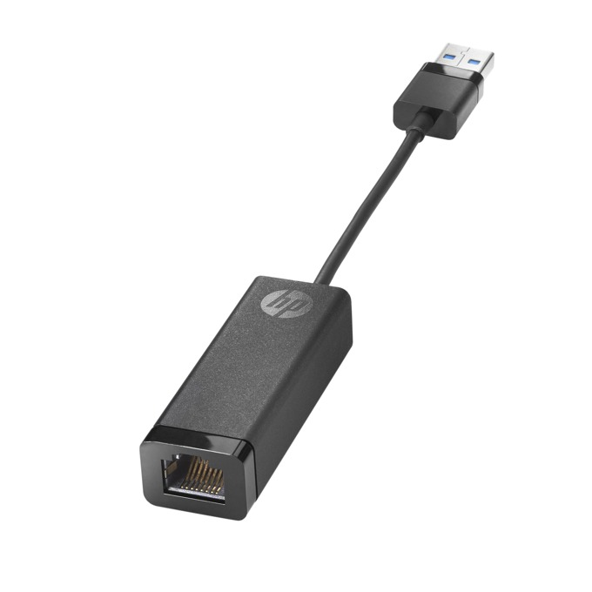
Network adapter problem
The network adapter may need driver updates to the network adapter drivers.

Slide 9
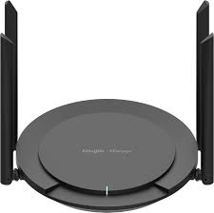
Overloaded router
Routers have a limit on connected devices and traffic
Solution: Limit the number of devices or upgrade the router

Slide 10
Conclusion
Troubleshooting network problems requires a systematic approach .
Tip: Use diagnostic tools and maintain equipment regularly .
This is a basic structure for a presentation with brief information on each point . You can add images or graphs for better visualization .

Slide 11
Thankyou for you attention

