Slide 1
Solutions for minor problems, network problems,
troubleshooting
Prepared by: Simeon Simeonov -
student 10 b grade

Slide 2
What are network problems and malfunctions?
Network problems and malfunctions refer to any disruptions or defects in the operation of a computer network that result in loss of connectivity, connection delays , or complete lack of access
to network resources (such as the Internet or a local area network). They can be caused by a variety of factors
and include both hardware and software problems.

Slide 3
Here are some common types of network problems:
Connectivity issues
•Broken cables – Physical break in network cables
or poor connections.
•Incorrect device configuration –
Errors in the settings of routers, switches, computers or network adapters.
•IP address exhaustion – If IP addresses are not managed properly in a network, there may not be enough for all devices.
Network slowdown
•Congested network – Excessive network traffic can cause congestion, which
slows down connections.
•Low bandwidth – Insufficient network
speed or limited bandwidth may cause delays.
•High latency – The high time it takes to transfer data from one end to another also leads to network slowdown.

Slide 4
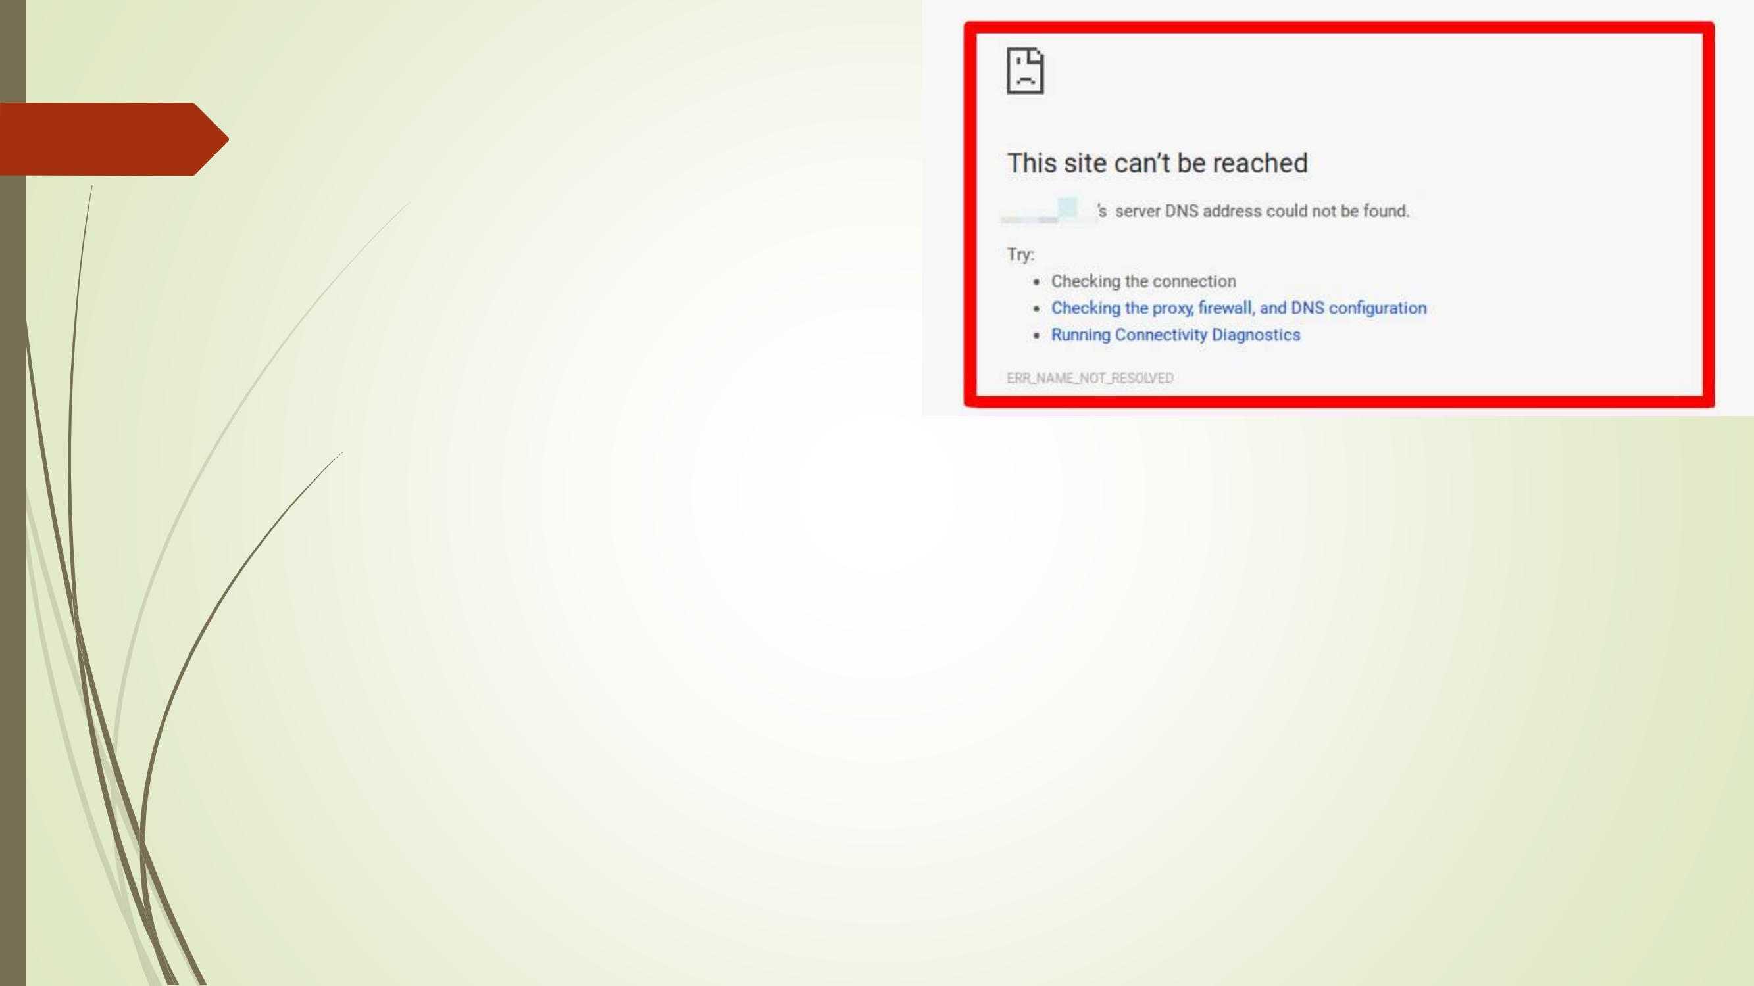
Network outages
devices
•Problems with routers and switches –
Network malfunction or failure devices may interrupt connectivity.
•Wireless network (Wi-Fi) problems –
Frequency interference, long distance
from the router, multiple connected devices , or weak signal strength can disrupt the wireless connection.
Security and network attacks
•Network attacks – DDoS attacks, malware, or hacking attempts can compromise the network.
•Incorrect firewall settings – This can block legitimate connections or allow unwanted connections.
DNS problems
•DNS server errors – If DNS servers are not working properly, devices will not be able to be able to find domains (for example, it will be impossible to access websites by their name).
•Cached incorrect DNS records – Sometimes old or incorrect DNS records can lead to incorrect routing.

Slide 5
Power problems
•Power supply failures – If routers, switches or servers
lose power, this will cause connectivity to be lost.
Software problems
•Operating errors
System – Poorly configured
or outdated software can cause network problems.
•Incorrect network settings
settings – For example, incorrectly set IP addresses, subnet masks, or
locks.

Slide 6
For minor network faults and issues, there are a few basic steps you can take to diagnose and fix the problem. Here are some of the most common:
the solutions encountered:
1. Restart the devices
2. Check the cables
•Make sure the cables are securely connected – Often the bad or loose
cable connections can
to cause problems
with the network. The check
of the cables may fix
this problem.
•Cable replacement –
If the cable is worn out
or damaged, the replacement
Replacing it with a new one may solve the problem.
•Restart the router –
One of the simplest but effective methods for solving
One of the most common
solutions to network problems is to restart your router or modem. This
can restore your connection and clear up temporary errors.
•Restart the computer/device – Sometimes the problem can be related to the device you are using. A simple restart can fix the problem.

Slide 7
4. Checking the IP configuration
•Re-evaluate the IP address – Check if the device has a correctly assigned IP address. In
Windows, you can use the ipconfig /renew
command to request a new IP address from the router.
5. Wi-Fi issues
•Check the signal range – If
The Wi-Fi signal is weak, try moving your device
closer to the router.
•Changing Wi-Fi channel – Sometimes
Wi-Fi problems are due to a congested channel. Go to settings
on the router and change the channel to a lower one
busy.
•Interference Check – Wireless
telephones, microwave ovens or other
electronic devices can cause interference. Try moving the
the router to another location.
•Check DHCP configuration
– If you have a static IP address, check that the settings are correct. For automatic
IP addresses, make sure that DHCP is enabled.
6. Solving DNS problems
•Change DNS servers – If there is a problem with your internet connection, try using a public DNS, such as
Google DNS (8.8.8.8 and 8.8.4.4) or OpenDNS.
7. Update drivers
•Update network drivers –
Check if your computer's network drivers are up to
date. You can do this through the "Device Manager" in Windows.
•Router firmware – Check if there is
a new firmware version for your router and
update if necessary.
•Clear the DNS cache – In Windows, use the ipconfig /
flushdns command to clear the DNS cache and resolve domain resolution issues .

Slide 8
8. Disabling and enabling the network adapter
9. Firewall or antivirus software issues
•Temporarily disable the network
adapter – You can disable and then enable the network adapter
adapter in the device settings to try to restore the network
•Temporarily disable the firewall
– A misconfigured firewall can block network connections. Test by temporarily disabling it.
•Check antivirus software –
Some antivirus programs can block network connections. Check if they are set up correctly.
connection.
•Replace the adapter – If the network adapter
adapter has a hardware problem, it may need to be replaced.
10. Factory reset router
•Factory reset
settings – If nothing works, you can reset the router to its factory settings. This will
11. Using network
tools
•Network troubleshooter – In
operating systems like Windows there is
built-in network diagnostic tools that can automatically detect and fix some of the problems.
remove all configurations, but it may solve deeper problems.

