Slide 1
MUTATIONAL VARIABILITY
Author: Ani Vasileva - student from 8B grade

Slide 2
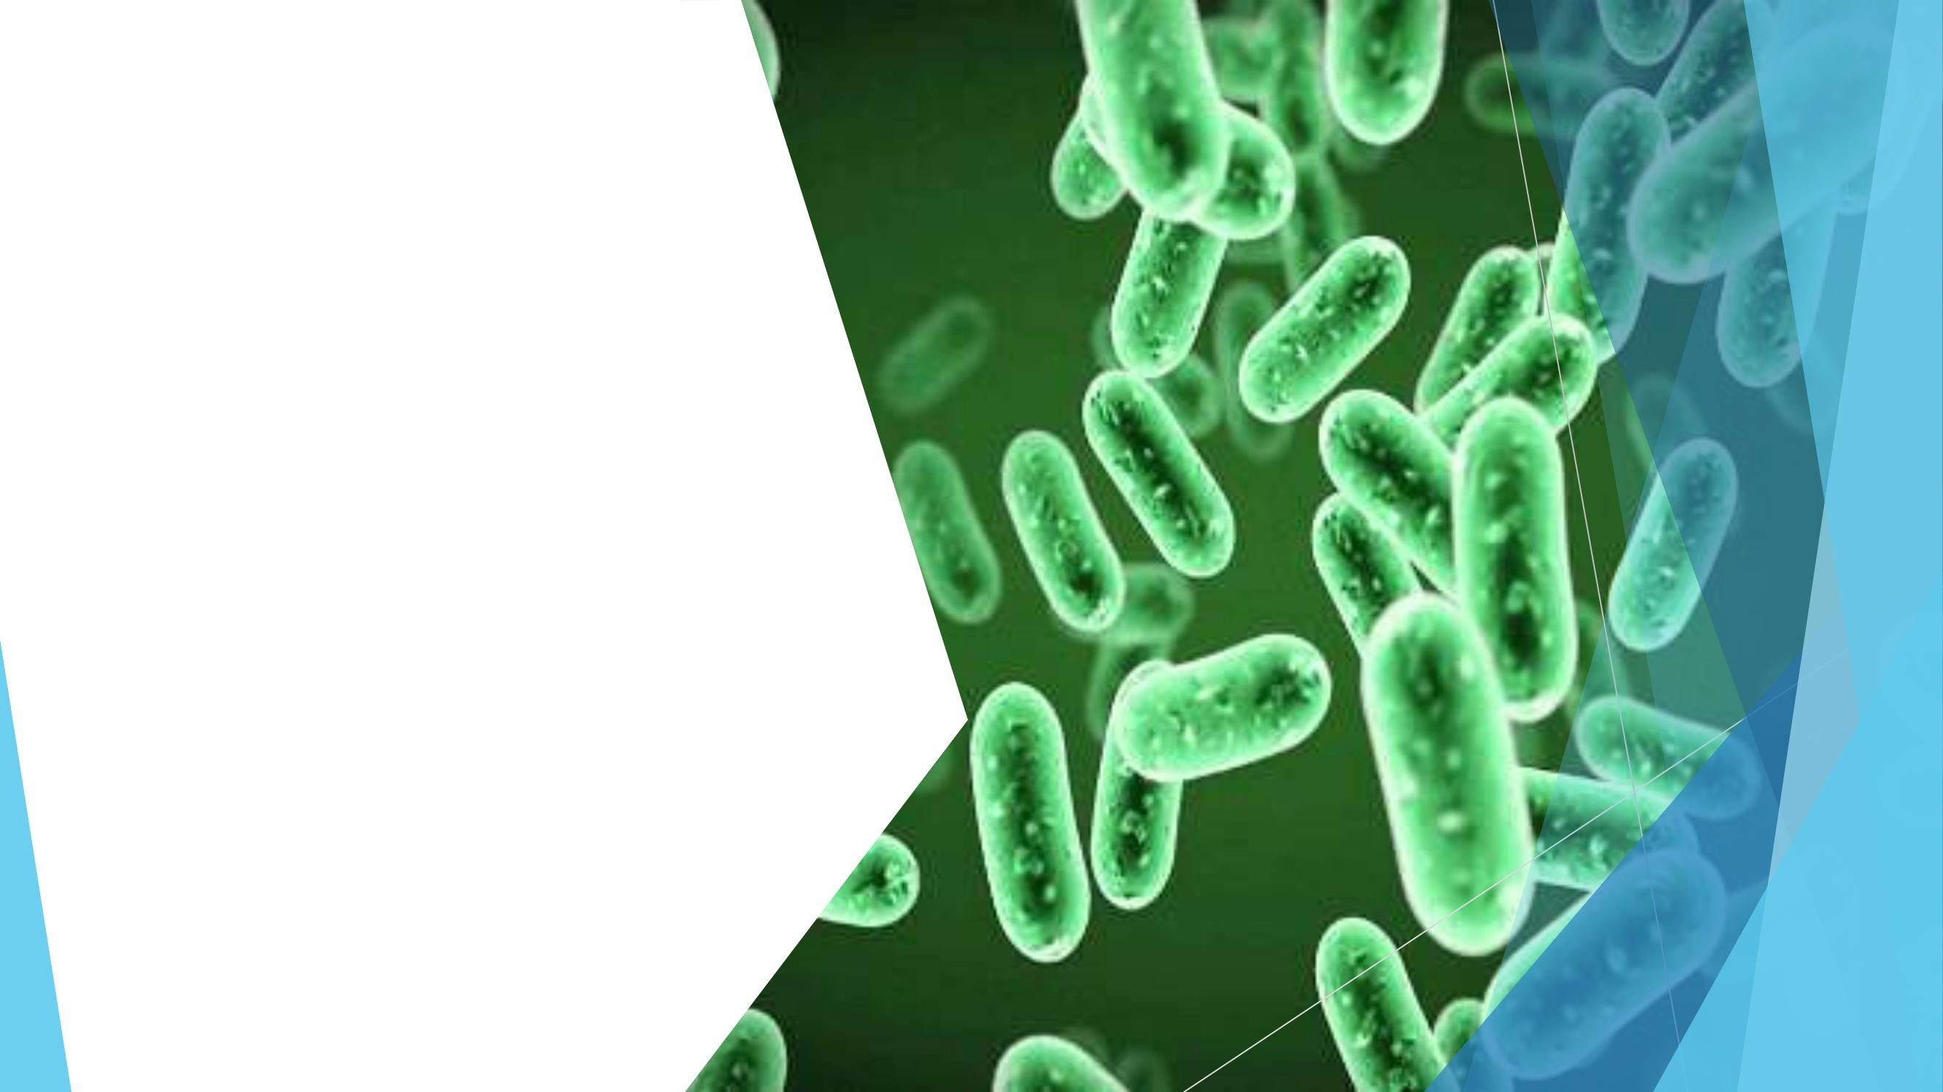
The mutation
variability of
organisms
Mutational variability of organisms is due to changes in their hereditary
structures that occur under the influence of various factors. The process of
occurrence of mutations is called mutagenesis, and the carrier of a particular mutation is called a mutant. In essence, mutations are changes in the
structure of chromosomes or genes, which change the phenotypic appearance of the organism.

Slide 3
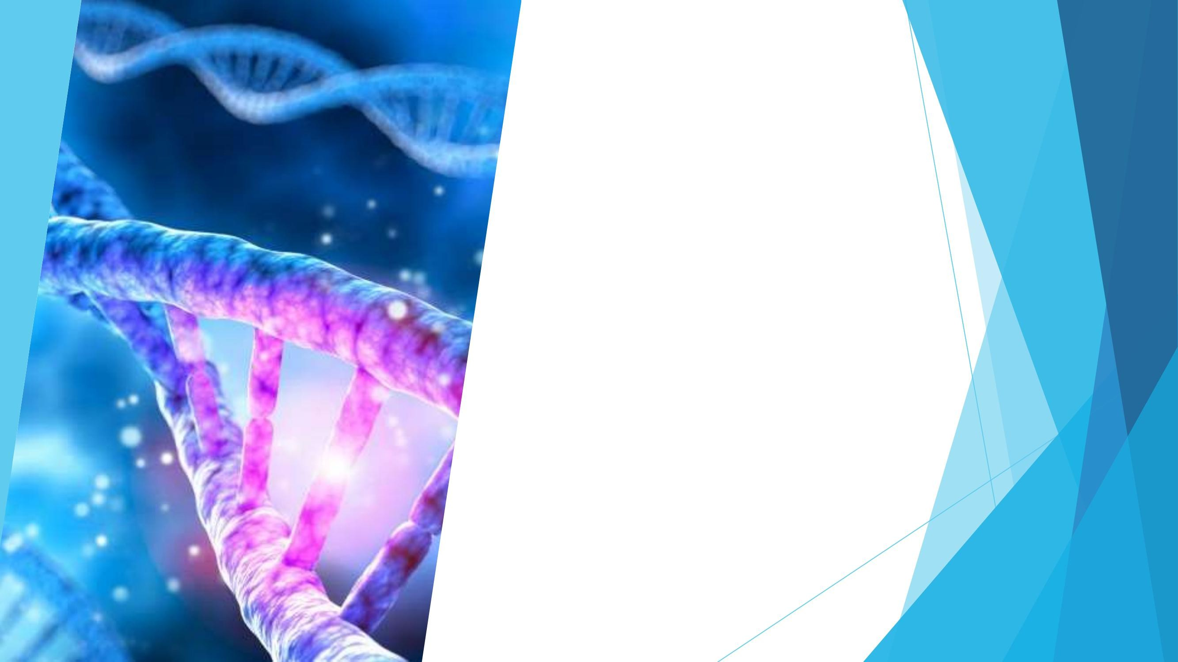
Features of mutations
They are qualitative changes in the hereditary apparatus of the cell.
They occur suddenly, without any transitions.
It is possible for the same mutations to reoccur. The resulting new forms are
constant.
Flow in different directions.

Slide 4
Types of mutations according to the way they occur

Slide 5
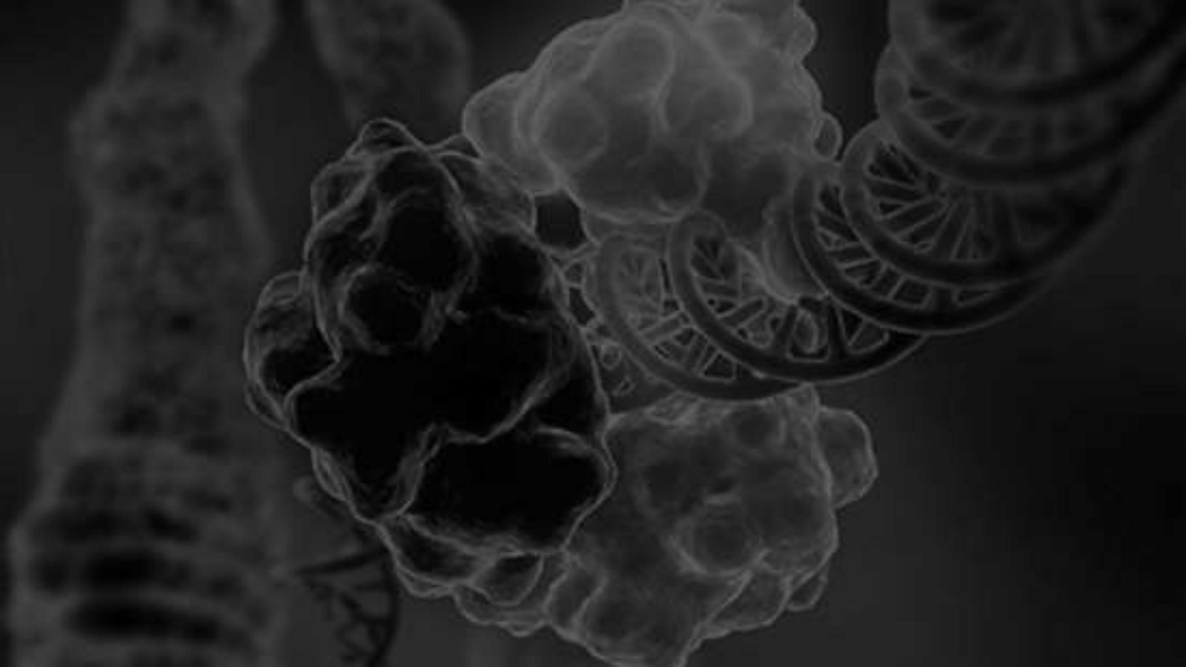
Spontaneous mutations
occur as a result of random events, without it being possible to
predicted. A characteristic of almost all genes is their mutability. The occurrence of mutations does not give an adaptive advantage to the cell or
the organism in which they arose. Under the influence of natural selection
beneficial (giving an advantage) mutations are passed on to the offspring, while carriers of harmful mutations rarely reach the point of producing offspring. Different sections along the length of the gene are characterized by different
mutability. There are characteristic one or two nucleotide
sequences along a given gene in which mutations occur occur significantly more than other regions of the same gene.

Slide 6
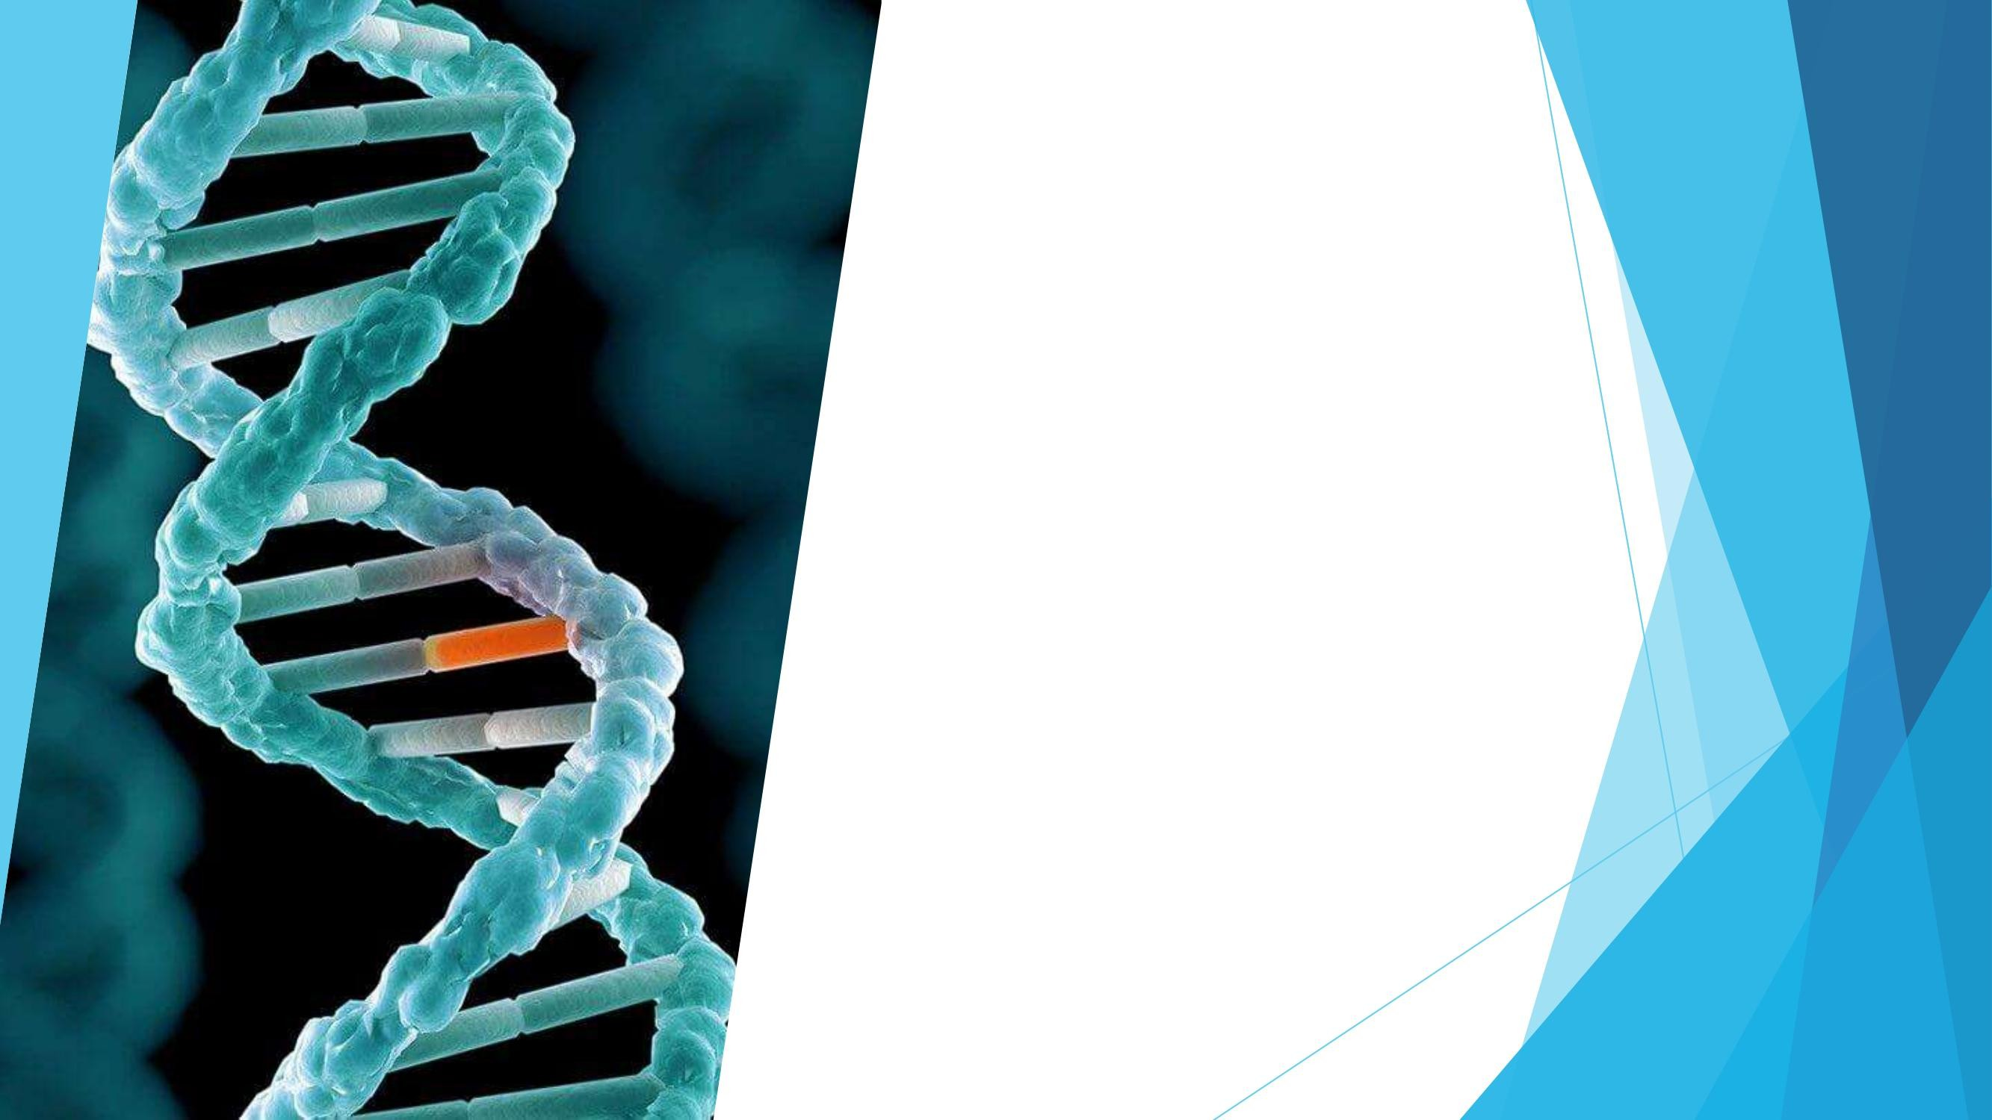
Induced mutations
arise under the influence of certain environmental factors. Some of the factors of induced mutagenesis are X-rays, UV, radiation decay, etc.

Slide 7
Types of mutations according to the type of
affected cells

Slide 8
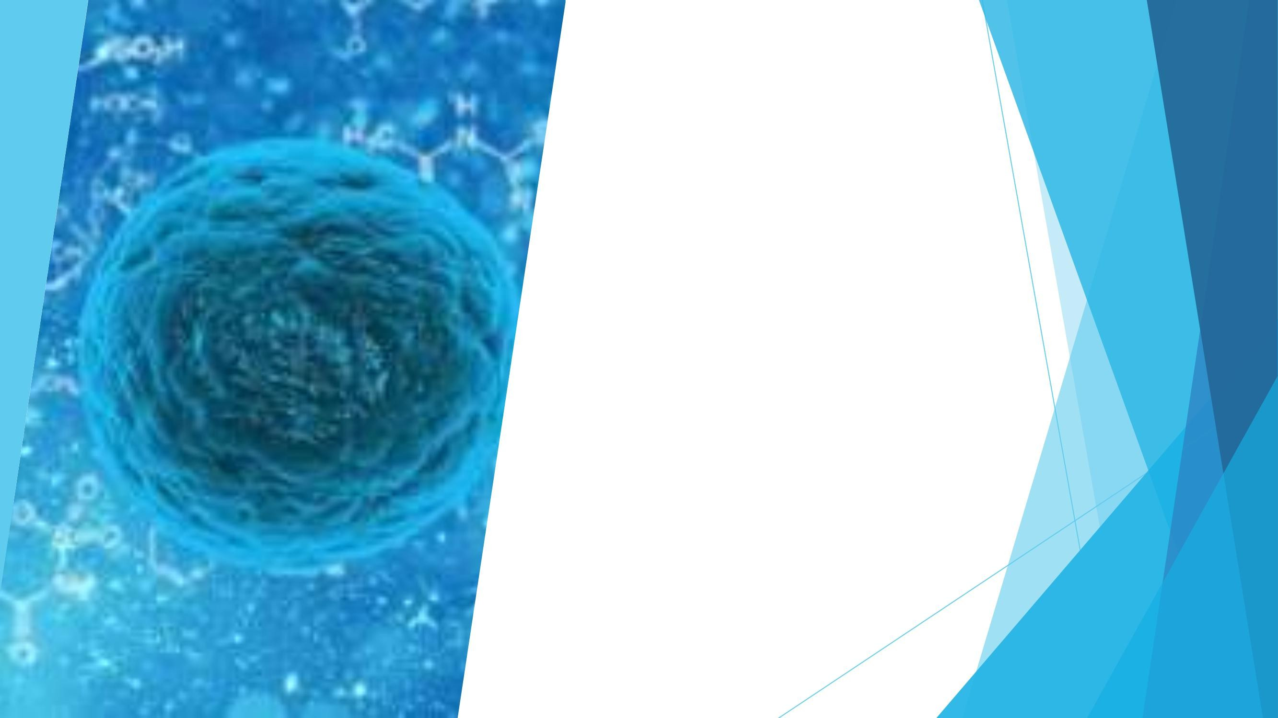
Somatic
They arise in the somatic cells of the organism, therefore they are not transmitted to its
offspring. Since the organs in multicellular organisms are made up of huge
numbers of equally specialized cells, mutations in one or a few cells rarely cause disorders in the functions of the organism. When mutations occur in the sex-linked genes described
above, it is possible for a gene in a hemizygous state to become lethal.

Slide 9
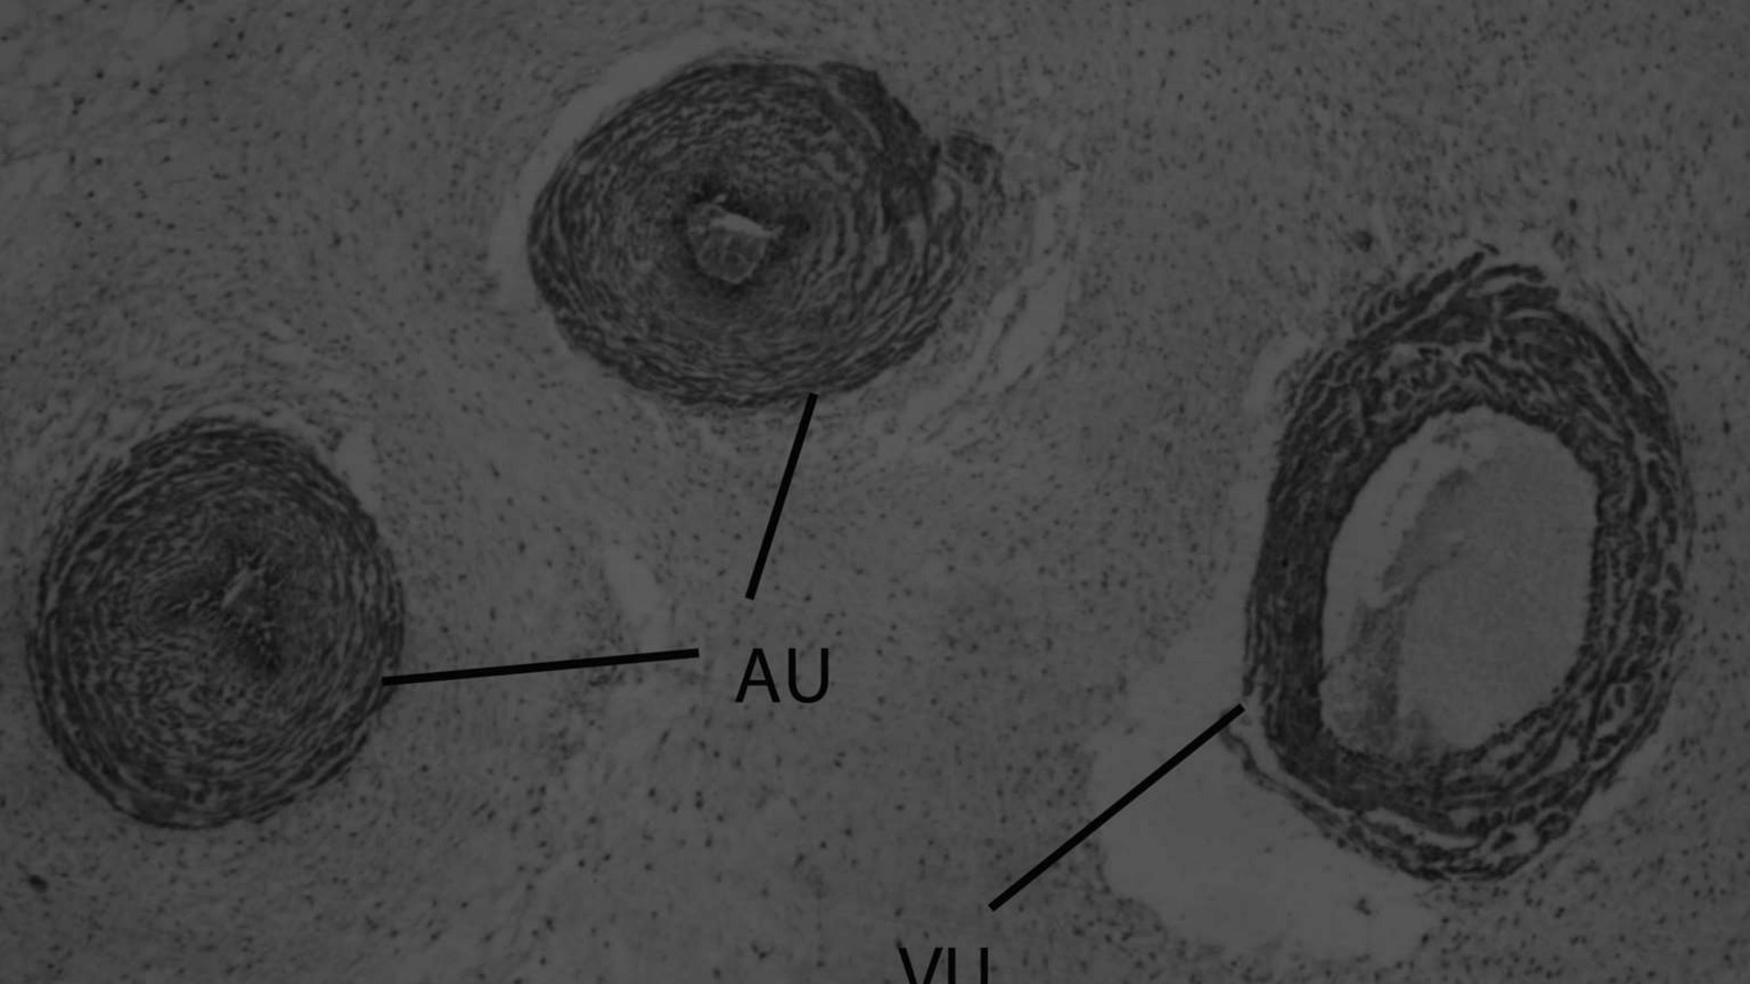
Germinal
Immature and mature germ cells are affected. Because they are transmitted to the offspring, these types of mutations represent a major problem in biology.
world. In most cases, two types of germline mutations occur –
dominant and recessive. Dominant ones are manifested in every organism
conceived from a damaged gamete, while recessive ones only when they are in a homozygous state, which is why in most organisms they remain
hidden in heterozygotes.

Slide 10
Types of mutations
according to the phenotypic trait they affect

Slide 11
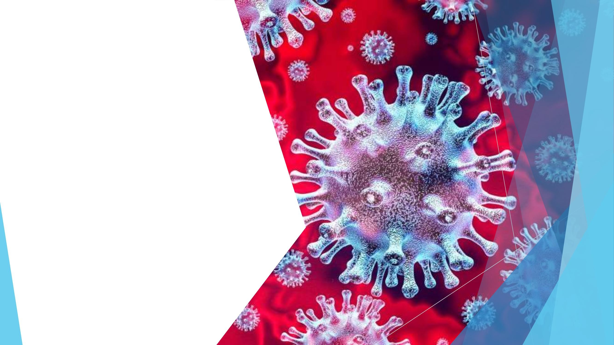
Morphological mutations
are characterized by a change in the structure of cells, tissues and organs. In animals, such
mutations cause a lack or
reduce the length of
legs, lack of hair, etc.

Slide 12
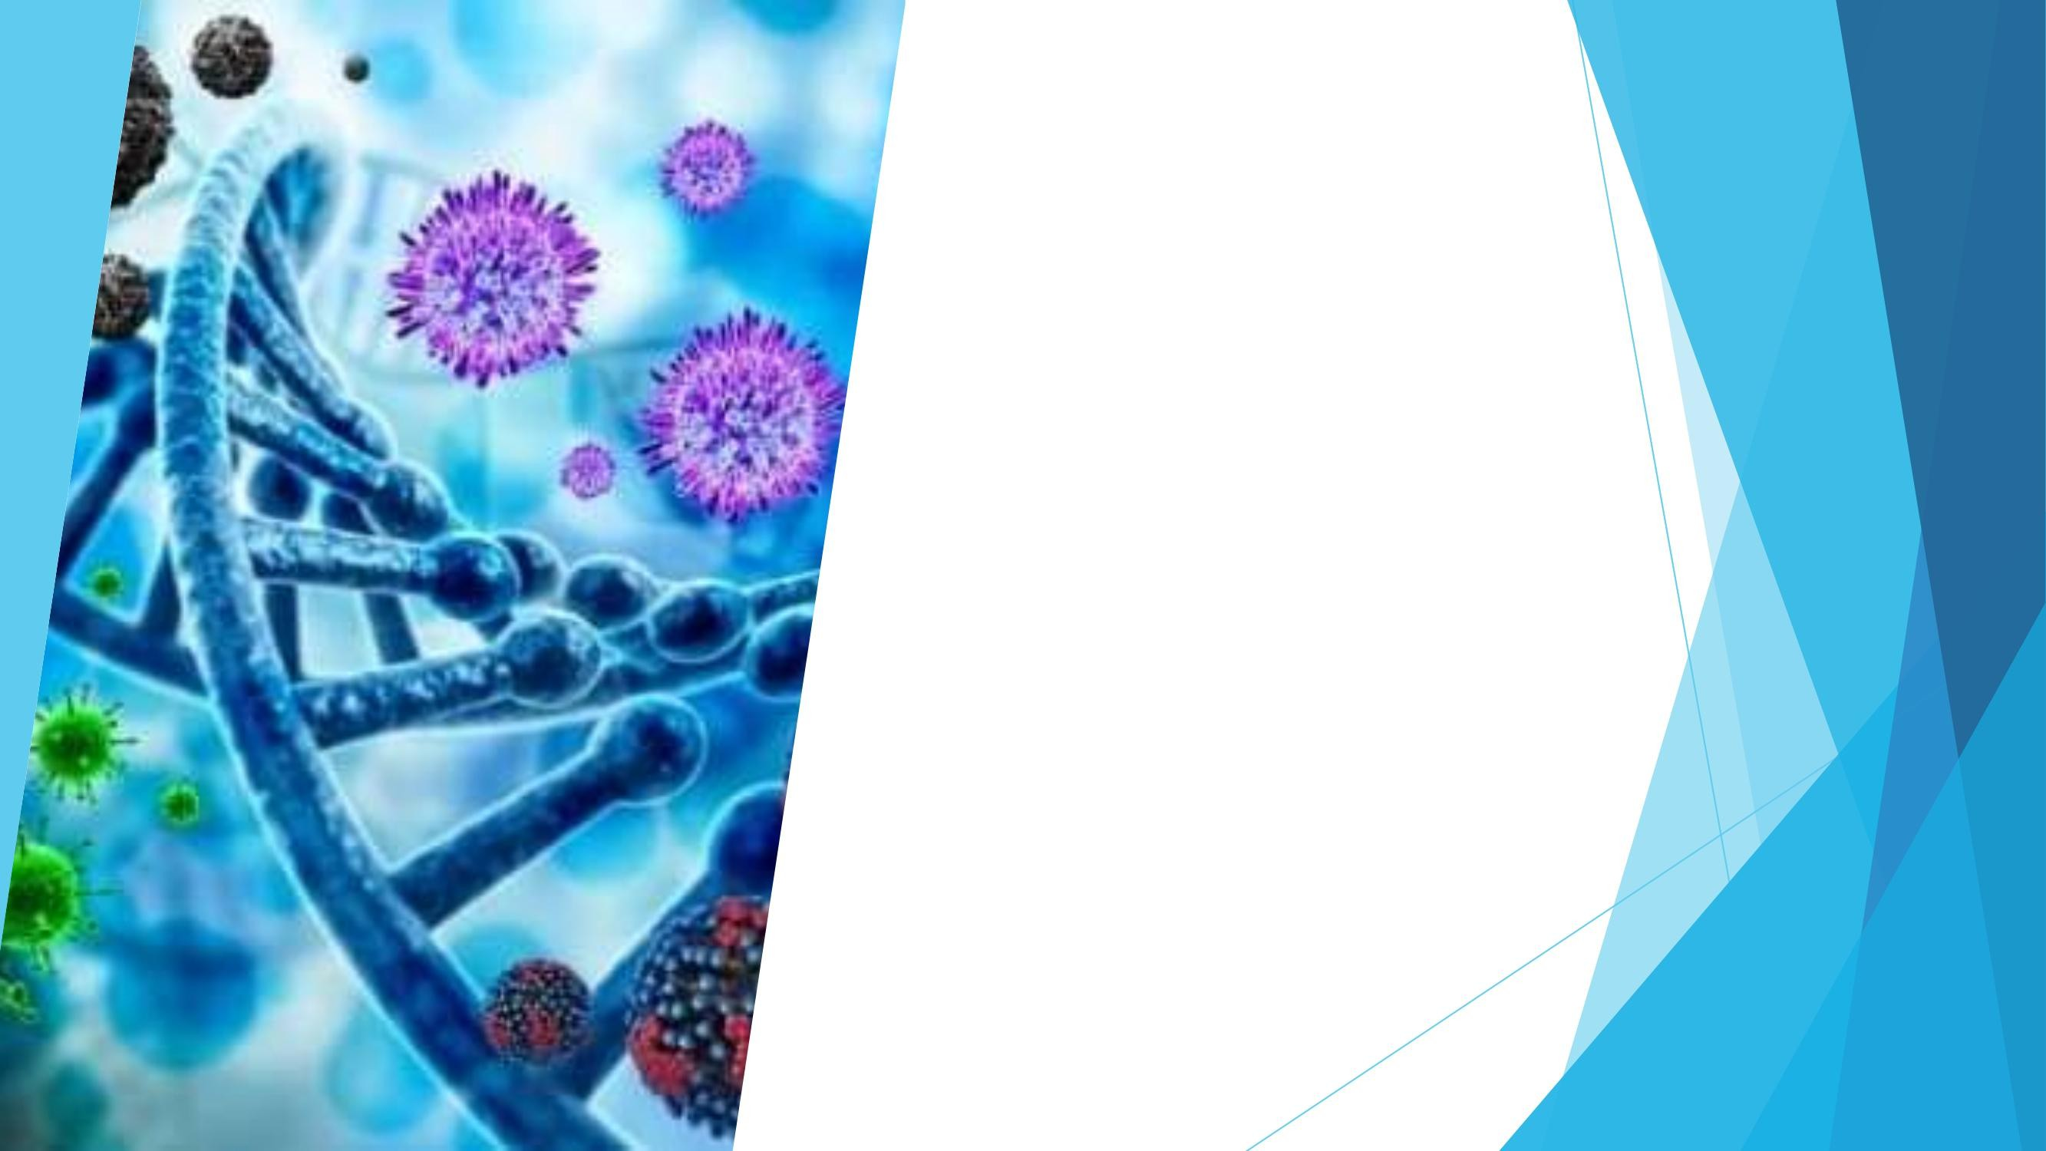
Physiological mutations
are characterized by a change in the physiological functions of the organism. Such mutations affect the genes responsible for heat shock and proteins
synthesized during low temperature stress in plants and animals,
antibiotic resistance in bacteria, etc.

Slide 13
Biochemical mutations
are characterized by a change in
the synthesis of some chemicals
substances in the cell. This type mutations lead to a change in the metabolism of substances in the cell. An example of such
mutation can cause insulin-dependent diabetes. The cells of the pancreas
gland of those suffering from this they do not produce disease sufficient quantity of
the protein insulin.

Slide 14
Mutations should not be considered as harmful or beneficial, because the effect they have on the organism depends on the environment. Thus, under some environmental conditions, a certain mutation can be beneficial, and under others it can be harmful. According to the changes that mutations cause on the hereditary structures, mutations are: •Genomic mutations
•Chromosomal aberrations •Gene mutations •Cytoplasmic mutations

Slide 15
Thank you for your attention!!!

