Slide 1
Application of enzymes in human activity
Author: Rumen Dyulgerov

Slide 2
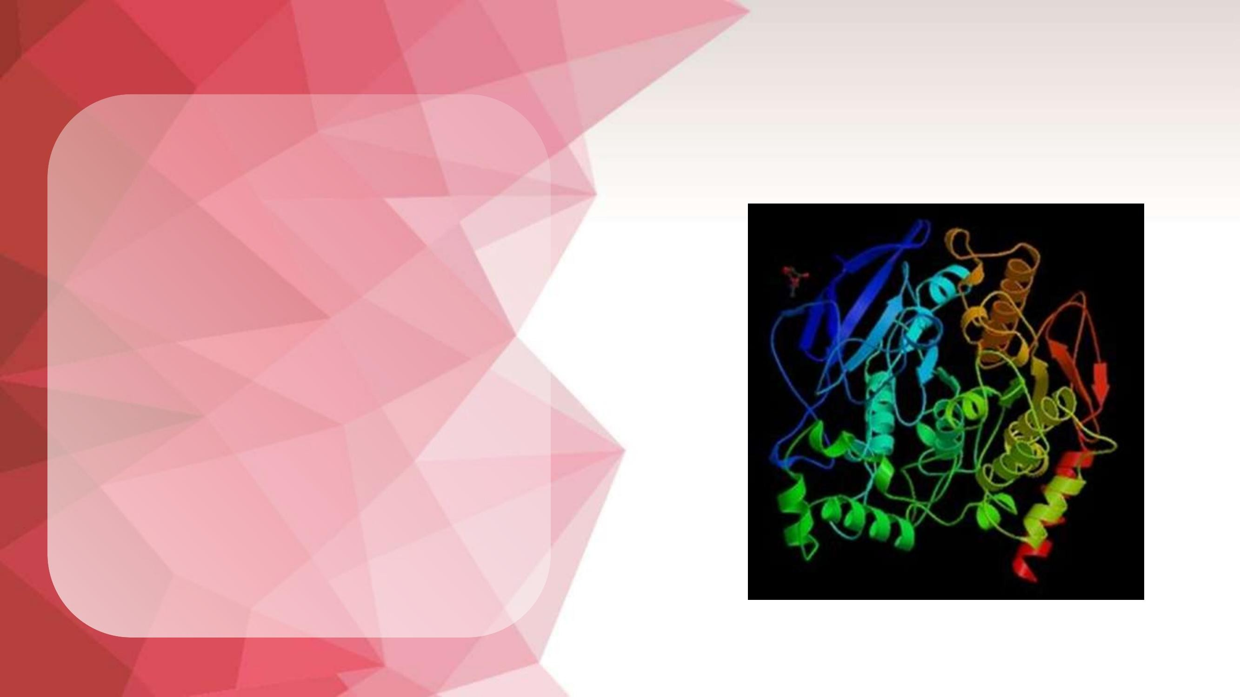
Enzymes
Enzymes help speed up
chemical reactions in the human body
body.
They bind to molecules and
change in a specific way. Enzymes are essential
importance for breathing,
digestion of food, muscle and nerve function.
Enzymes are made up of
proteins that are grouped into complex shapes found throughout the body. The chemical reactions,
which are life-sustaining – our
metabolism relies on work,
which is carried out by enzymes

Slide 3
Structure
With the exception of a small group of catalytically active RNA molecules, all known enzymes are proteins. As typical proteins, enzymes are made up
of the linear
arrangement of amino acids in polypeptides chains. The length of these chains varies from hundreds to tens of thousands of amino acids. The function of the enzyme depends not only on
the correct arrangement of the individual
amino acids, but above all from
the three-dimensional folding of the polypeptide chain
circuit in space. It is often observed
and association of several individual proteins into a self-contained unit that functions as a single whole. In this case, enzymes are
called oligomers – composed of separate independent proteins.

Slide 4
Enzyme Specificity
Enzymes are usually specific both for the reaction they catalyze and for the substances that enter into it. Specificity
is determined by the correspondence in the shape of the substrate and the catalytic site of the enzyme, by the attraction and repulsion of their surface electric charges, and by the coincidence of corresponding hydrophobic and hydrophilic regions. There are several types of specificity of enzymatic action, inherent to varying degrees for individual enzymes: Chemospecificity (group specificity) - specificity for certain chemical groups present in the substrate.,Regiospecificity (reaction specificity) - specificity for the type of bond that is broken or created during the reaction. Stereospecificity - specificity for the configuration of the molecule with a preference
for one or another enantiomer

Slide 5
Inhibitors
For all processes in the body to run properly, enzymes sometimes need to slow down. For example, if an enzyme is producing too much, it needs to
there is a way to reduce and stop production. Enzyme activity can be inhibited
in many ways. Competitive inhibitors – the molecule blocks the active site so that the substrate competes with the inhibitor,
to attach to the enzyme.
Non-competitive inhibitors – the molecule se
binds to an enzyme somewhere other than the active site and reduces effectiveness
him.
Irreversible inhibitors – an irreversible inhibitor binds to an enzyme and blocks it
deactivate permanently

Slide 6
Perfect conditions
Enzymes can only “work” under certain conditions. Most enzymes in the human body work best at 37°C body temperature.
At lower temperatures, they still work, but much more slowly. Similarly, enzymes can only function within a
certain pH range. Their preference depends on where they are in the body. For example, enzymes in the intestines work best at a pH of 7.5, while enzymes in the stomach work best at a pH of 2. If the temperature is too high or the
environment is too acidic or alkaline, the enzyme changes – it becomes
denatures.

Slide 7
Enzymes and health
Enzymes are particularly important for
living organisms and the incorrect work even one in about 2000 enzymes existing in the body
can lead to disease. An example of a disease caused by
a malfunctioning enzyme is phenylketonuria. In this, the enzyme
phenylalanine hydroxylase, which processes the essential amino acid
phenylalanine into tyrosine, simply does not work. This leads to increased phenylalanine levels with consequences
from brain damage and retardation
of mental activity

Slide 8
Digestive and metabolic
enzymes
Animal nutrition is based on digestive enzymes such as ÿ-amylase, trypsin. The main role is in the digestion of
food and providing nutrients to the entire body. Another class of enzymes are called metabolic enzymes. Their
role is to catalyze chemical reactions throughout the body, including the uptake of oxygen. Most of our cells (except for erythrocytes) would suffer from a lack of oxygen even in the presence of excess oxygen without the action of the enzyme cytochrome oxidase. Enzymes also play a role in muscle contraction and relaxation. The fact is that without
Without these two classes of enzymes, life cannot exist.

Slide 9
Specific Enzymes
There are thousands of enzymes in the human body, but let's
Let's give just a few examples:
Lipase - a group of enzymes that help break down excrete fats in the intestines.
Amylase - helps change starches into sugars. Amylase is found in saliva.
Trypsin - found in the small intestine, breaks down proteins into amino acids. Lactase - also found in the small intestine, breaks down lactose, the sugar in milk, in
glucose and galactose.
DNA polymerase - synthesizes DNA from deoxyribonucleotides.

Slide 10
Thank you for your attention!!!

