Slide 1
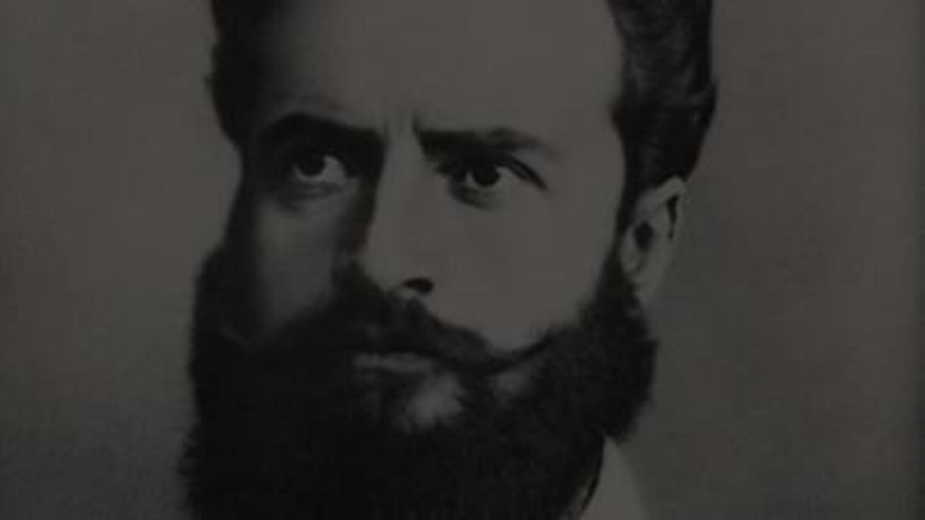
"Botev lives in our hearts"
Prepared by: Alexander Edrev – student 9b

Slide 2
BIOGRAPHY
Hristo Botev Petkov, known as Hristo Botev,
is Bulgarian revolutionary, poet and publicist. He is considered a national hero and one of the most
prominent Bulgarians of the Bulgarian Renaissance period.

Slide 3
He was born on January 6, 1848 (December 25, 1847 old style) in Kalofer, into the family of teacher Botyo Petkov (1815 –
1869) and Ivanka Boteva (1823 – 1911). There are other hypotheses
about his birthplace, which are now rejected by researchers – that he was “from Karlovo”, as it is written in one
official letter from Nayden Gerov, or that he was born in the village of Osen, as Botev himself mentions in his article "Examples from the Turkish
justice".

Slide 4
Popular works by Botev

Slide 5
To My First Love Farewell in 1868
Hadji Dimitar
The hanging of Vasil Levski
Your mother

Slide 6
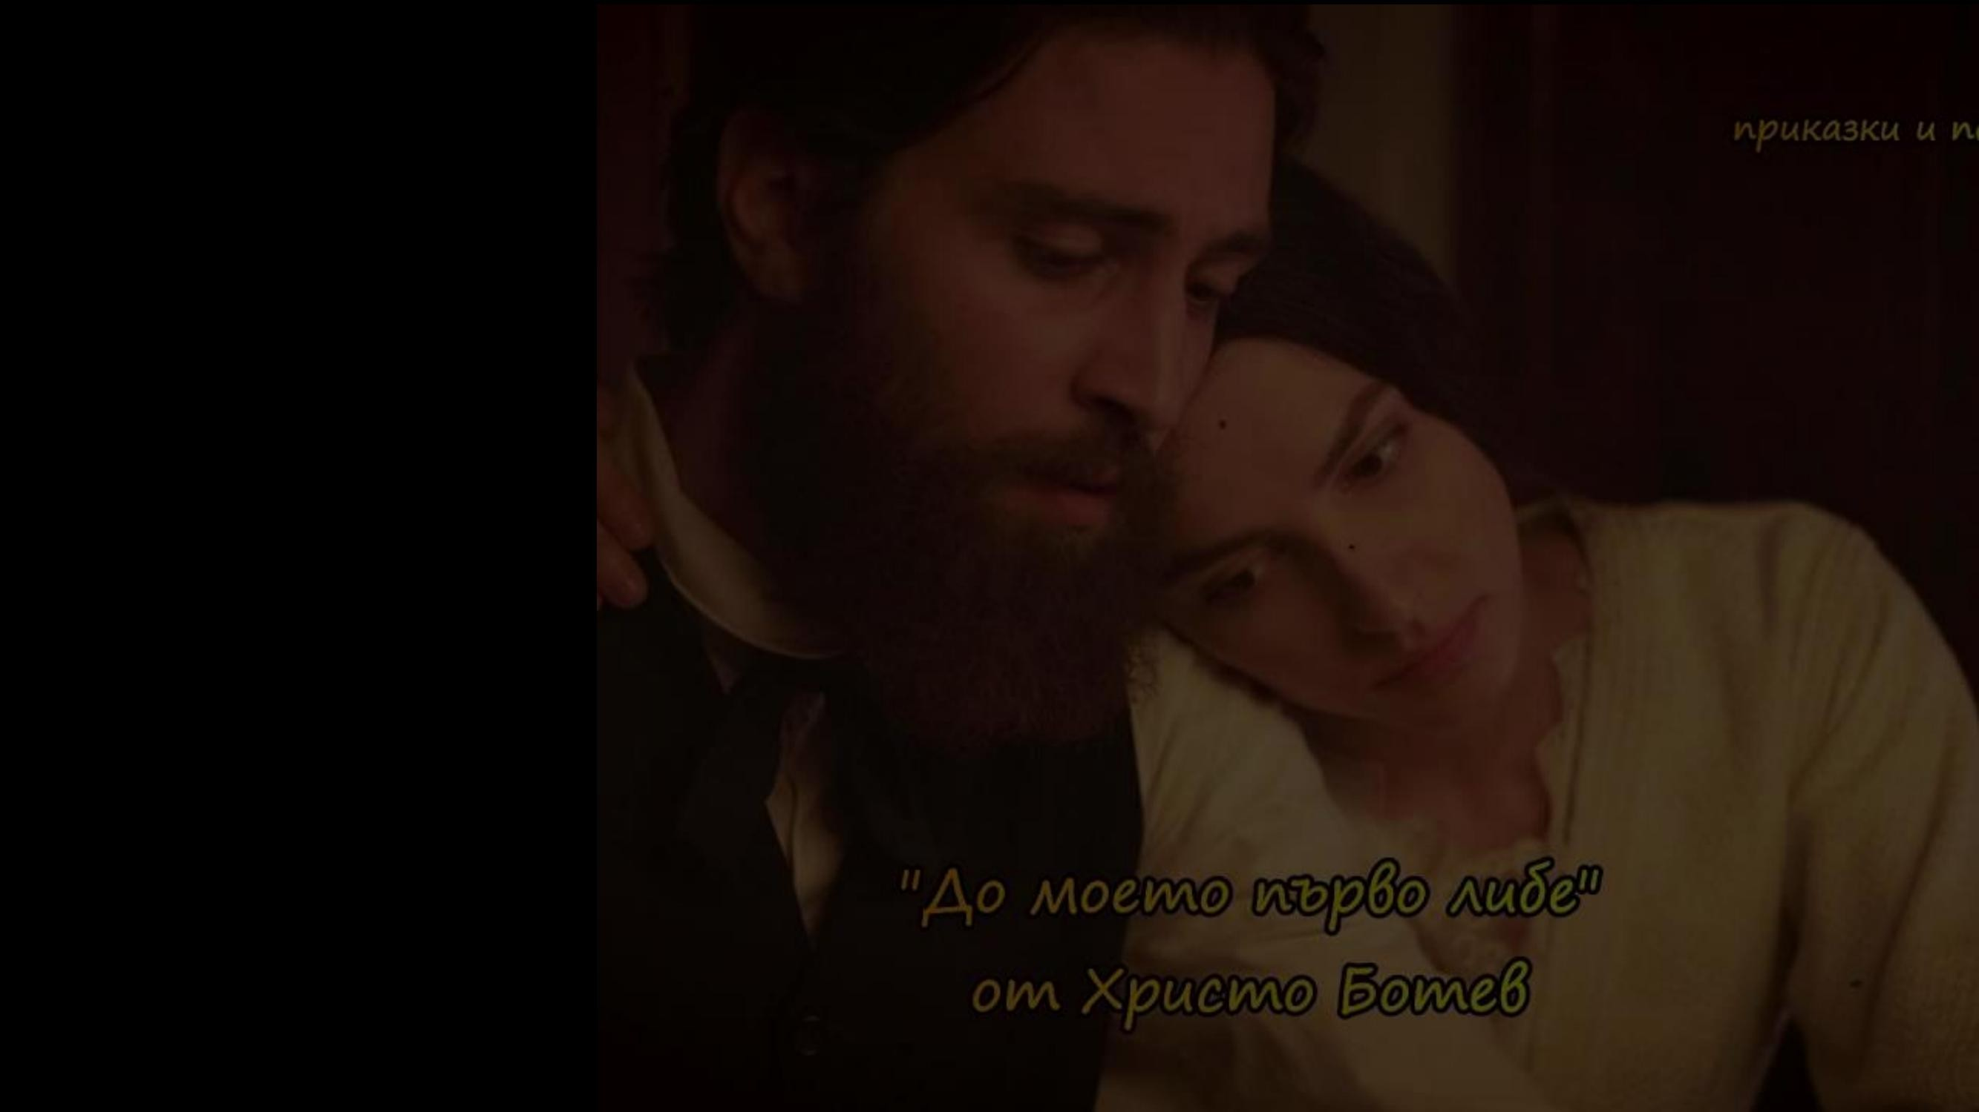
Until my first love
Farewell in 1868
Hadji Dimitar
The hanging of Vasil Levski
Your mother

Slide 7
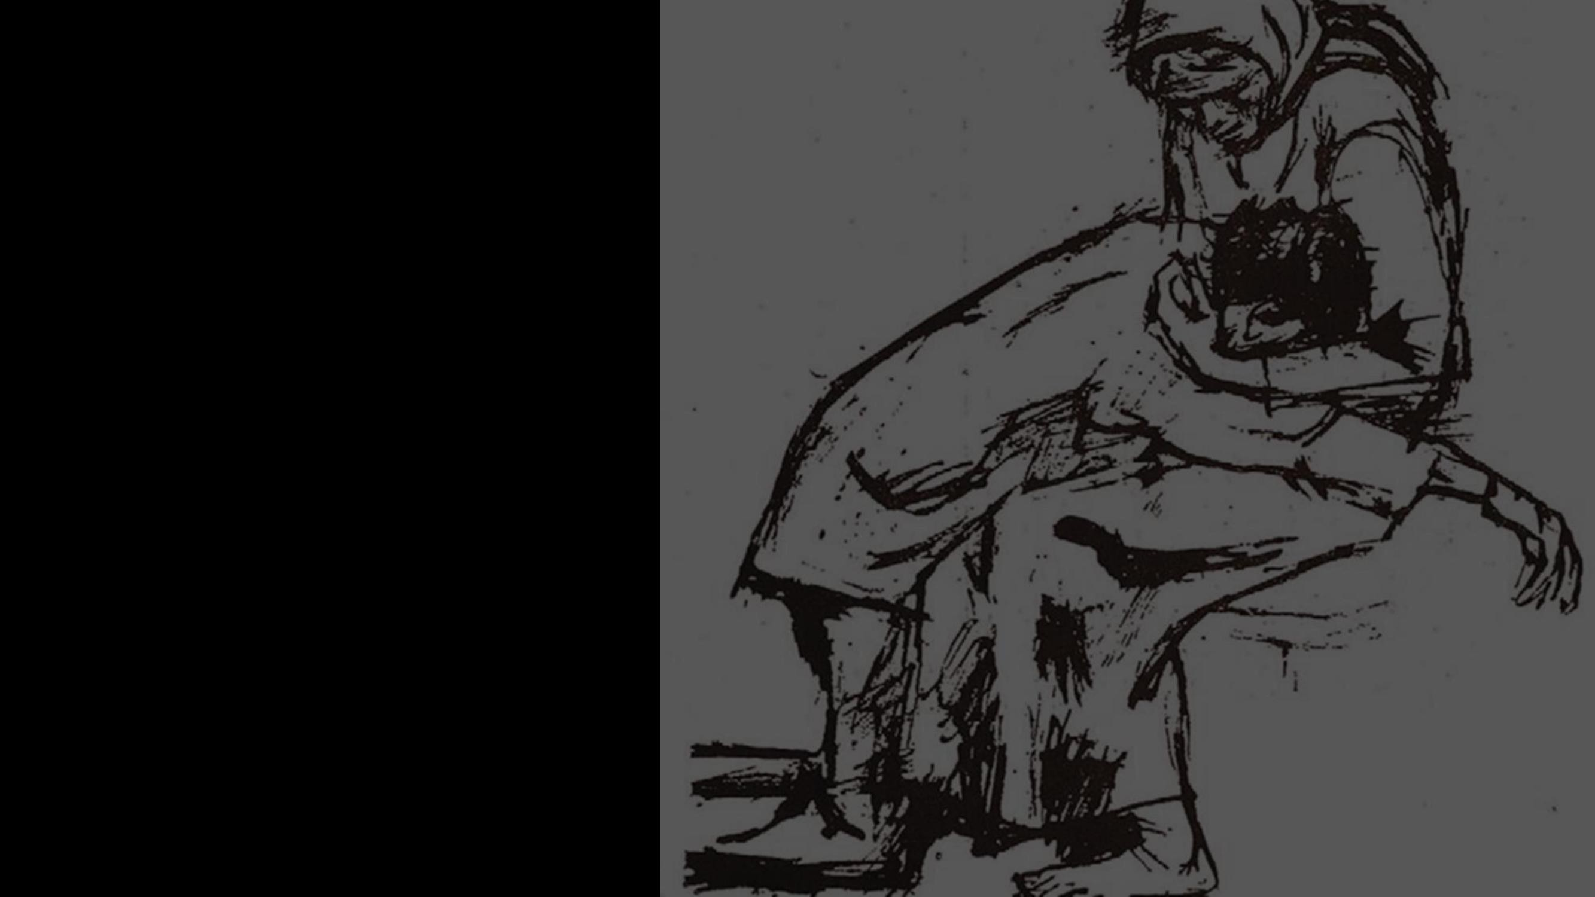
Farewell in 1868.
Hadji Dimitar
The hanging of Vasil Levski
Your mother

Slide 8
Hadji Dimitar
The hanging of Vasil Levski
Your mother

Slide 9
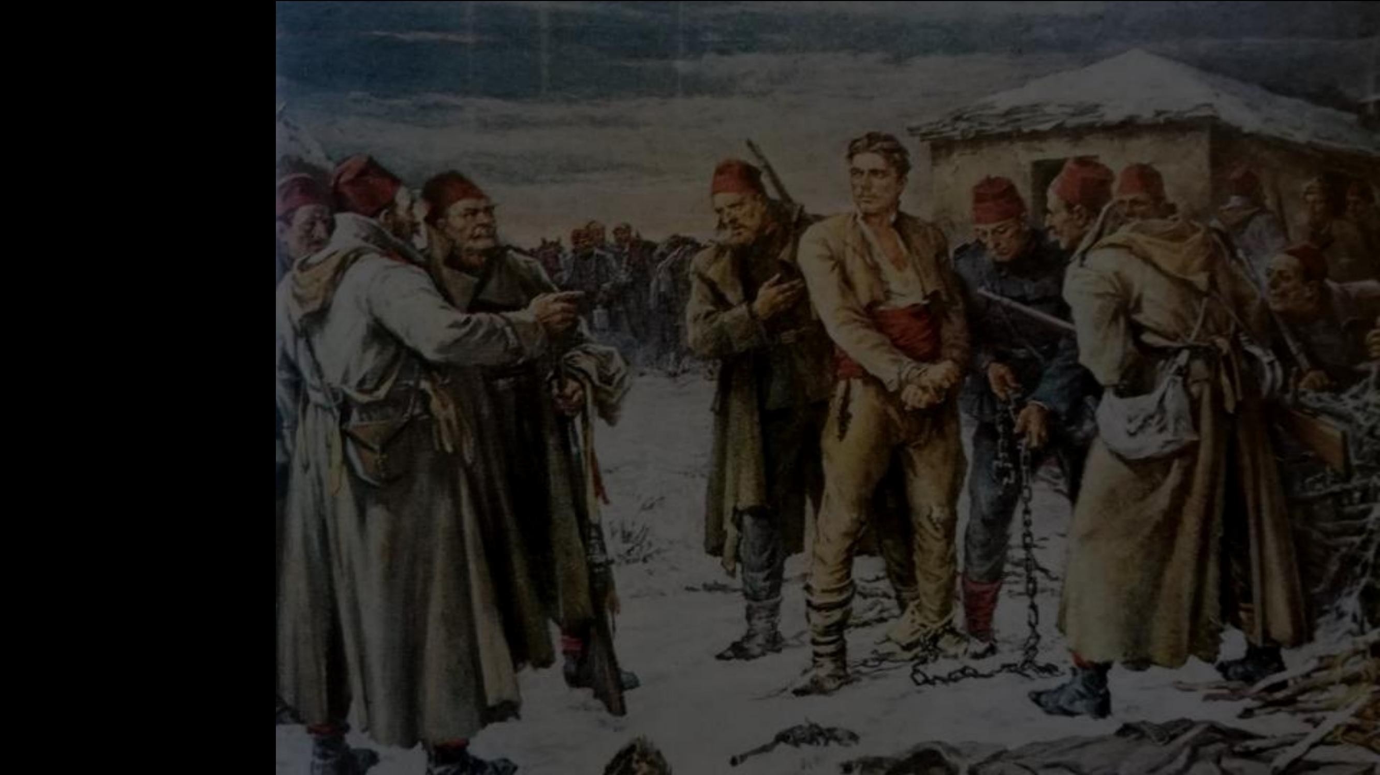
The hanging of Vasil Levski
Your mother

Slide 10
Your mother

Slide 11
Hristo Botev, this is the symbol of our school. It is named after him and of course every year our school celebrates its patron saint's day. Like every school, we have an anthem, created by Antonia Skenderova.
by Google

Slide 12
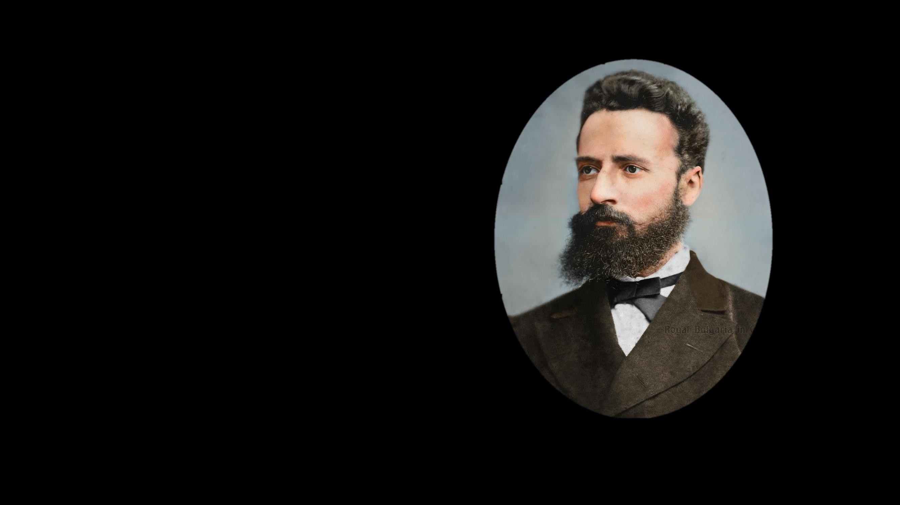
My school, beautiful, beloved,
You give us knowledge, drive, and passion.
You took the proud name of Botev,
You turn our childhood dreams into a temple.
Chorus:
Hello, school, hello!
Live, school, live!
Your heart beats like a Botev, Stay in our souls!
Dear teachers with a noble spirit
centuries-old traditions are preserved even today, They teach us to honor our dear homeland, We carry the Botev faith with honor!

Slide 13
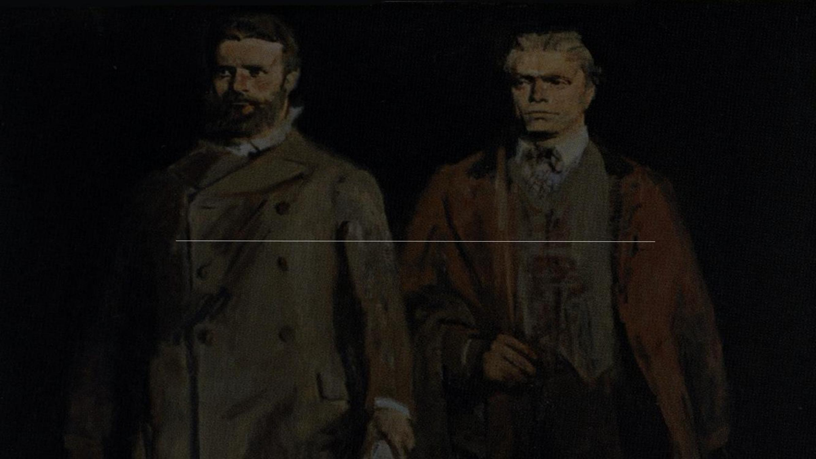
Thank you for your attention!
Machine Translated by Google

