Slide 1
KEEP IT CLEAN, KEEP IT GREEN
VULCAN SECONDARY SCHOOL

Slide 2
THERE ARE 17 SUSTAINABLE DEVELOPMENT GOALS
The 2030 Agenda for Sustainable Development, adopted by all United Nations Member States in 2015, provides a shared blueprint for peace and prosperity for people and the planet, now and into the future. At its heart are the 17 Sustainable Development Goals (SDGs), which are an urgent call for action by all countries - developed and developing - in a global partnership. They recognize that ending poverty and other deprivations must go hand-in-hand with strategies that improve health and education, reduce inequality, and spur economic growth – all while tackling climate change and working to preserve our oceans and forests.
But we are currently focusing on the sixth, seventh and fourteenth.

Slide 3
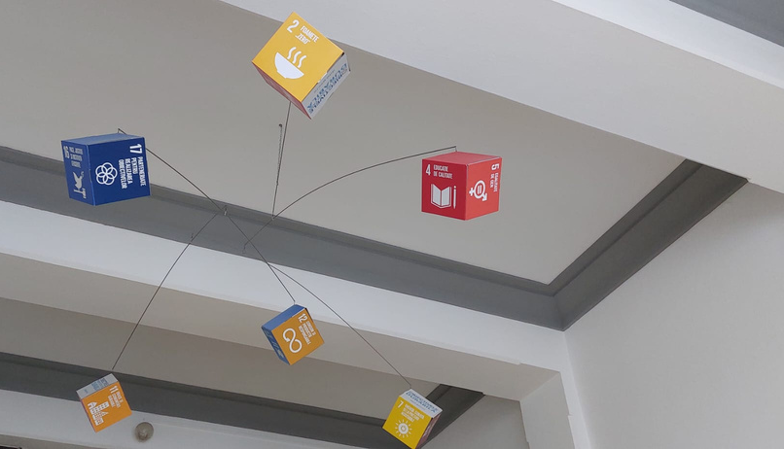
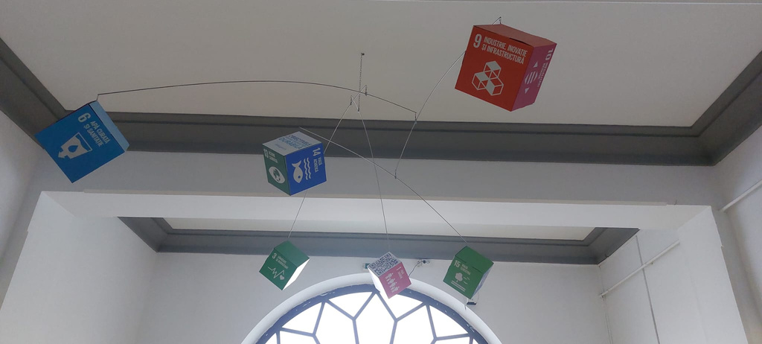
IN OUR SCHOOL, YOU CAN FIND THE 17 SUSTAINABLE DEVELOPMENT GOALS HUNG ON THE CEILING
Presentation Design

Slide 4
6: Water and Sanitation
Sustainable Development Goal 6 (SDG 6) on water and sanitation, adopted by United Nations Member States at the 2015 UN Summit as part of the 2030 Agenda for Sustainable Development, provides the blueprint for ensuring availability and sustainable management of water and sanitation for all.

Slide 5
7: Energy
Energy lies at the heart of both the 2030 Agenda for Sustainable Development and the Paris Agreement on Climate Change. Achieving SDG7 will open a new world of opportunities for millions of people through new economic opportunities and jobs, empowered women, children and youth, better education and health, more sustainable, equitable and inclusive communities, and greater protections from, and resilience to, climate change.

Slide 6
14: Conserve and sustainably use the oceans, seas and marine resources for sustainable development
Oceans contribute to poverty eradication by creating sustainable livelihoods and decent work. Over three billion people depend on marine and coastal resources for their livelihoods. In addition, oceans are crucial for global food security and human health. They are also the primary regulator of the global climate, an important sink for greenhouse gases and they provide us with water and the oxygen we breathe. Finally, oceans host huge reservoirs of biodiversity.

Slide 7
Brasov and it’s green energy
Brașov, a popular mountain city in central Romania, submitted its candidacy for the European Green Capital 2025 title, mayor Allen Coliban announced. The award recognizes and rewards cities' efforts to achieve ambitious goals for environmental improvement and sustainable development.
One of Brașov's strengths is that it has the largest green public transport fleet in Romania, the City Hall said, adding that, with the help of Resilience Facility funds, it will become the country's first 100% electric transport fleet.
Brașov was also the first city in Romania to use 100% green energy for public consumption. In addition, the municipality secured financing to build a photovoltaic park which, together with solar panels to be placed on school units, will ensure Brașov's energy independence to a proportion of 90%.

Slide 8
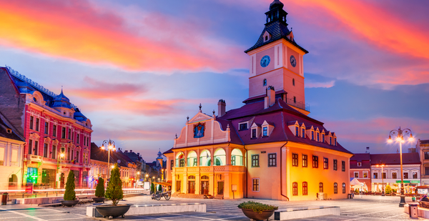
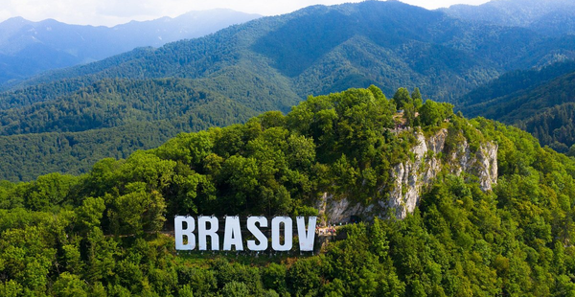
Added to this are the steps taken by Brașov regarding the transition to alternative transport, being the first large city to have a Velo Masterplan and several ongoing projects: compliant bicycle lanes so that every resident of Brasov has a lane less than 250 meters away by 2026; building park&rides at city entrances; dedicated lanes for public transport.

