Slide 1
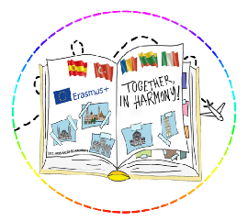
TOGETHER, IN HARMONY!
PROJECT FUNDED BY THE EUROPEAN COMISSION THROUGH THE ERASMUS+ PROGRAM, SCHOOL EDUCATION, KEY ACTION 2 PARTNERSHIPS FOR COOPERATION
Reference number: 2022-1-RO01-KA220- SCH-000085644
Therapy for the soul
(Romanian students' activities)
The European Commission support for the production of this publication does not constitute an endorsement of the contents which reflects the views only of the authors, and the Commission cannot be held responsible for any use which may be made of the information contained therein.

Slide 2
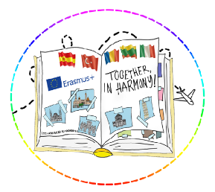
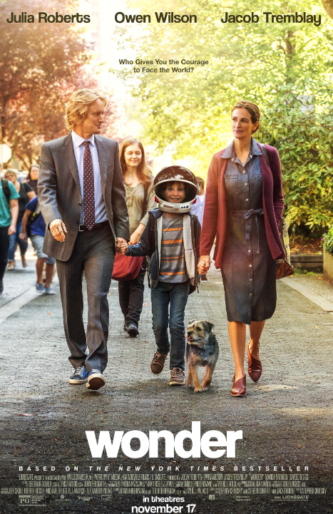
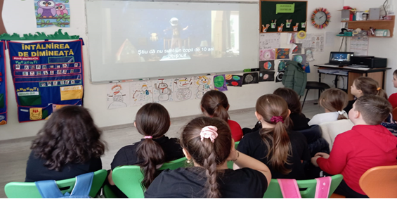
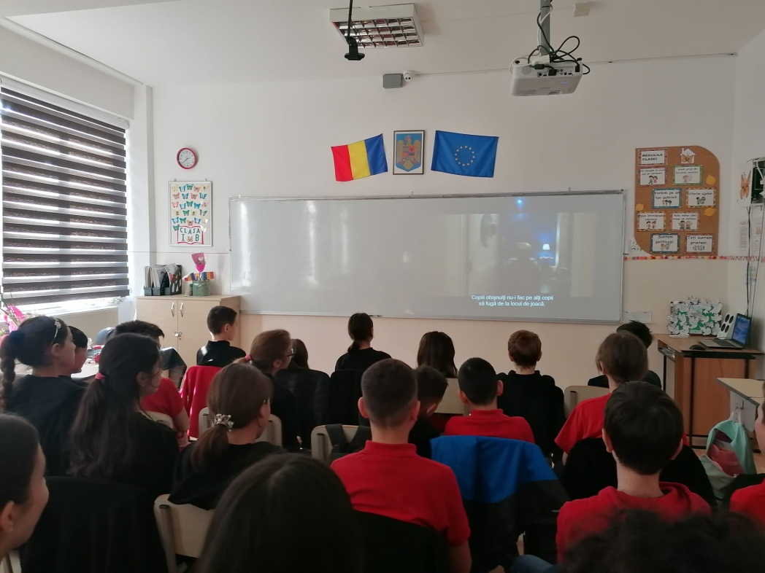
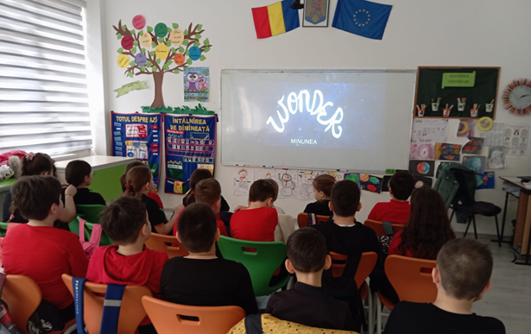
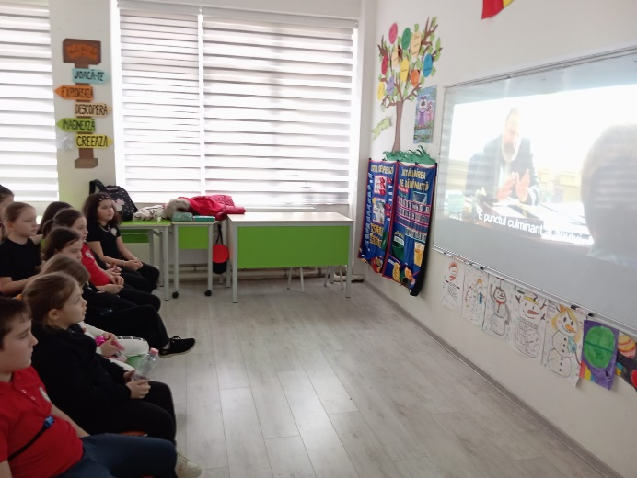
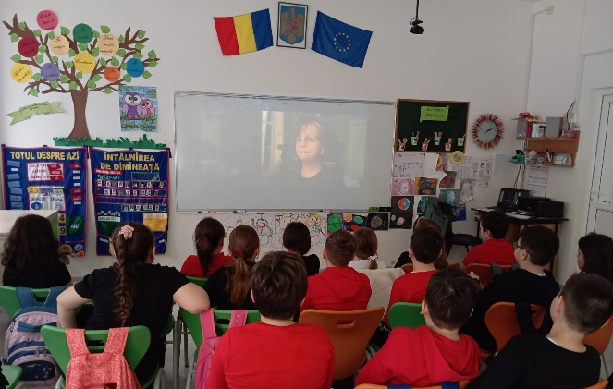
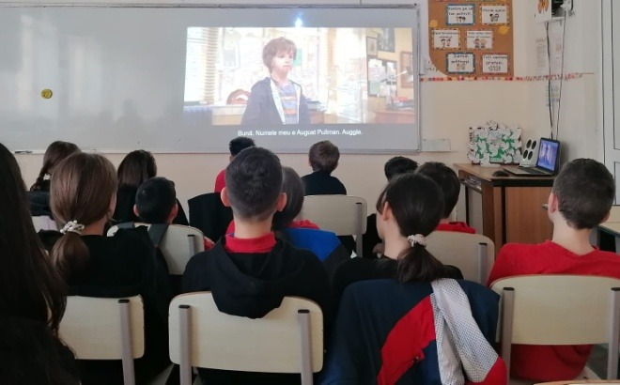
Students of the 2nd grade Step by Step and 5th C watched the film Wonder based on the novel of the same name written by R.J. Palacio, an emotional story about courage and kindness, integration and acceptance, written with sensitivity and humor. The protagonist is August Pullman, a 5th grader who is the victim of intolerance because of his physical appearance.

Slide 3
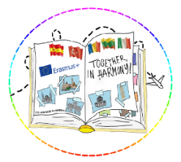
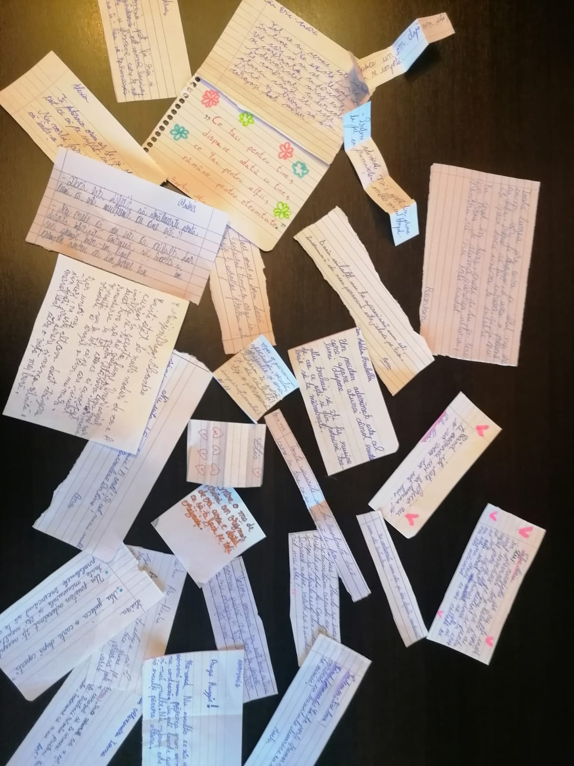
In the second part of the activity, there was a debate about the rights and duties of children. The children expressed their opinions, emotions, and feelings related to what they watched and gave examples of similar situations encountered in everyday life, they concluded.
The activity ended with the writing of motivational messages regarding the fight against stereotypes, prejudices, and discrimination.

Slide 4
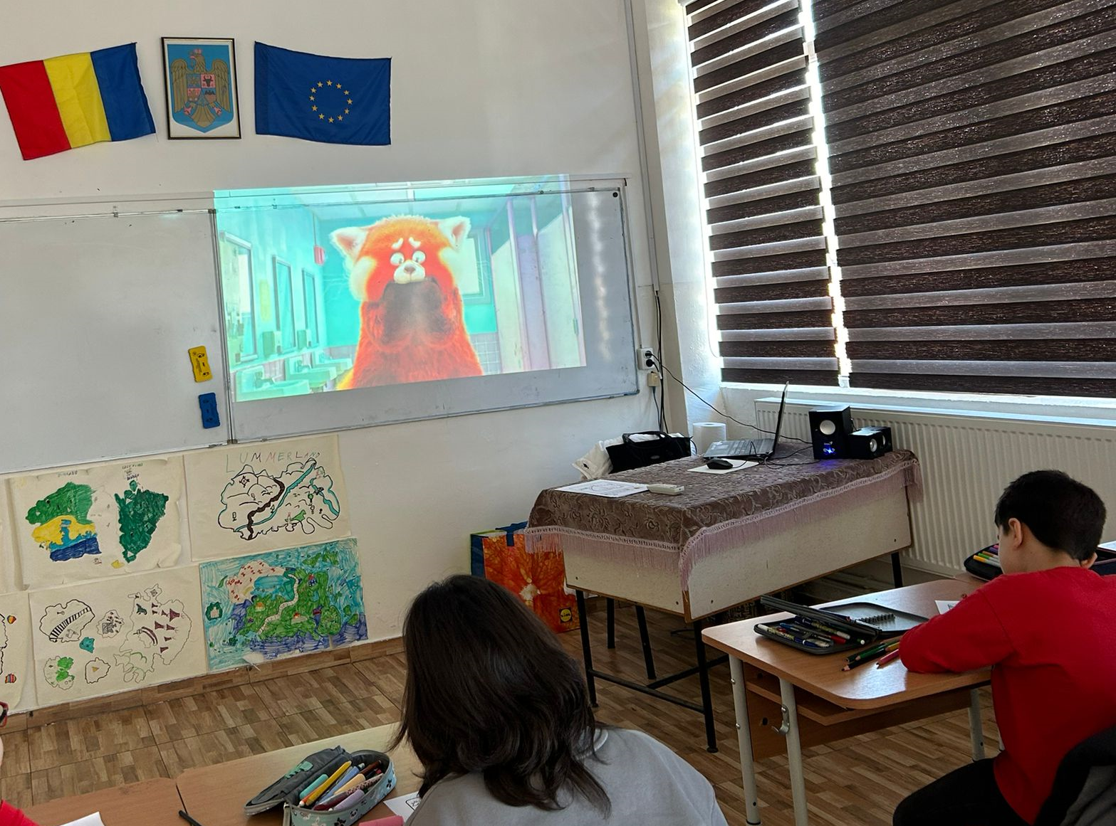
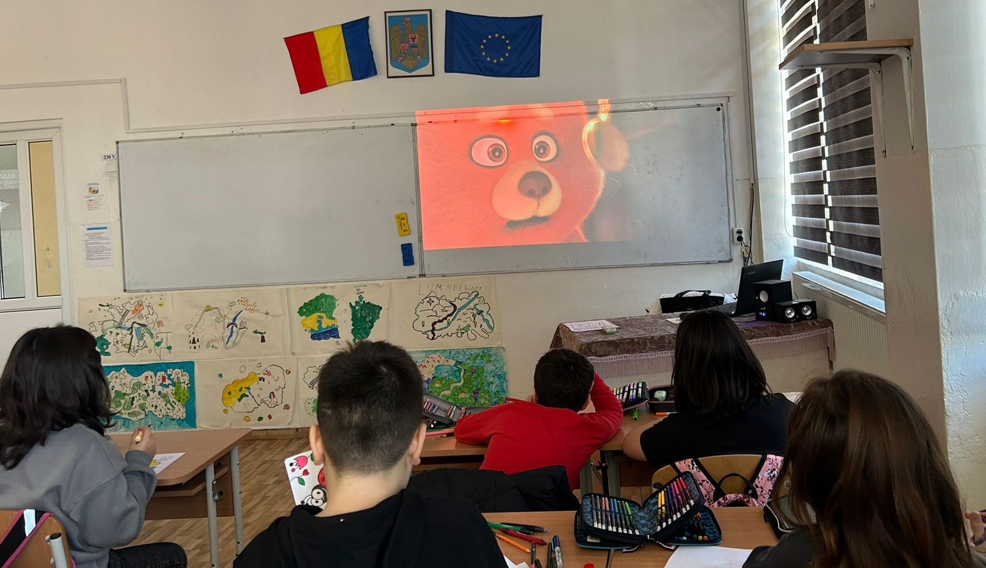
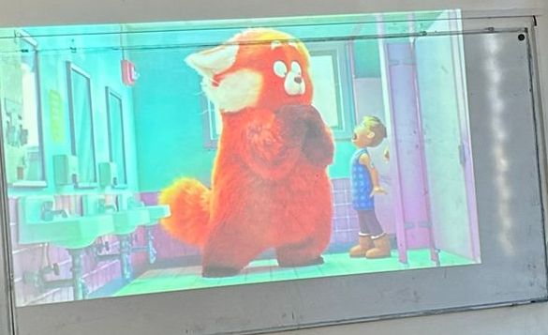
The third-grade C students, before watching the film, used the wheel of names application to choose its title, after which they were invited to make predictions about the subject. After watching, the children identified the characters' emotions and the behaviors they generated and presented examples from their own experiences to compare the solutions found by the characters with their solutions.

Slide 5
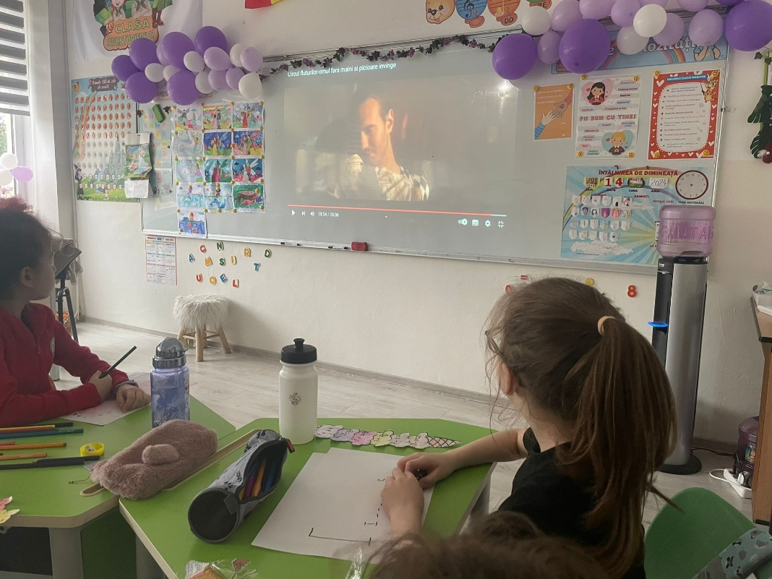
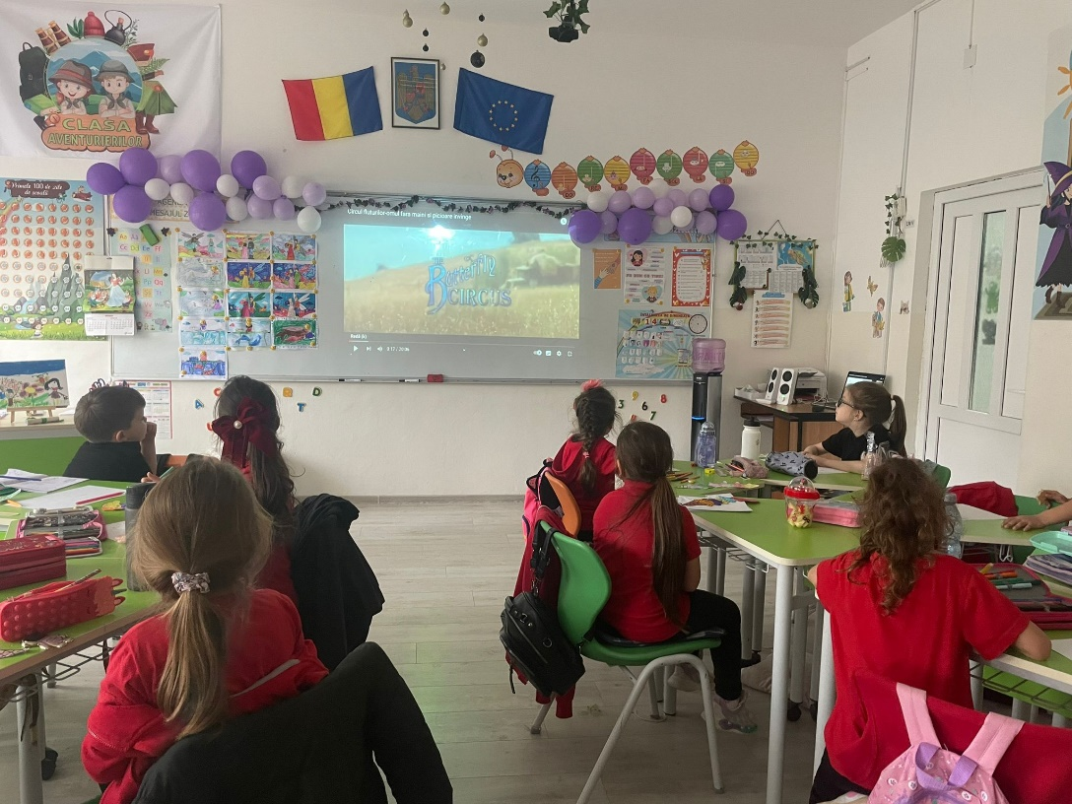
The viewing of the inspirational film The Butterfly Circus by the students of the Step by Step preparatory class allowed them to observe the emotions and actions of the characters and to discuss what they felt during the viewing and the message conveyed by the film. The activity provided the children with an immersive entertainment experience and helped them develop critical thinking skills, empathy, and creativity while allowing them to reflect on their development and the value of their experiences.

Slide 6
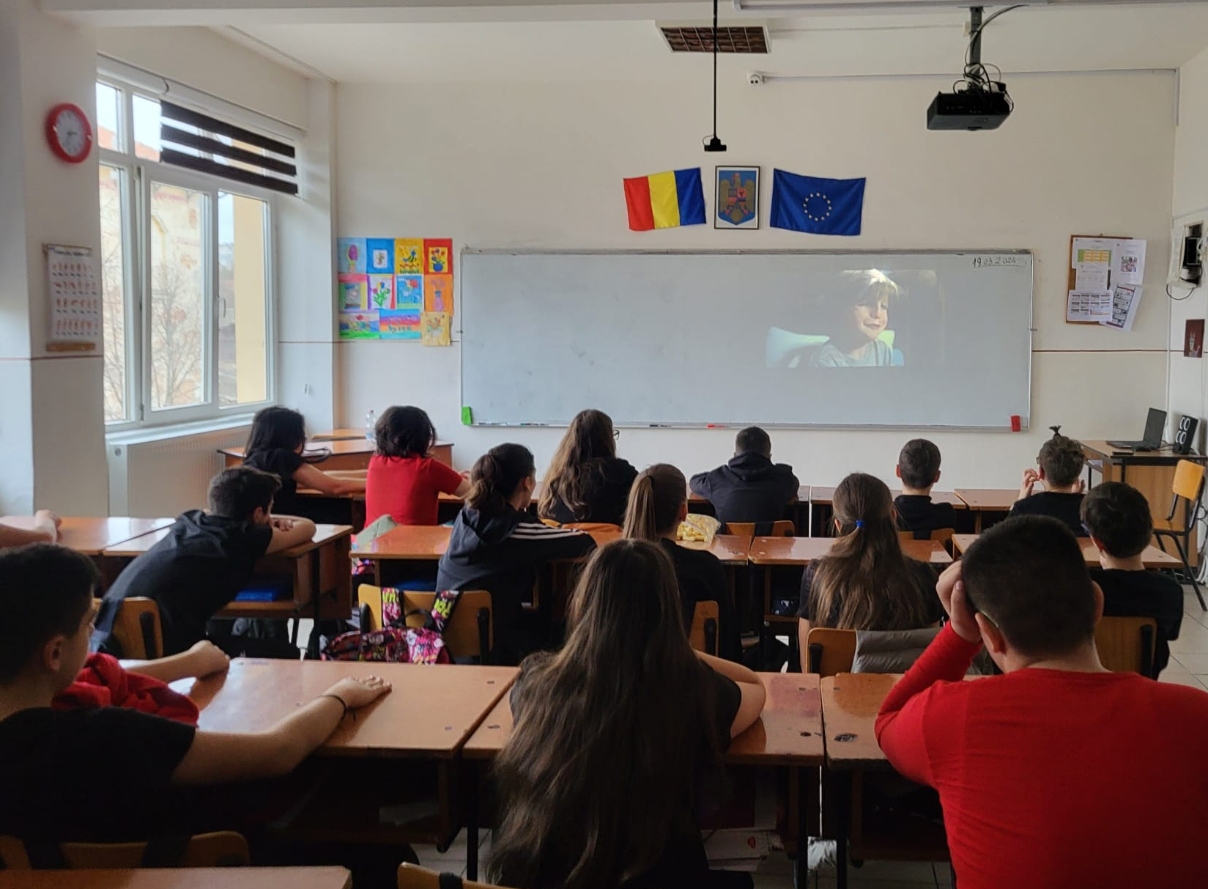
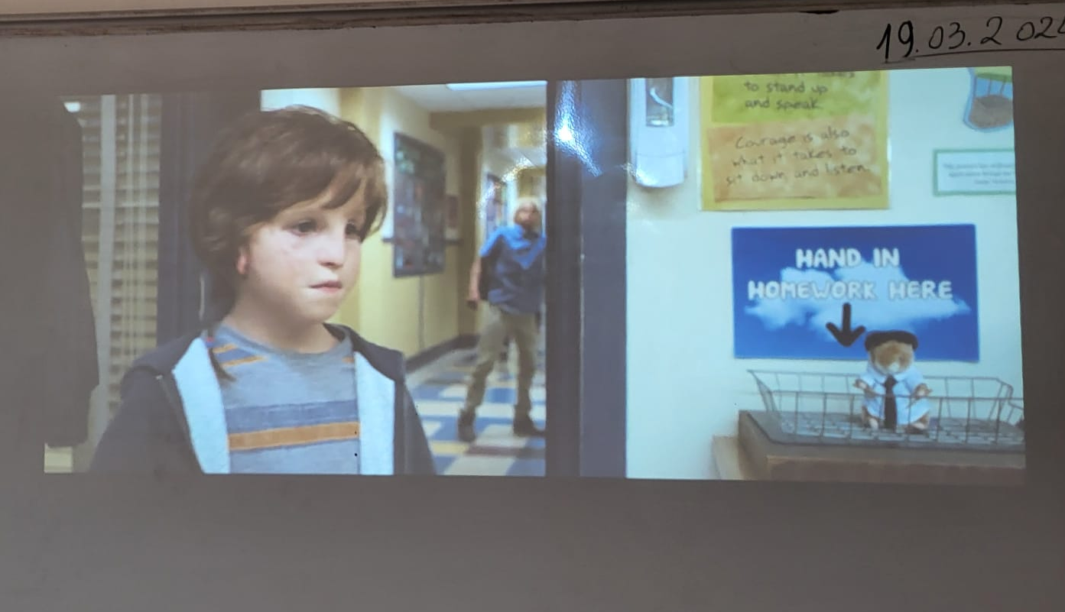
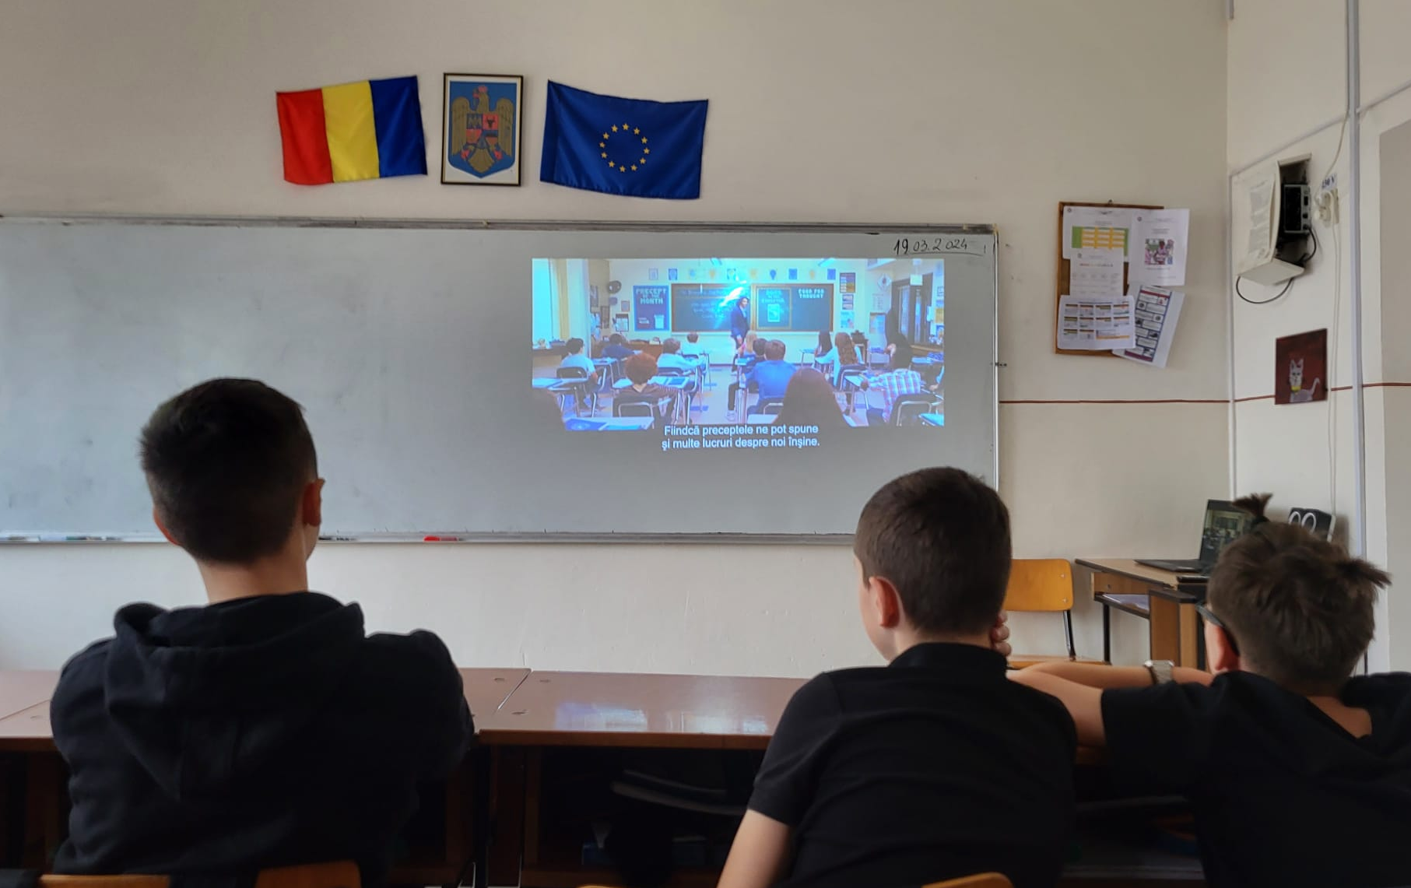
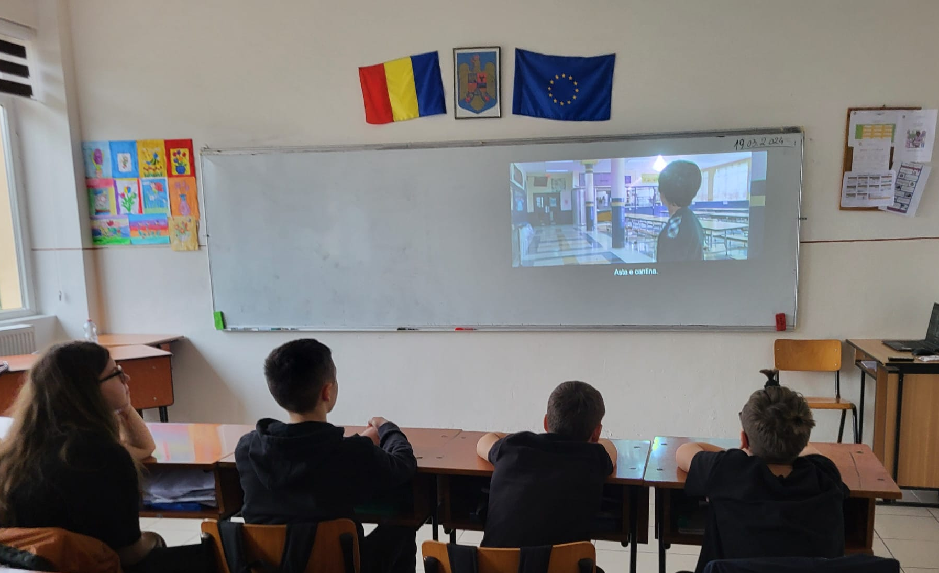
The students of the 6th grade D, after watching the movie Wonder, made the distinction between the positive and negative qualities of the characters and remembered the message conveyed by them.
By writing a journal page or a letter addressed to one of the characters, the students freely expressed their emotions experienced while watching the film.

Slide 7
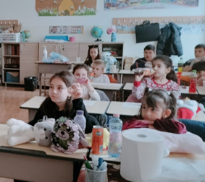
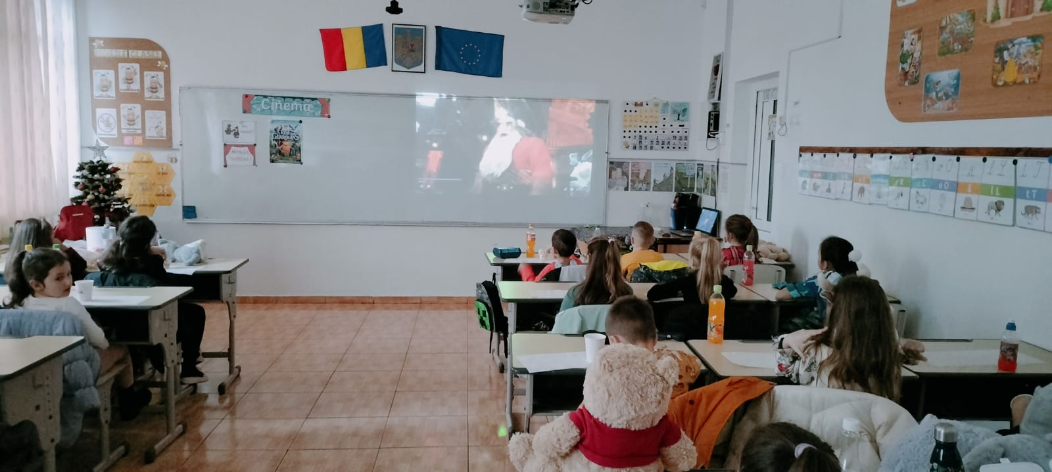
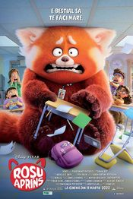
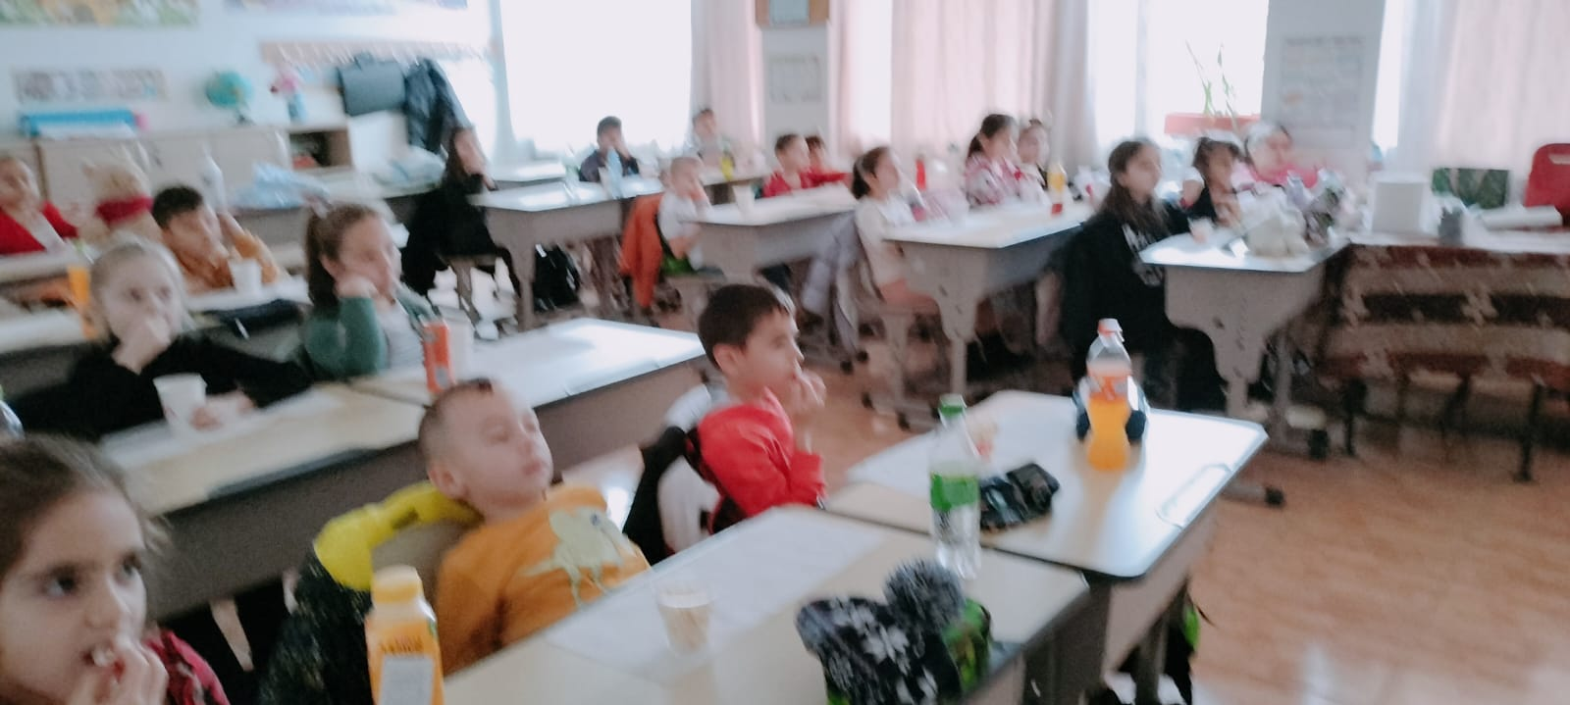
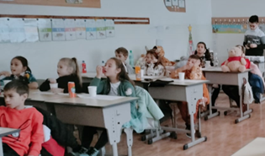
Dragă Auggie,
Second-grade A students watched the movie Turning Red.
After watching, the children participated in a debate in which they identified the characters' emotions and the behaviours they generated.

