Slide 1
SCHOOL JOSÉ JUAN ORTIZ

Slide 2
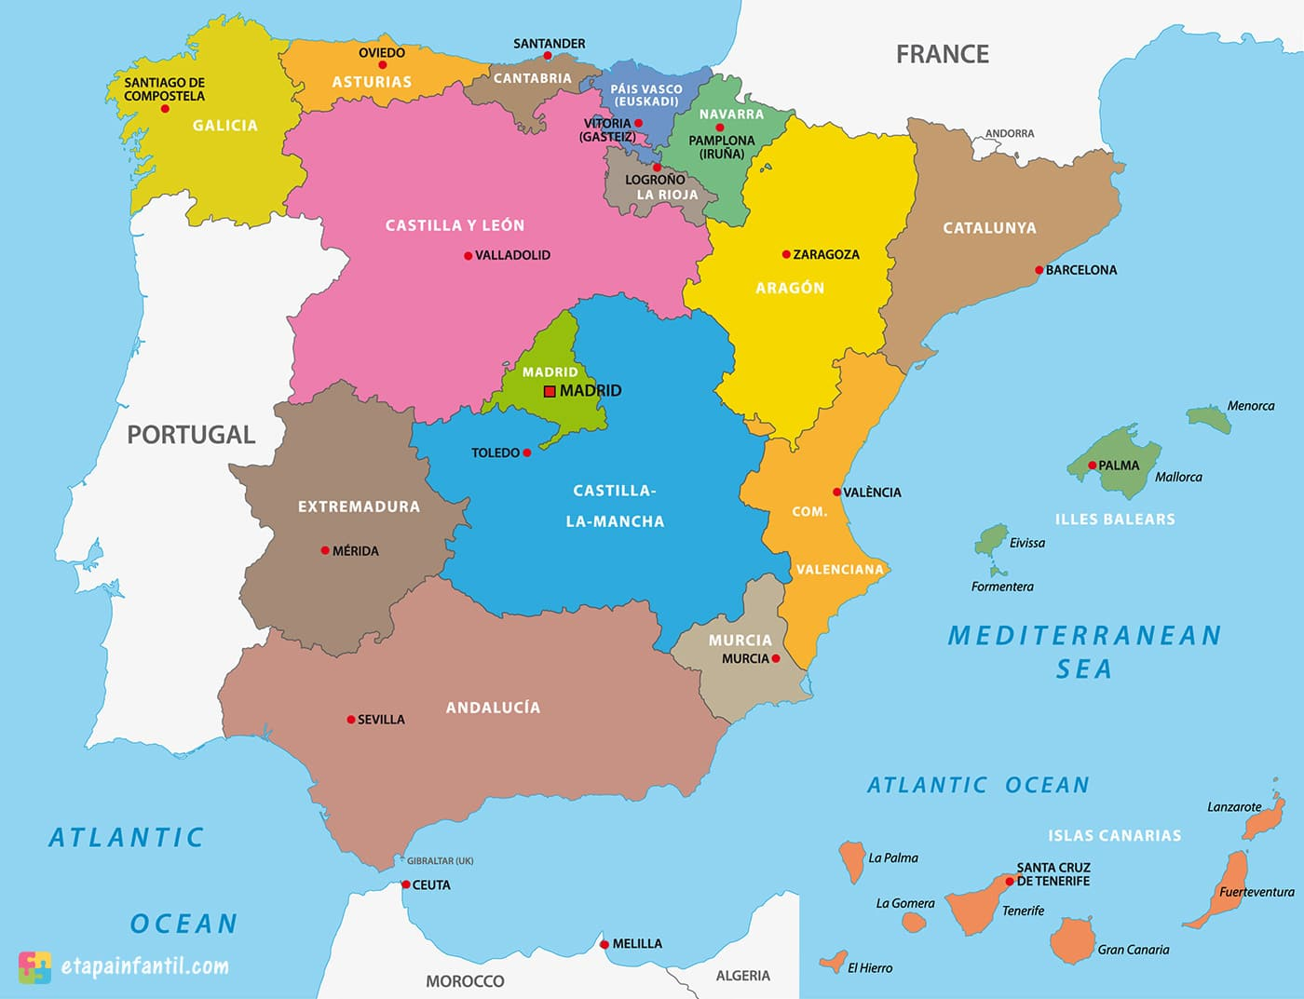
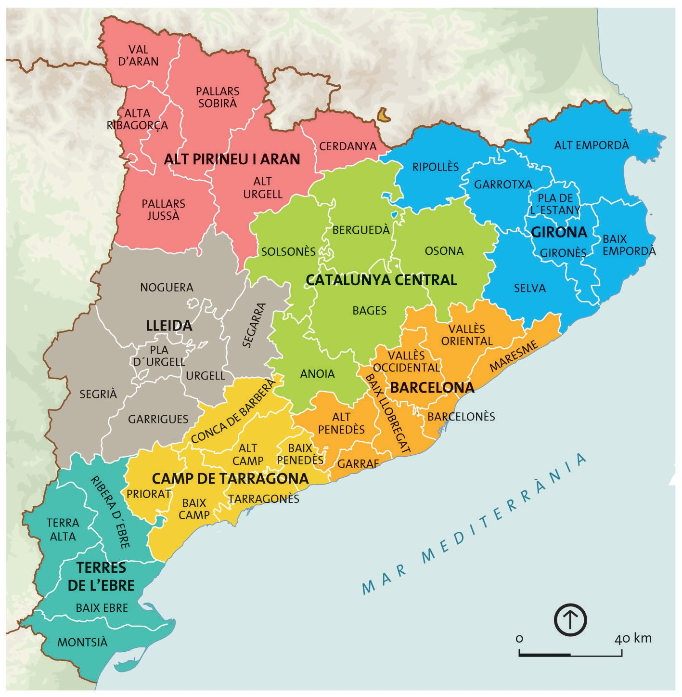
WHERE IS SANT ANDREU DE LA BARCA?
It belongs to the Baix Llobregat region, in the province of Barcelona.
Barcelona
Sant Andreu de la Barca

Slide 3
SANT ANDREU DE LA BARCA
Our city has got 27.558 inhabitants.
The territory distribution is balanced. (residential, industrial and forestry use).

Slide 4
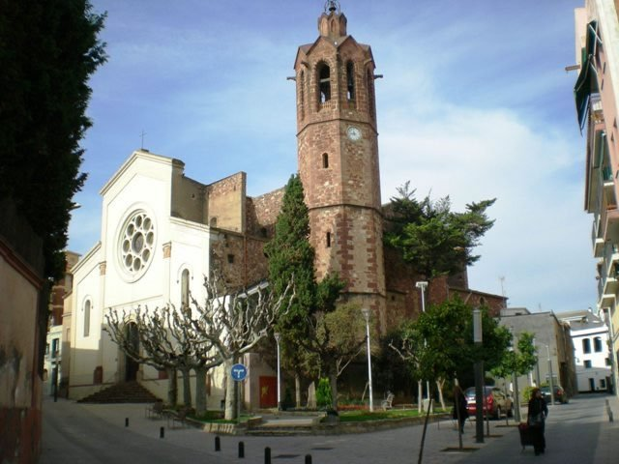
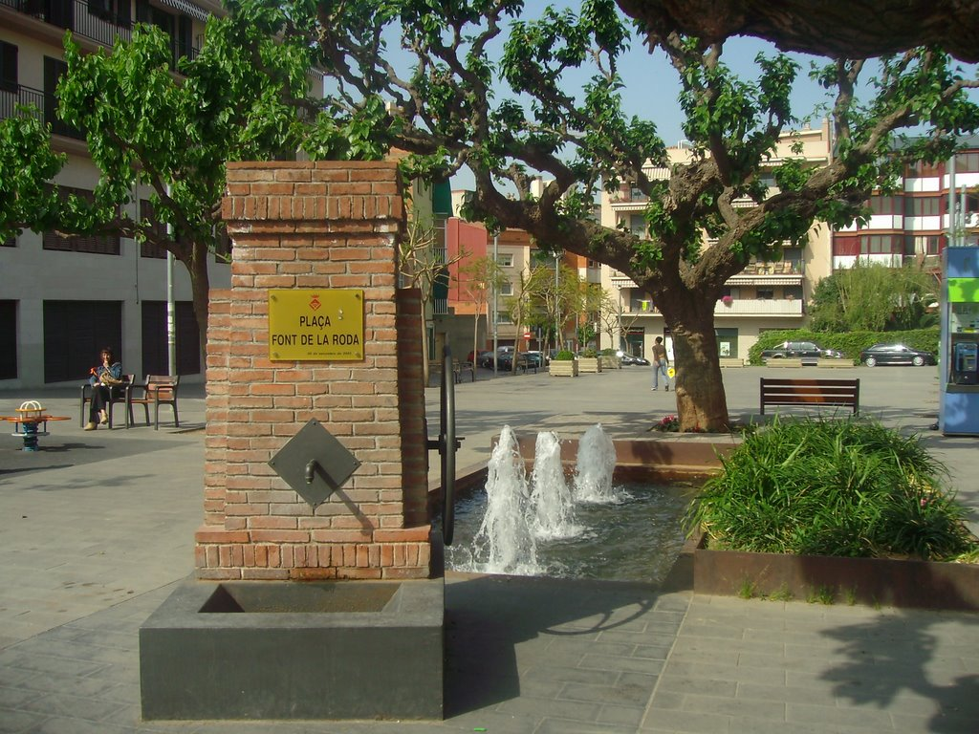
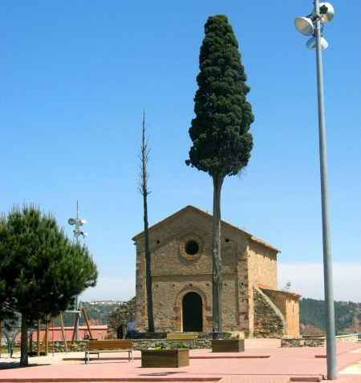
THE MOST EMBLEMATIC PLACES IN OUR CITY
The church
La Font de la roda
Santa Madrona del Palau Chapel

Slide 5
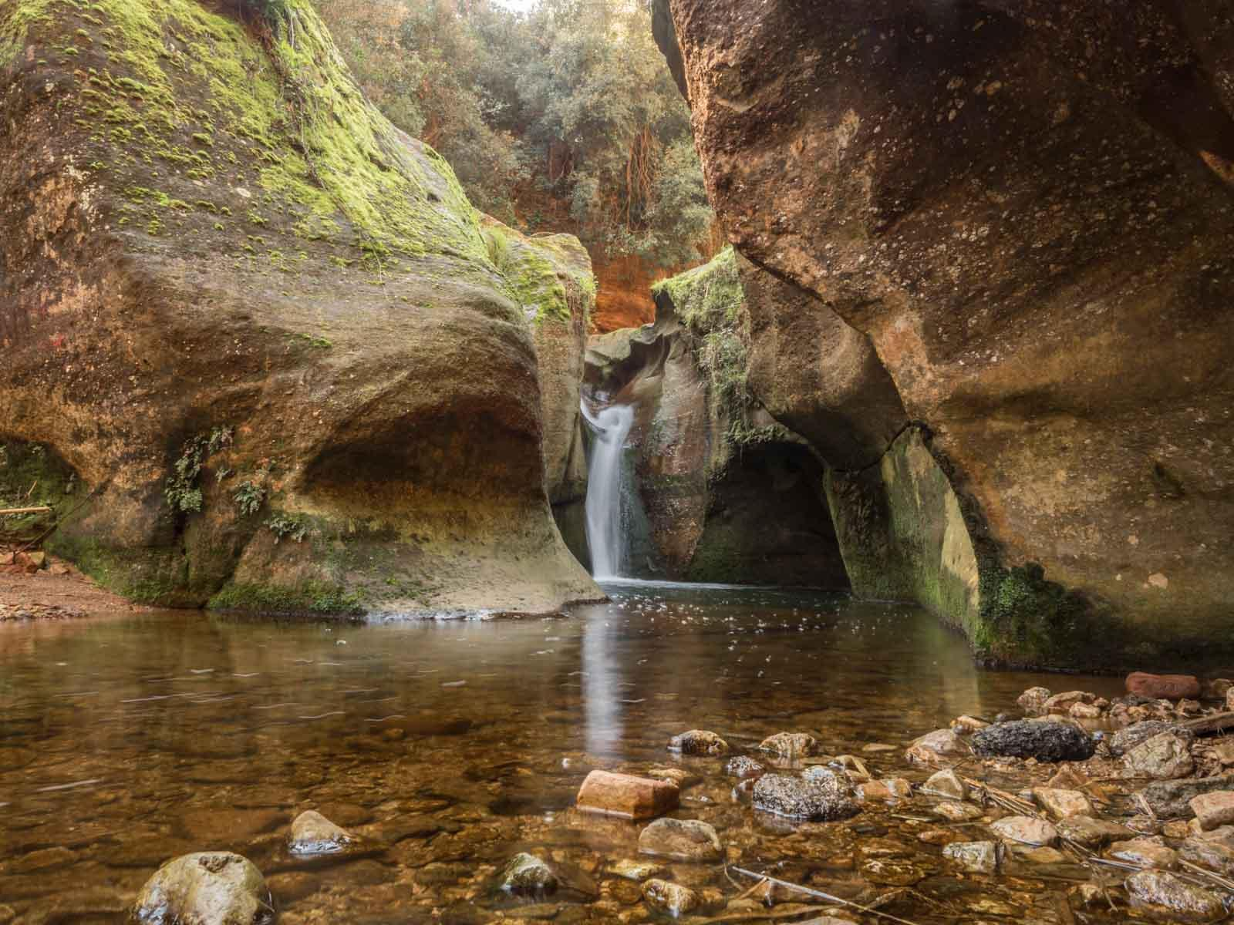
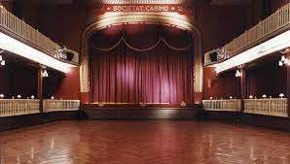
THE MOST EMBLEMATIC PLACES IN OUR CITY
El Casino
El Gorg de la Mola

Slide 6
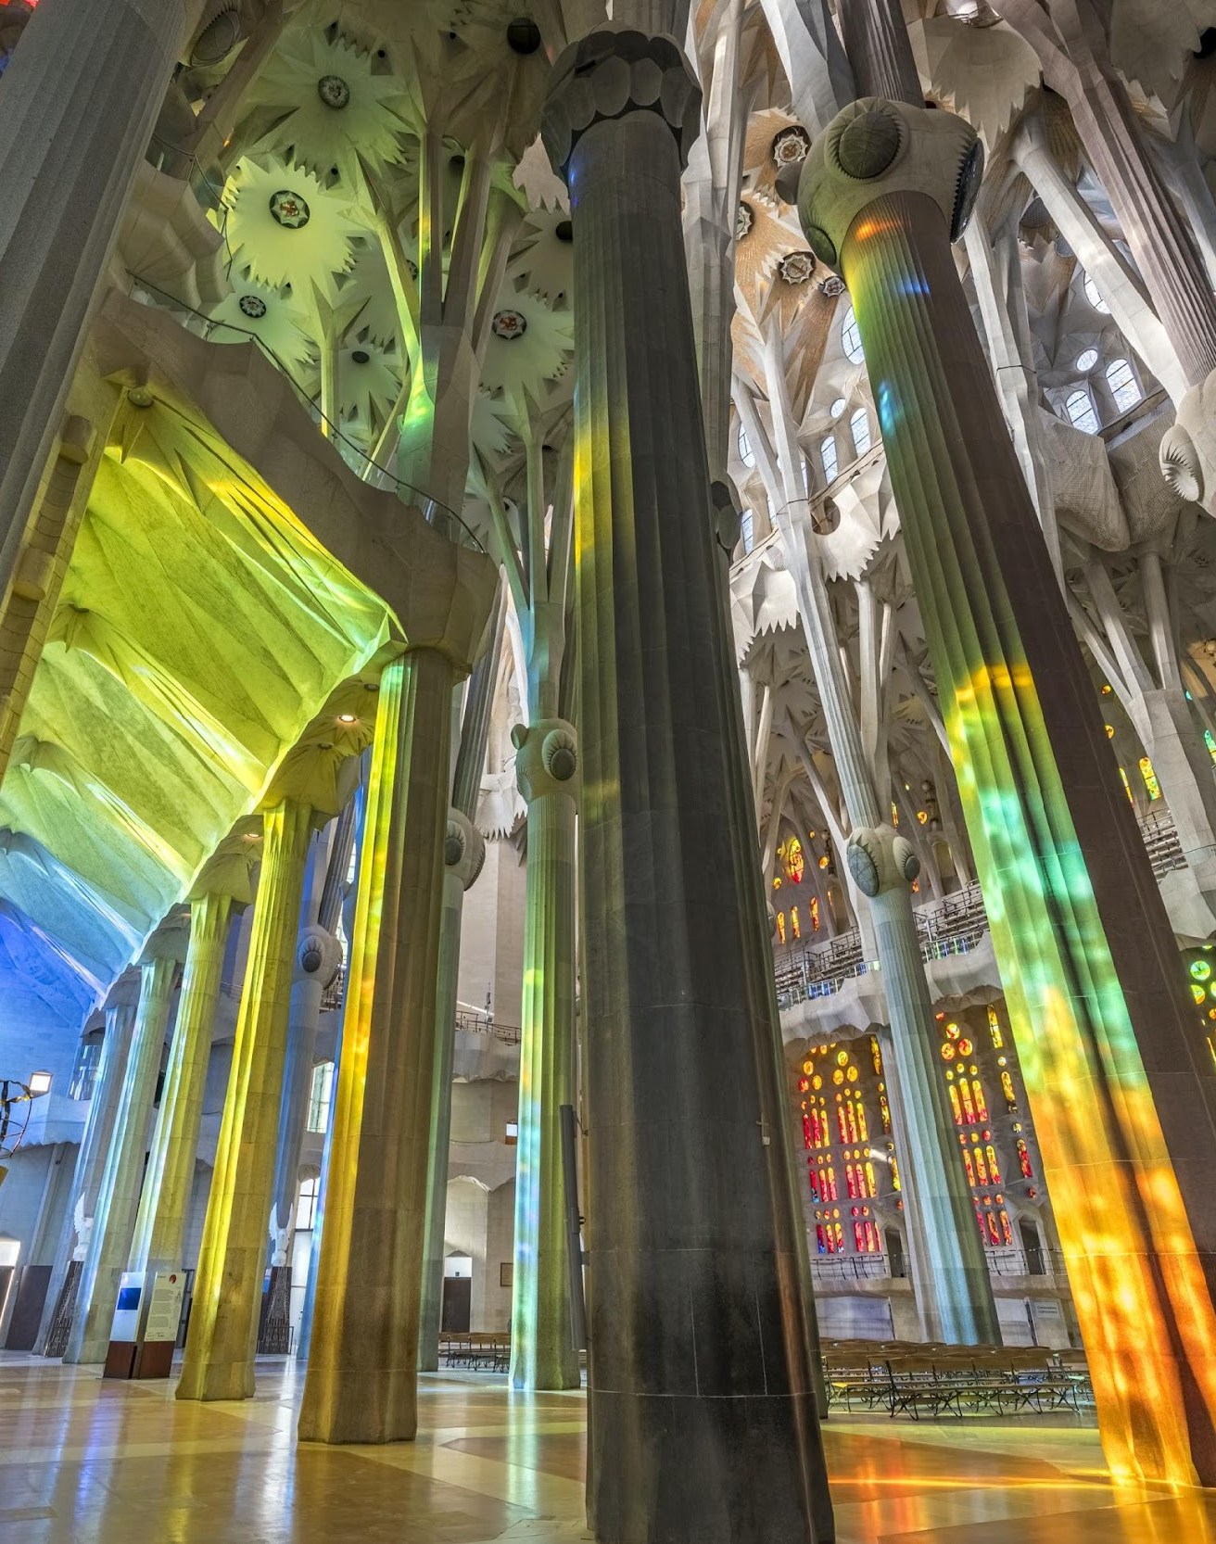
OUR PROVINCE: BARCELONA
Sant Andreu de la Barca is in the outskirts of Barcelona.
It is 25 km away from the capital city.
Barcelona, the city of wonders:
- Sagrada Familia
- Park Güell
- The cathedral
- Mercat de la Boqueria

Slide 7
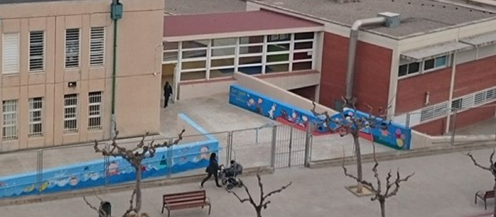
JOSÉ JUAN ORTIZ SCHOOL

Slide 8
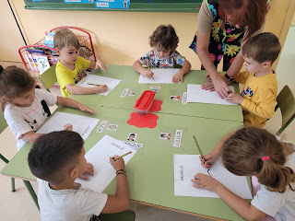
OUR SCHOOL
We are an infant and primary education PUBLIC school .
We have students from 3 years old to 12 years old.
We used to have 2 classes per level, but know…

Slide 9
OUR SCHOOL ORGANIZATION IS…
COMUNITAT DELS PETITS |  |  | COMUNITATS DELS MITJANS |  |  | COMUNITAT DELS EXPERTS
I3 | 3 YEARS OLD | 20 STUDENTS | 2ND A | 7 YEARS OLD | 21 STUDENTS | 4TH A | 9 YEARS OLD | 25 STUDENTS
I4 | 4 YEARS OLD | 22 STUDENTS | 2ND B | 7 YEARS OLD | 21 STUDENTS | 4TH B | 9 YEARS OLD | 25 STUDENTS
I5 | 5 YEARS OLD | 22 STUDENTS | 3RD A | 8 YEARS OLD | 21 STUDENTS | 5TH A | 10 YEARS OLD | 25 STUDENTS
1ST | 6 YEARS OLD | 22 STUDENTS | 3RD B | 8 YEARS OLD | 24 STUDENTS | 5TH B | 10 YEARS OLD | 25 STUDENTS
* We only have 2 classes per level in years 2, 3, 4, 5 and 6. |  |  |  |  |  | 6TH A | 11-12 YEARS OLD | 24 STUDENTS
 |  |  |  |  |  | 6TH B | 11-12 YEARS OLD | 27 STUDENTS

Slide 10
SCHOOL TIMETABLE
Infant and primary education have the same timetable
MORNING: from 9h to 12:30h
Lunch time: from 12:30h to 15h
AFTERNOON: from 15h To 16:30h
AFTER SCHOOL: the parents association offers after school activities from 16:30h to 18h, such as: English, sports, etc.

Slide 11
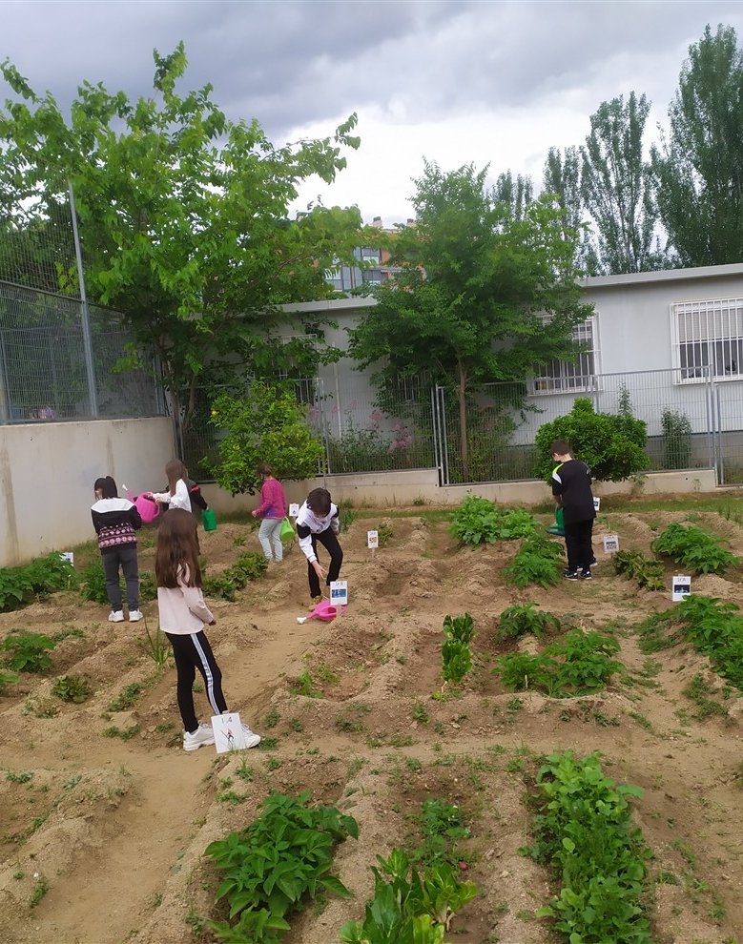
SCHOOL SPACES
5 PLAYGROUNDS
CITY VEGETABLE GARDEN
1 GYM + 1 PSYCOMOTRICITY CLASSROOM
1 DINNING ROOM
KITCHEN
1 MUSIC CLASSROOM
2 ENGLISH CLASSROOMS
1 ARTS & CRAFTS CLASSROOM
1 NESE CLASSROOM
1 SIEI CLASSROOM
1 COMPUTER CLASSROOM
1 CLASSROOM FOR NEW COMERS
1 RELIGION CLASSROOM
1 LIBRARY
1 SCIENCE CLASSROOM
FAMILIES ASSOCIATION ROOM

Slide 12
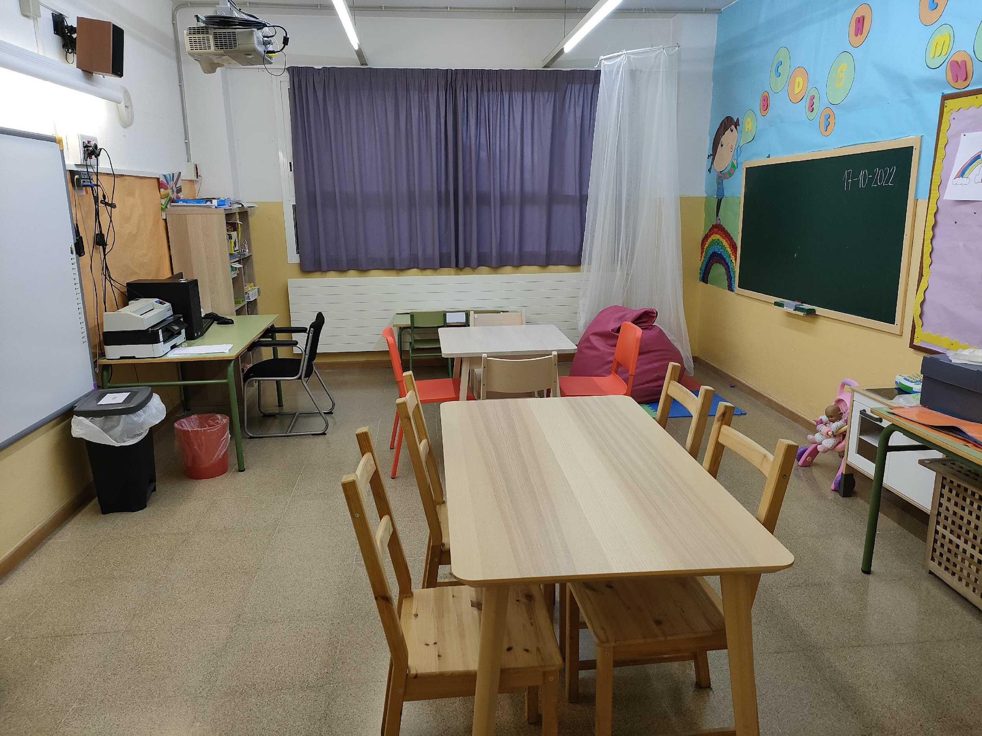
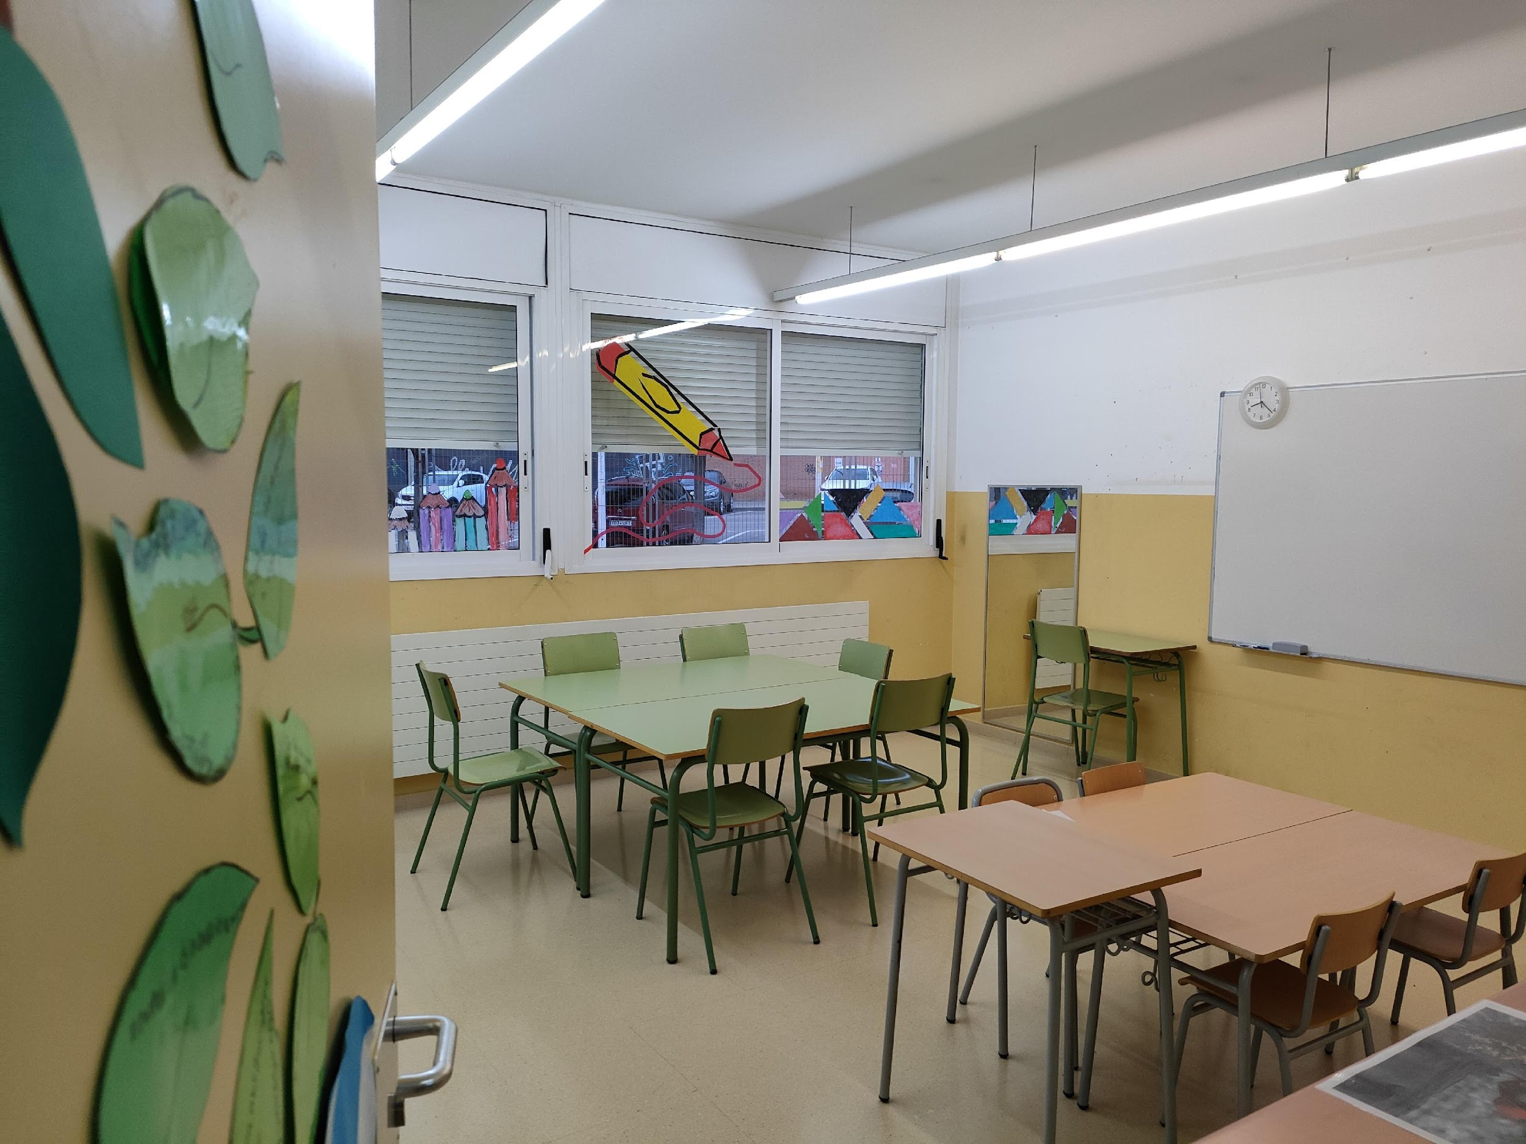
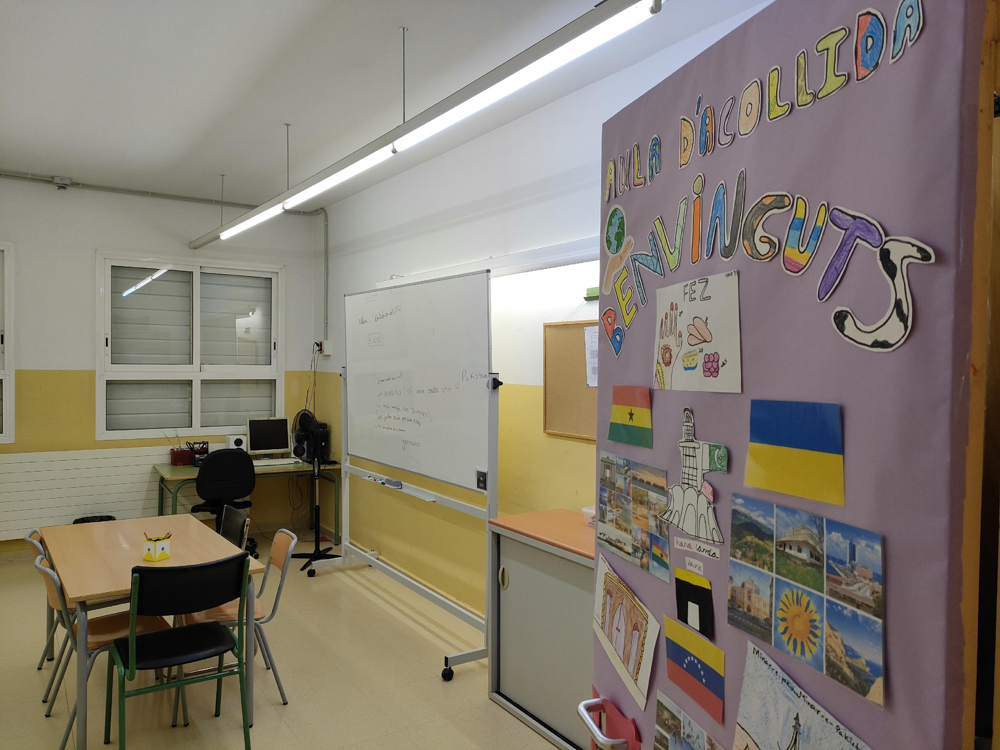
SCHOOL PLACES
SIEI CLASSROOM
“Intensive Support for Inclusive Schooling”
NESE CLASSROOM
“Specific Educational Support Needs”
NEW COMERS CLASSROOM

Slide 13
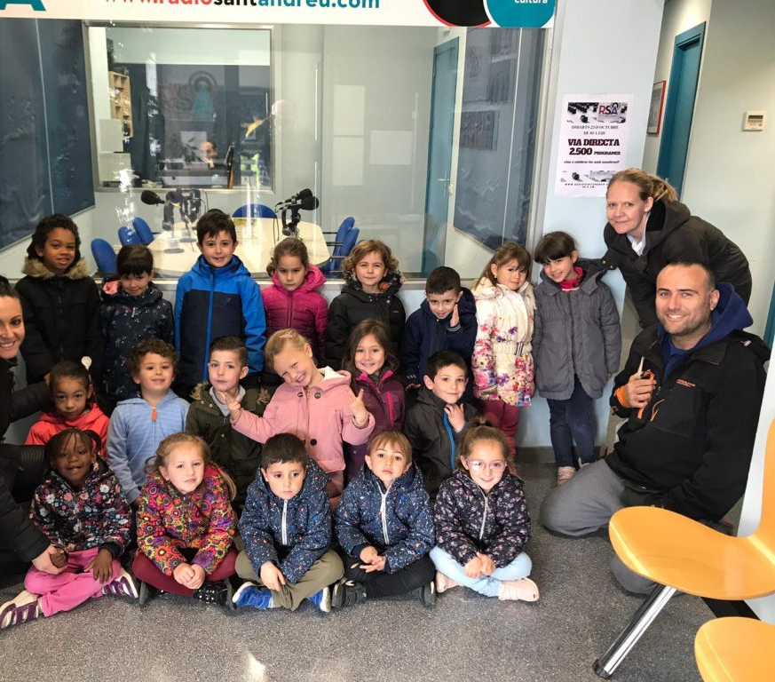
SCHOOL DIVERSITY
One of our strengths is our students social and cultural diversity.
We count on with a 32% of FOREIGN STUDENTS COMING FROM:
CENTER AND SOUTH AMERICA
MOROCO
GHANA
PAKISTAN AND INDIA
EAST OF EUROPE (ROMANIA AND UKRAINE)
CHINA

Slide 14
OUR SCHOOL MISSION
Work for quality and educational equity.
Foster coeducation among our community.
Promote the gender equality treatment.
Promote integral personal growth.
Make the students the protagonist of their own learning.

Slide 15
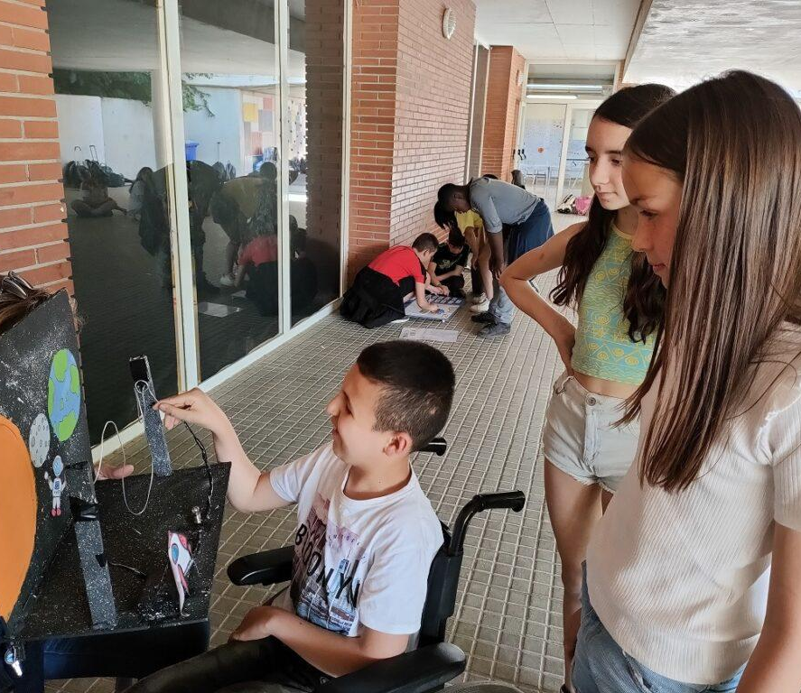
OUR SCHOOL MISSION
Work to attend diversity.
Promote democratic values ​​and respect for human rights.
Promote knowledge and respect for Catalan language and culture.
Establish communication and dialogue between the families and the school.
Maintain a good relationship with the environment.

Slide 16
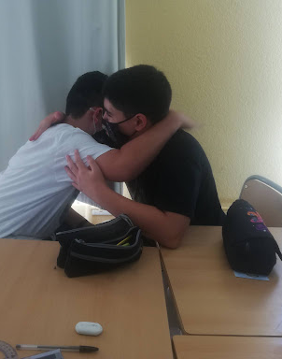
OUR VALUES
Respect for the other and the physical, social and cultural environment.
Non-discriminatory attitude (Coeducation)
Critical spirit, of dialogue, entrepreneurial, solidarity and democracy
Resolve conflicts through mediation
Work of healthy behaviours (emotional Ed.)

Slide 17
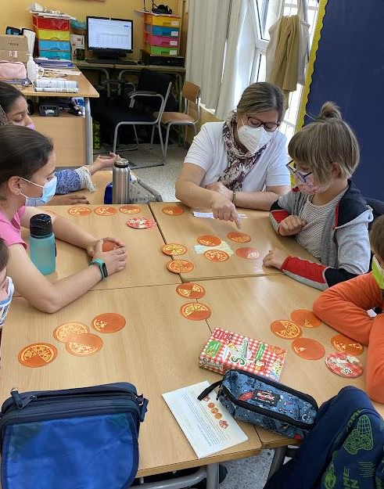
Our values
Stimulation of personal effort.
Respect and attention to the rhythm of each individual's learning.
Teamwork for the benefit of the whole group.
Innovative will (methodologies, new technologies)
Ecological awareness.
Communication, dialogue and collaboration with families and with the educational community.

Slide 18
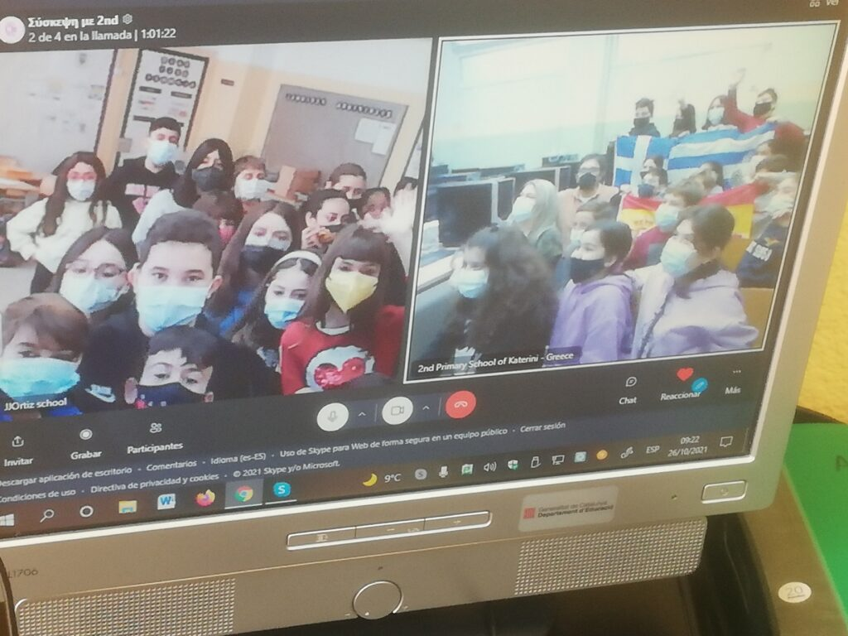
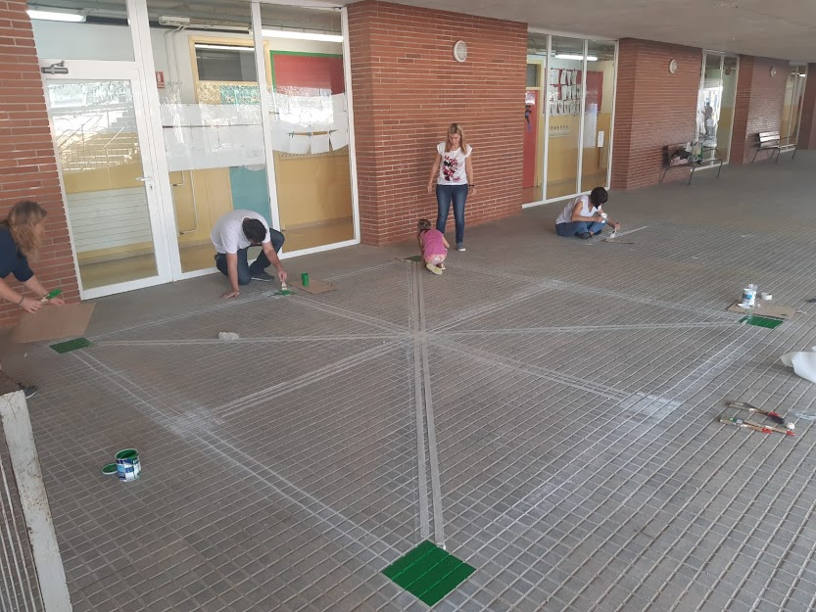
OUR SCHOOL’S PROJECTS
Transversal Project of our school: WOMEN THROUGH HISTORY
SDG’S
Maths and English Corners
Erasmus +
eTwinning
Emotional education
Educational playgrounds
Travelling suitcase
Artistic Project
Wednesday of fruit

Slide 19
OUR QUOTE
"Education is not the answer to the question. Education is the WAY to find the answer to all the questions "
William Allin
DO YOU WANT TO KNOW MORE ABOUT OUR SCHOOL?
https://agora.xtec.cat/escolaortiz/general/un-dia-a-la-nostra-escola/

