Slide 1


Slide 2
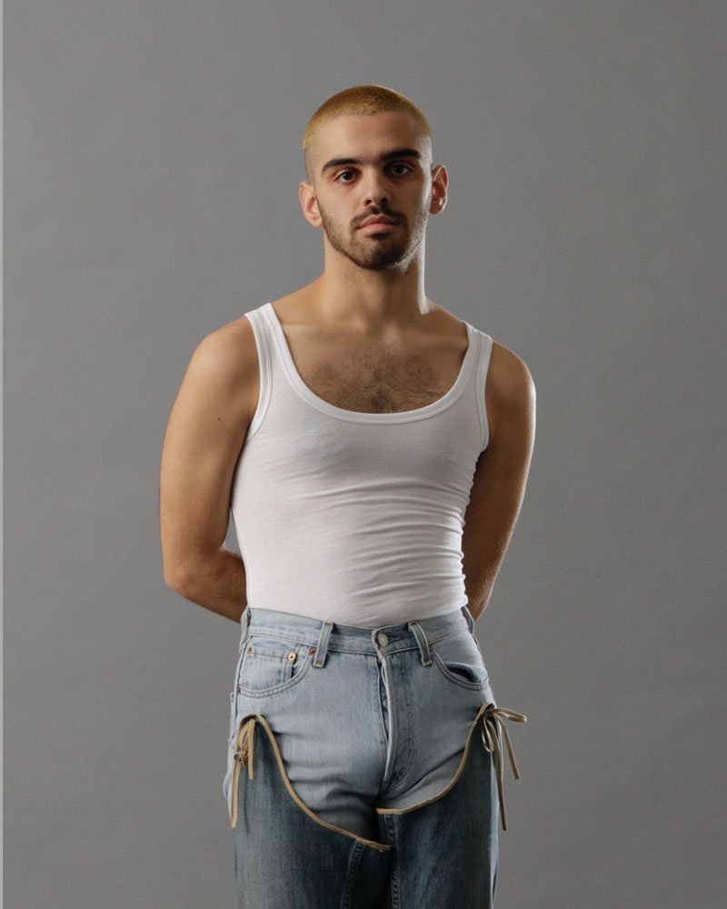
Emeerree is a Spanish genderless fashion brand founded by Aarón Moreno.
The brand’s DNA is defined by reinterpreting the basics of the wardrobe, redesigning in each collection day-to-day garments such as jeans or undershirts and mixing them with elements of corsetry.
All their fabrics are obtained through local businesses, deadstock, defective fabrics, or ecological production.
Emeerree bets on ustainable production, using made-to-order sales. In this way, only what is necessary is made, thus avoiding excess stock.

Slide 3

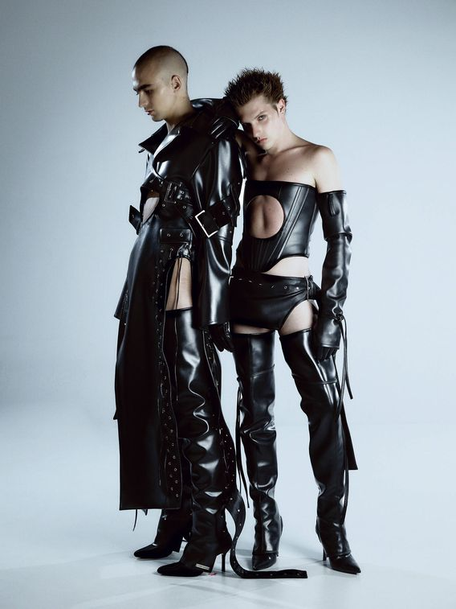
Interview to Emeerre
Do you remember when your passion for the fashion began?
When I finished high school I didn't know what to do, but I knew that I had to go this way and it was with the first sewing class that I knew I was right.

Slide 4
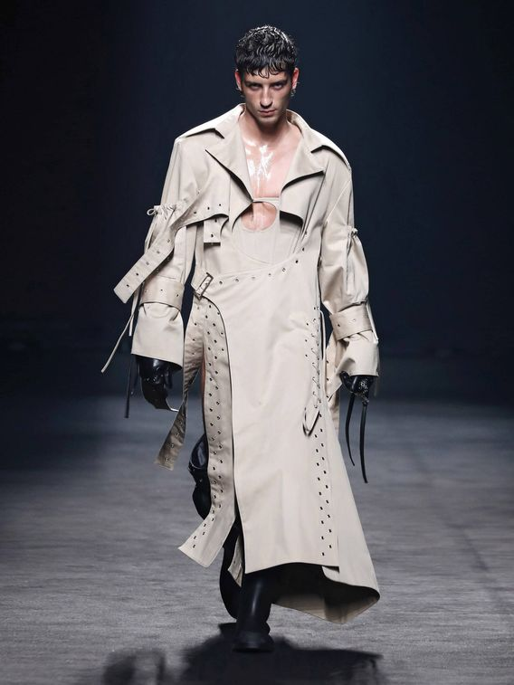
Are the beginnings in the world of fashion as difficult as they say?
It is more difficult than it seems because months of work are summed up in 5 minutes when launching a collection, on networks or on the catwalk. If I could give a advice, it would be to enter this world in a serious and responsible manner because this is not a hobby.

Slide 5
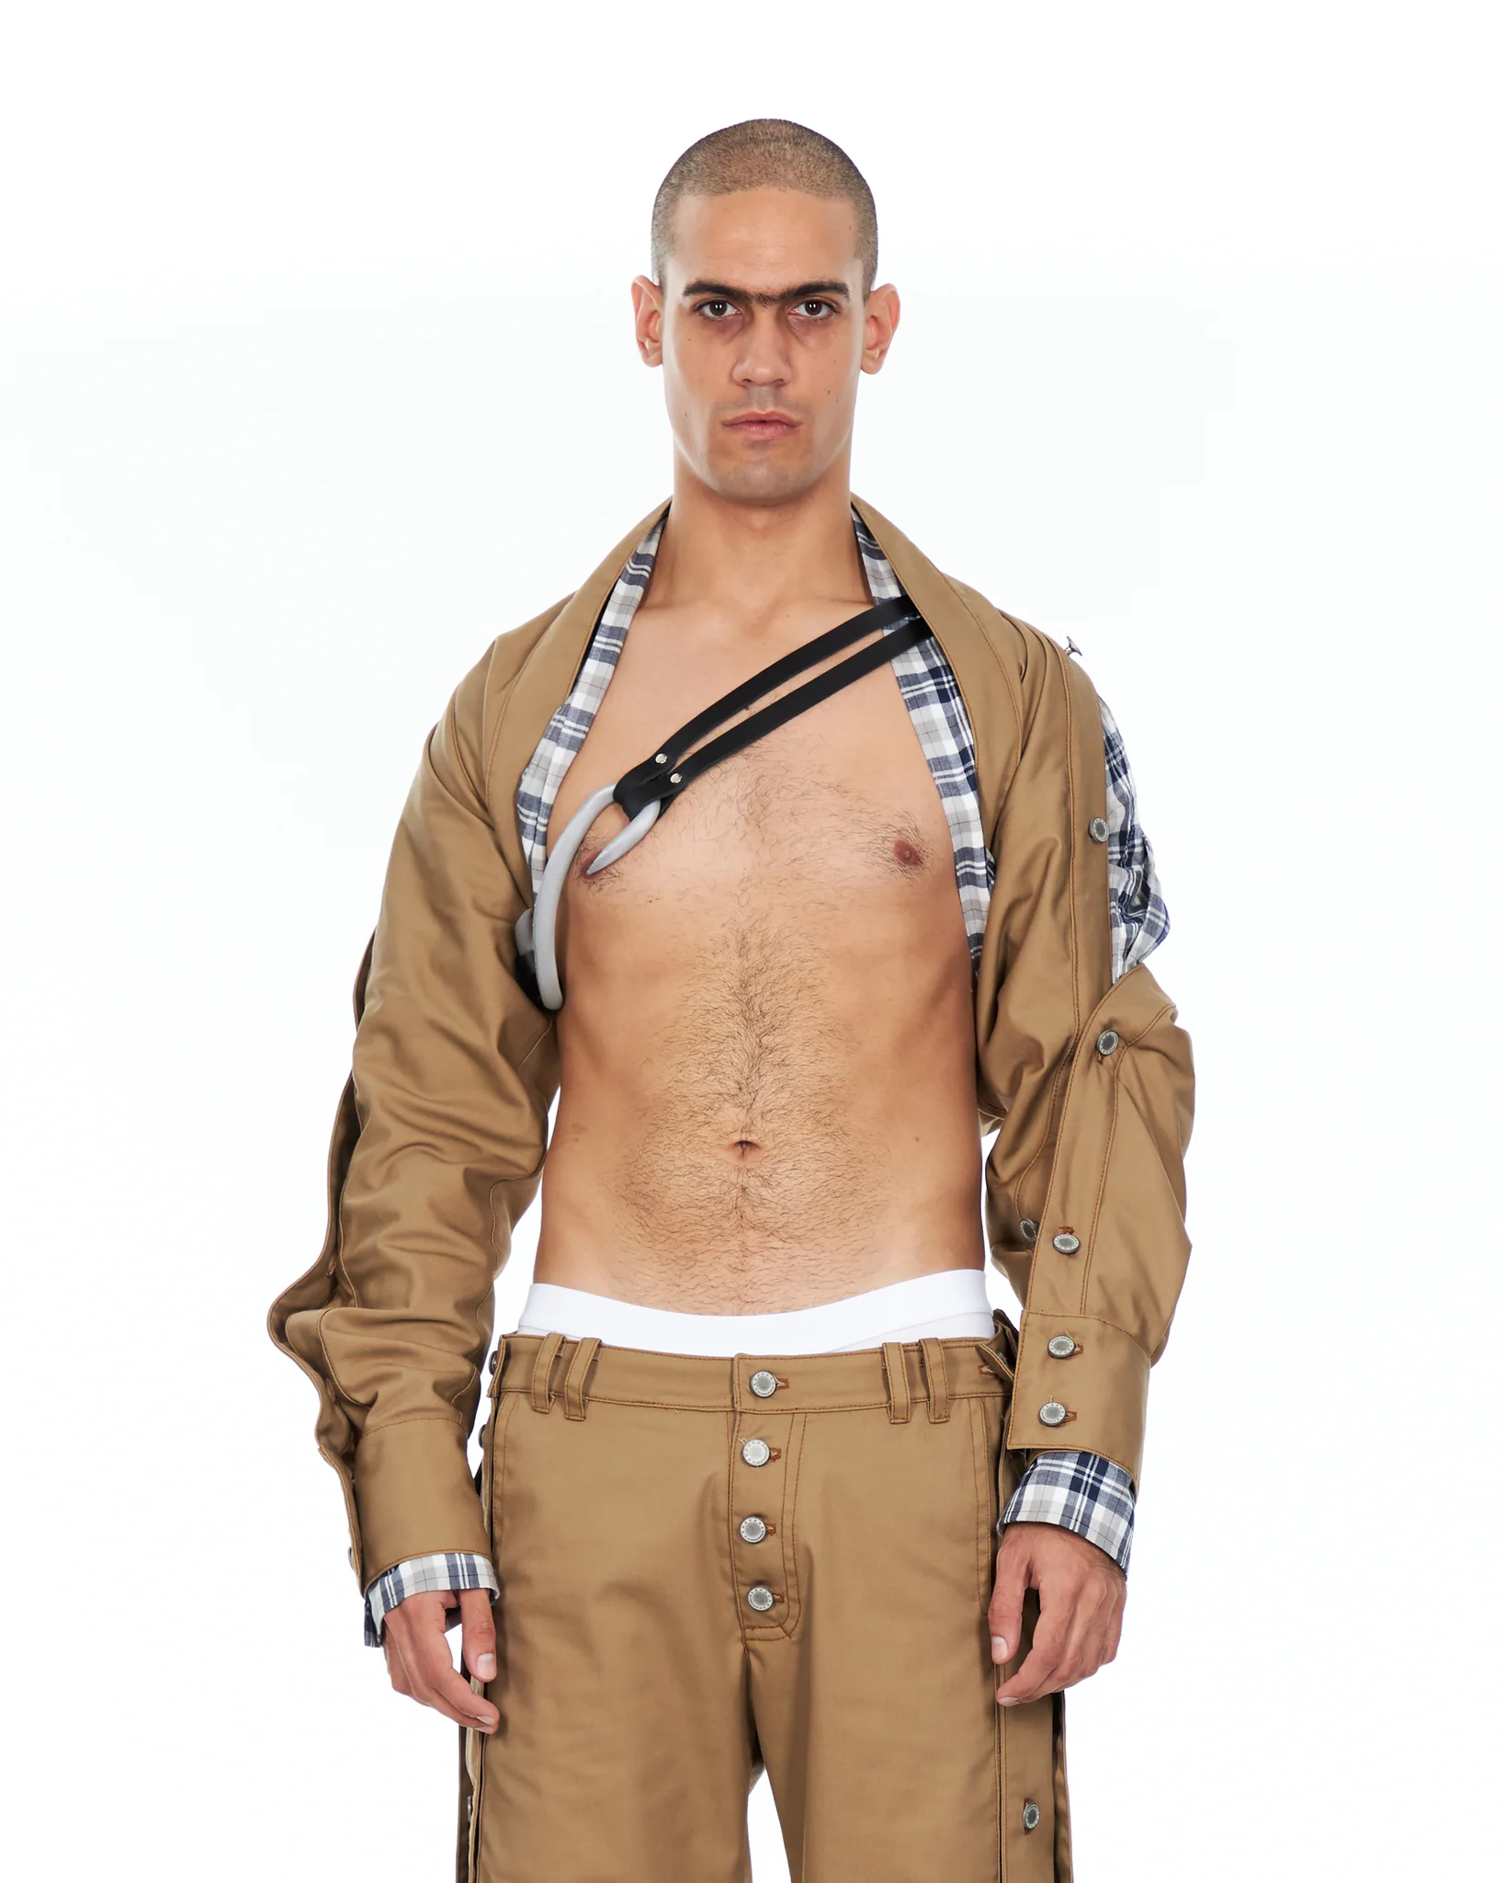
How would you define the Emeerree project?
What is always present in the brand is the solidity of the proposals, the commitment and the sexy. This is translated in different ways depending on the needs or the starting point of the collections.

Slide 6
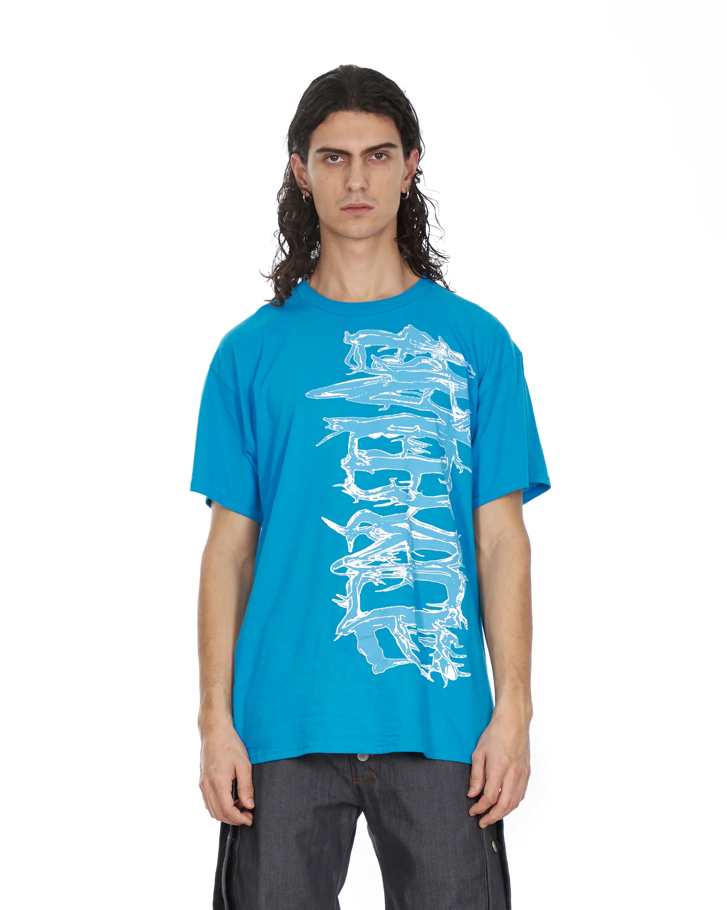
If you had to take a photo of your inspiration moodboard, what would we find in it?
Lots of things, from scraps of fabrics that I find to quick sketches of things that come to mind, reference photos, details, portraits of people I consider that represent the brand...

Slide 7
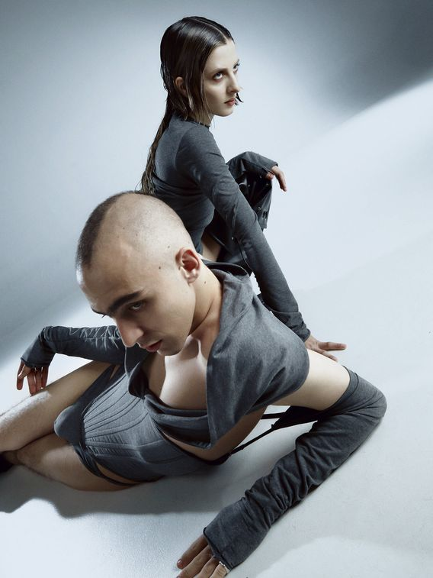
What are the steps that you follow in the creative processes for creating your collections?
I don't have a defined creative process. I really like starting from things that attract me, so when I find something that excites me, I start to work with it. I think that this way I don't feel so limited when designing new collections and I enjoy my work more.

Slide 8
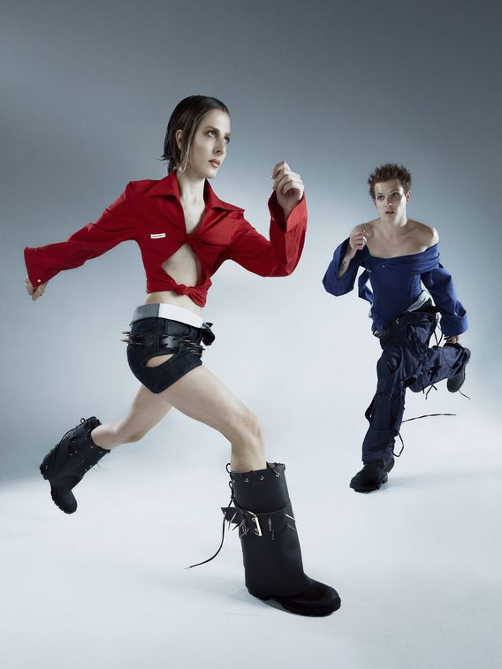
You get all your fabrics through local businesses, surplus, defective fabrics. Do you see it necessary for brands to have sustainable creation processes?
It is very necessary, especially in large companies that would have to put more effort into it. We have to be responsible with the industry and not produce or consume more than we need. Bet for quality and understand that within the definition of sustainability is also the quality of the working life of workers.

Slide 9
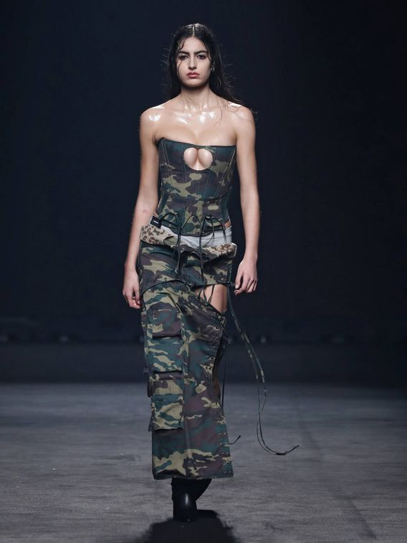
Focusing on the current topic, what was your feeling when you saw Dua Lipa, one of the current style icons, wearing one of your garments from the 2022 collection?
I was very happy, she wore it twice. I am very happy to see that my work reaches so far and to those types of profiles. It is evident that her team works hard to bring her current proposals, and not only from well-known brands, but also from emerging brands and seeing one of my pieces there makes me feel fulfilled with what I do.

Slide 10
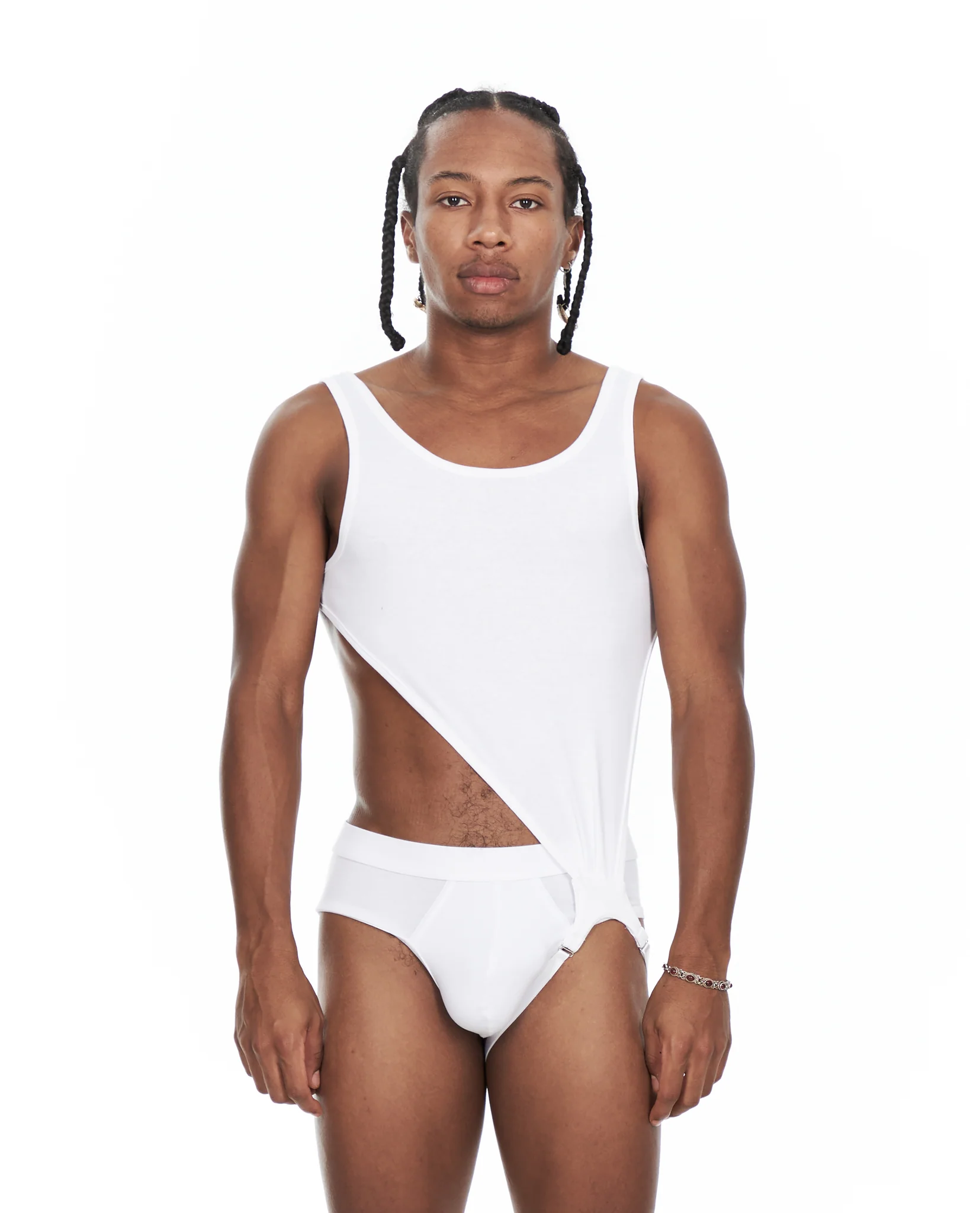
Did you know this was going to happen or was it an online purchase that caught you completely by surprise?
Her stylists contacted us to give her the look, so I knew she had it, although I didn't know when she was going to wear it. I knew when because the day she uploaded the story to Instagram people started to sending us the photo.

Slide 11
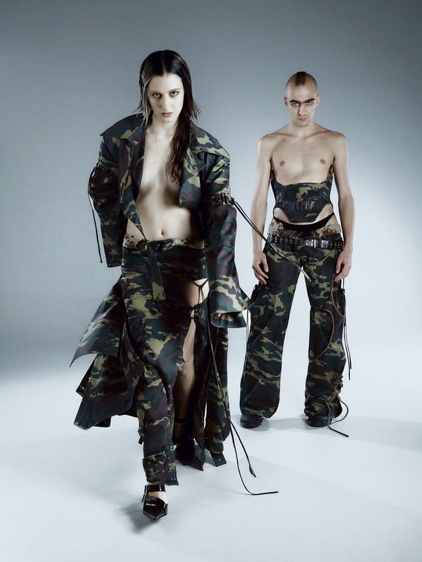
How do you think the artist is linked to the brand's values?
Sexy is always present in its image and it is something that I feel the brand identifies with .

Slide 12
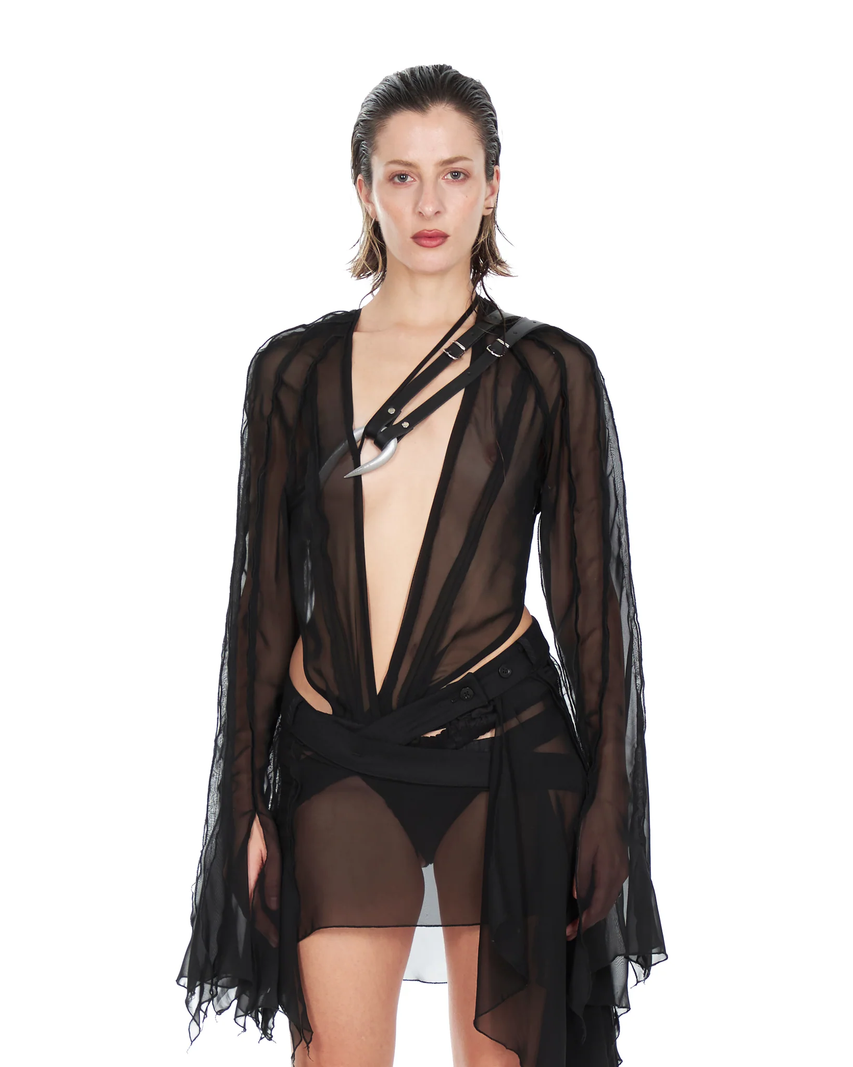
Have you noticed much of the commotion after the publication?
She is a person who causes a lot of interest, many people shared the photo and even her fans mentioned us. It's very fun to see and experience all that.

Slide 13
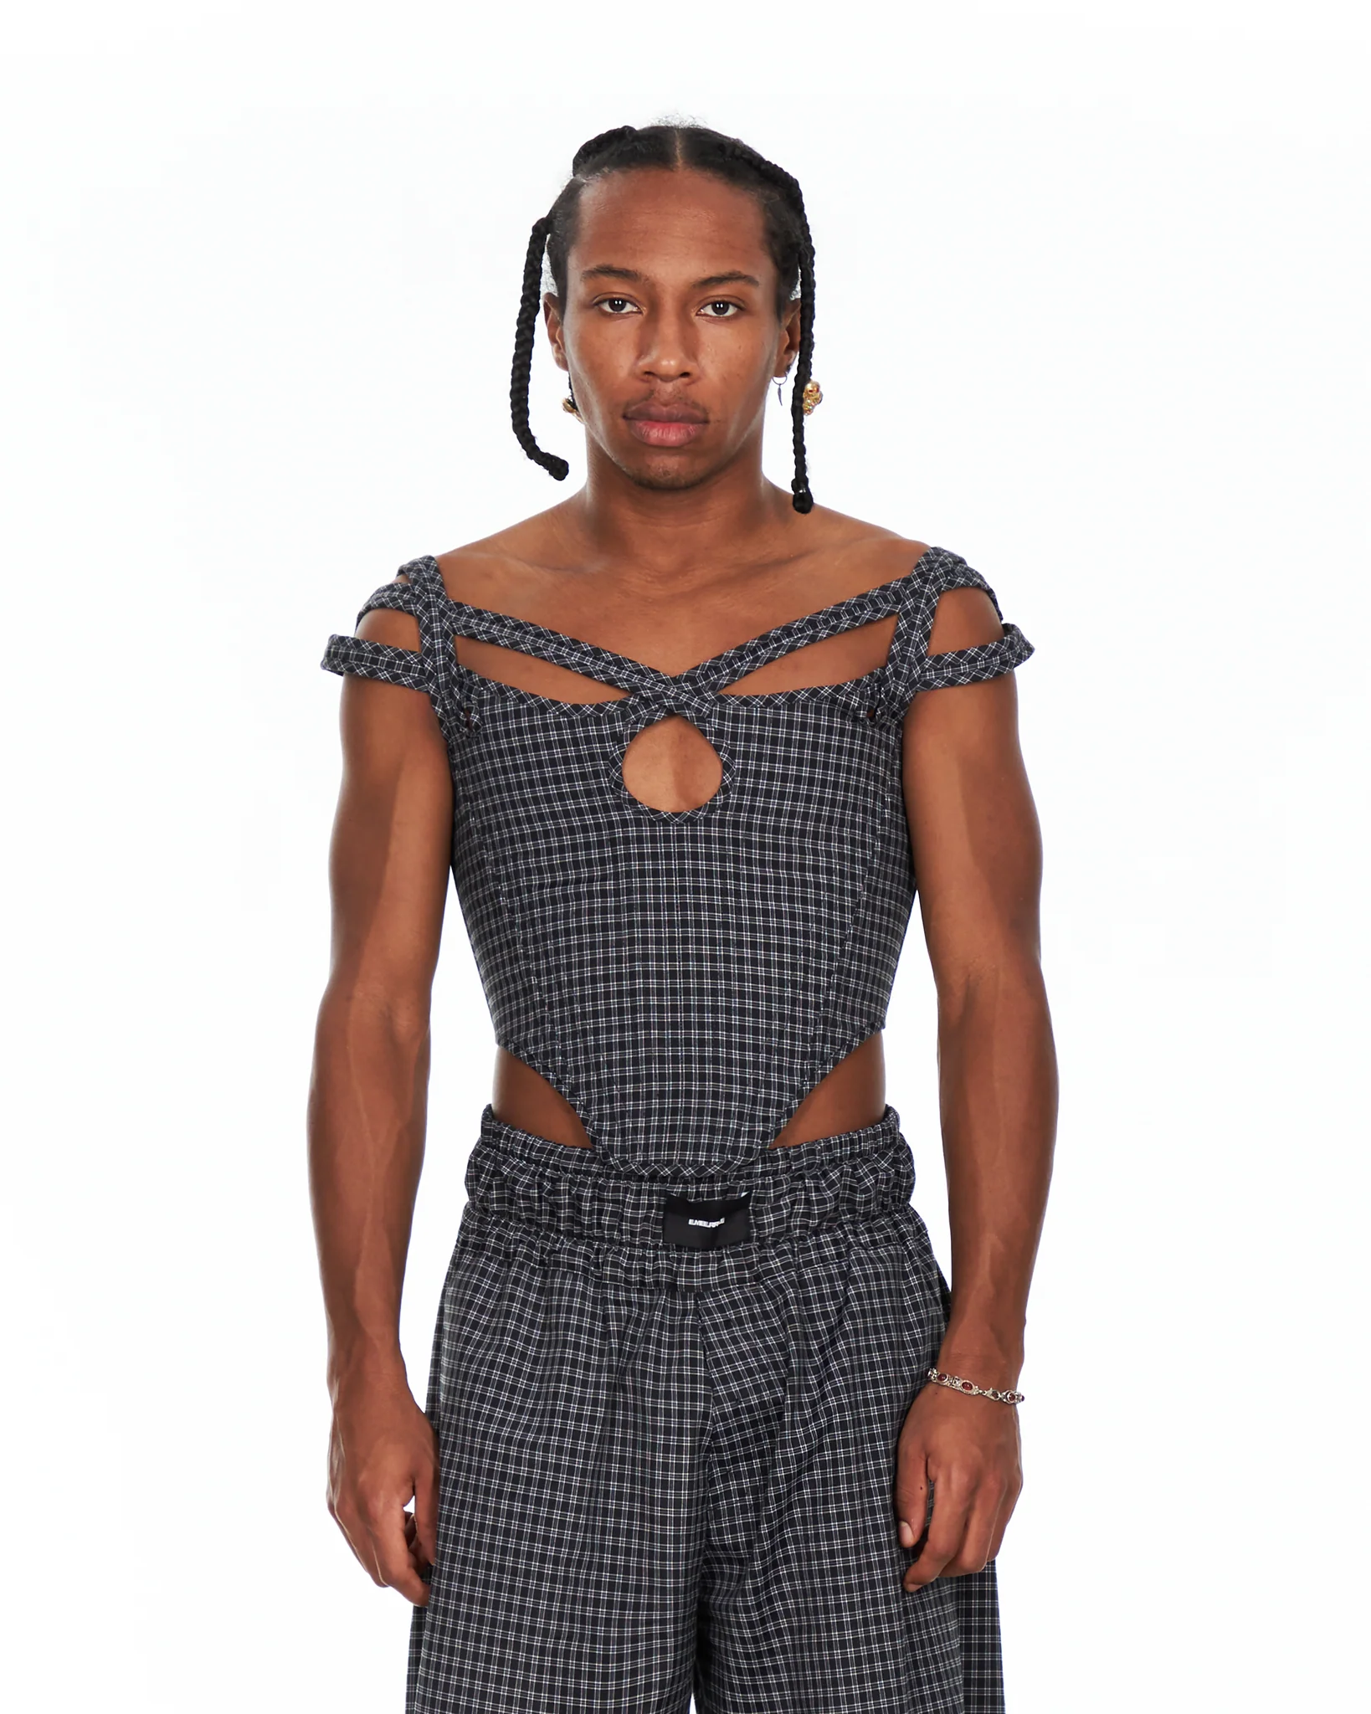
What does it mean to you? Do you think this has opened doors for you?
I don't think it opened many doors for me, but it makes the proposal seem stronger to others. I continue working the same as before.

Slide 14
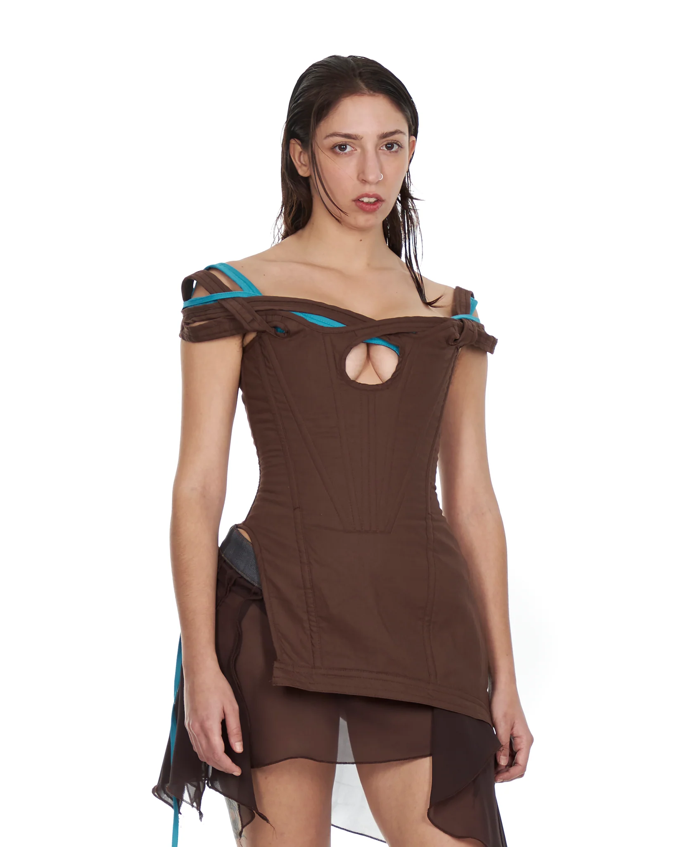
What other celebrities do you think would fit with your designs?
Right now I'm obsessed with Julia Fox and Bella Hadid. Hopefully soon!

Slide 15
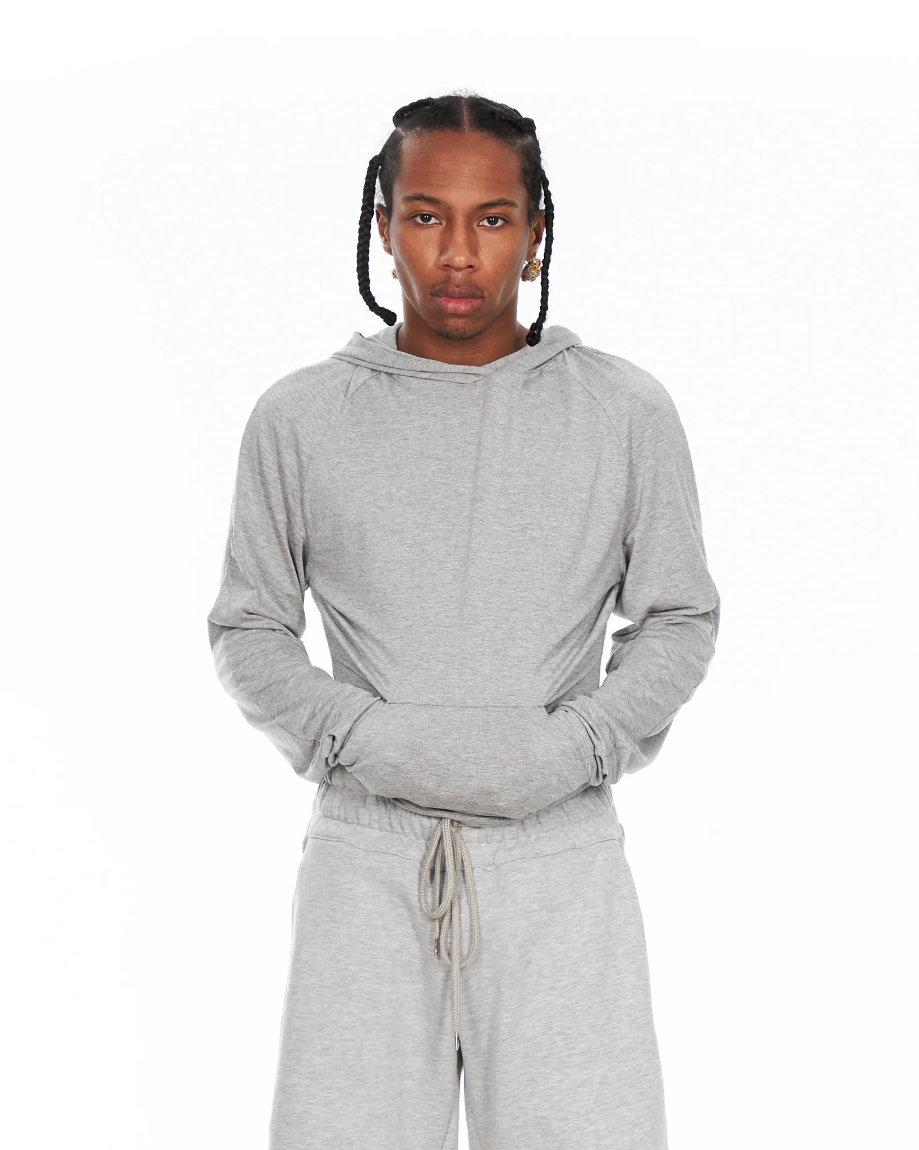
With a brand that launches such a disruptive proposal, although with a very current and fresh message, do you find it difficult to find a place in the more mainstream world?
I think that the cool thing for brands is to gradually create their space. Inevitably we need elements that work in what we understand as mainstream to survive.

Slide 16
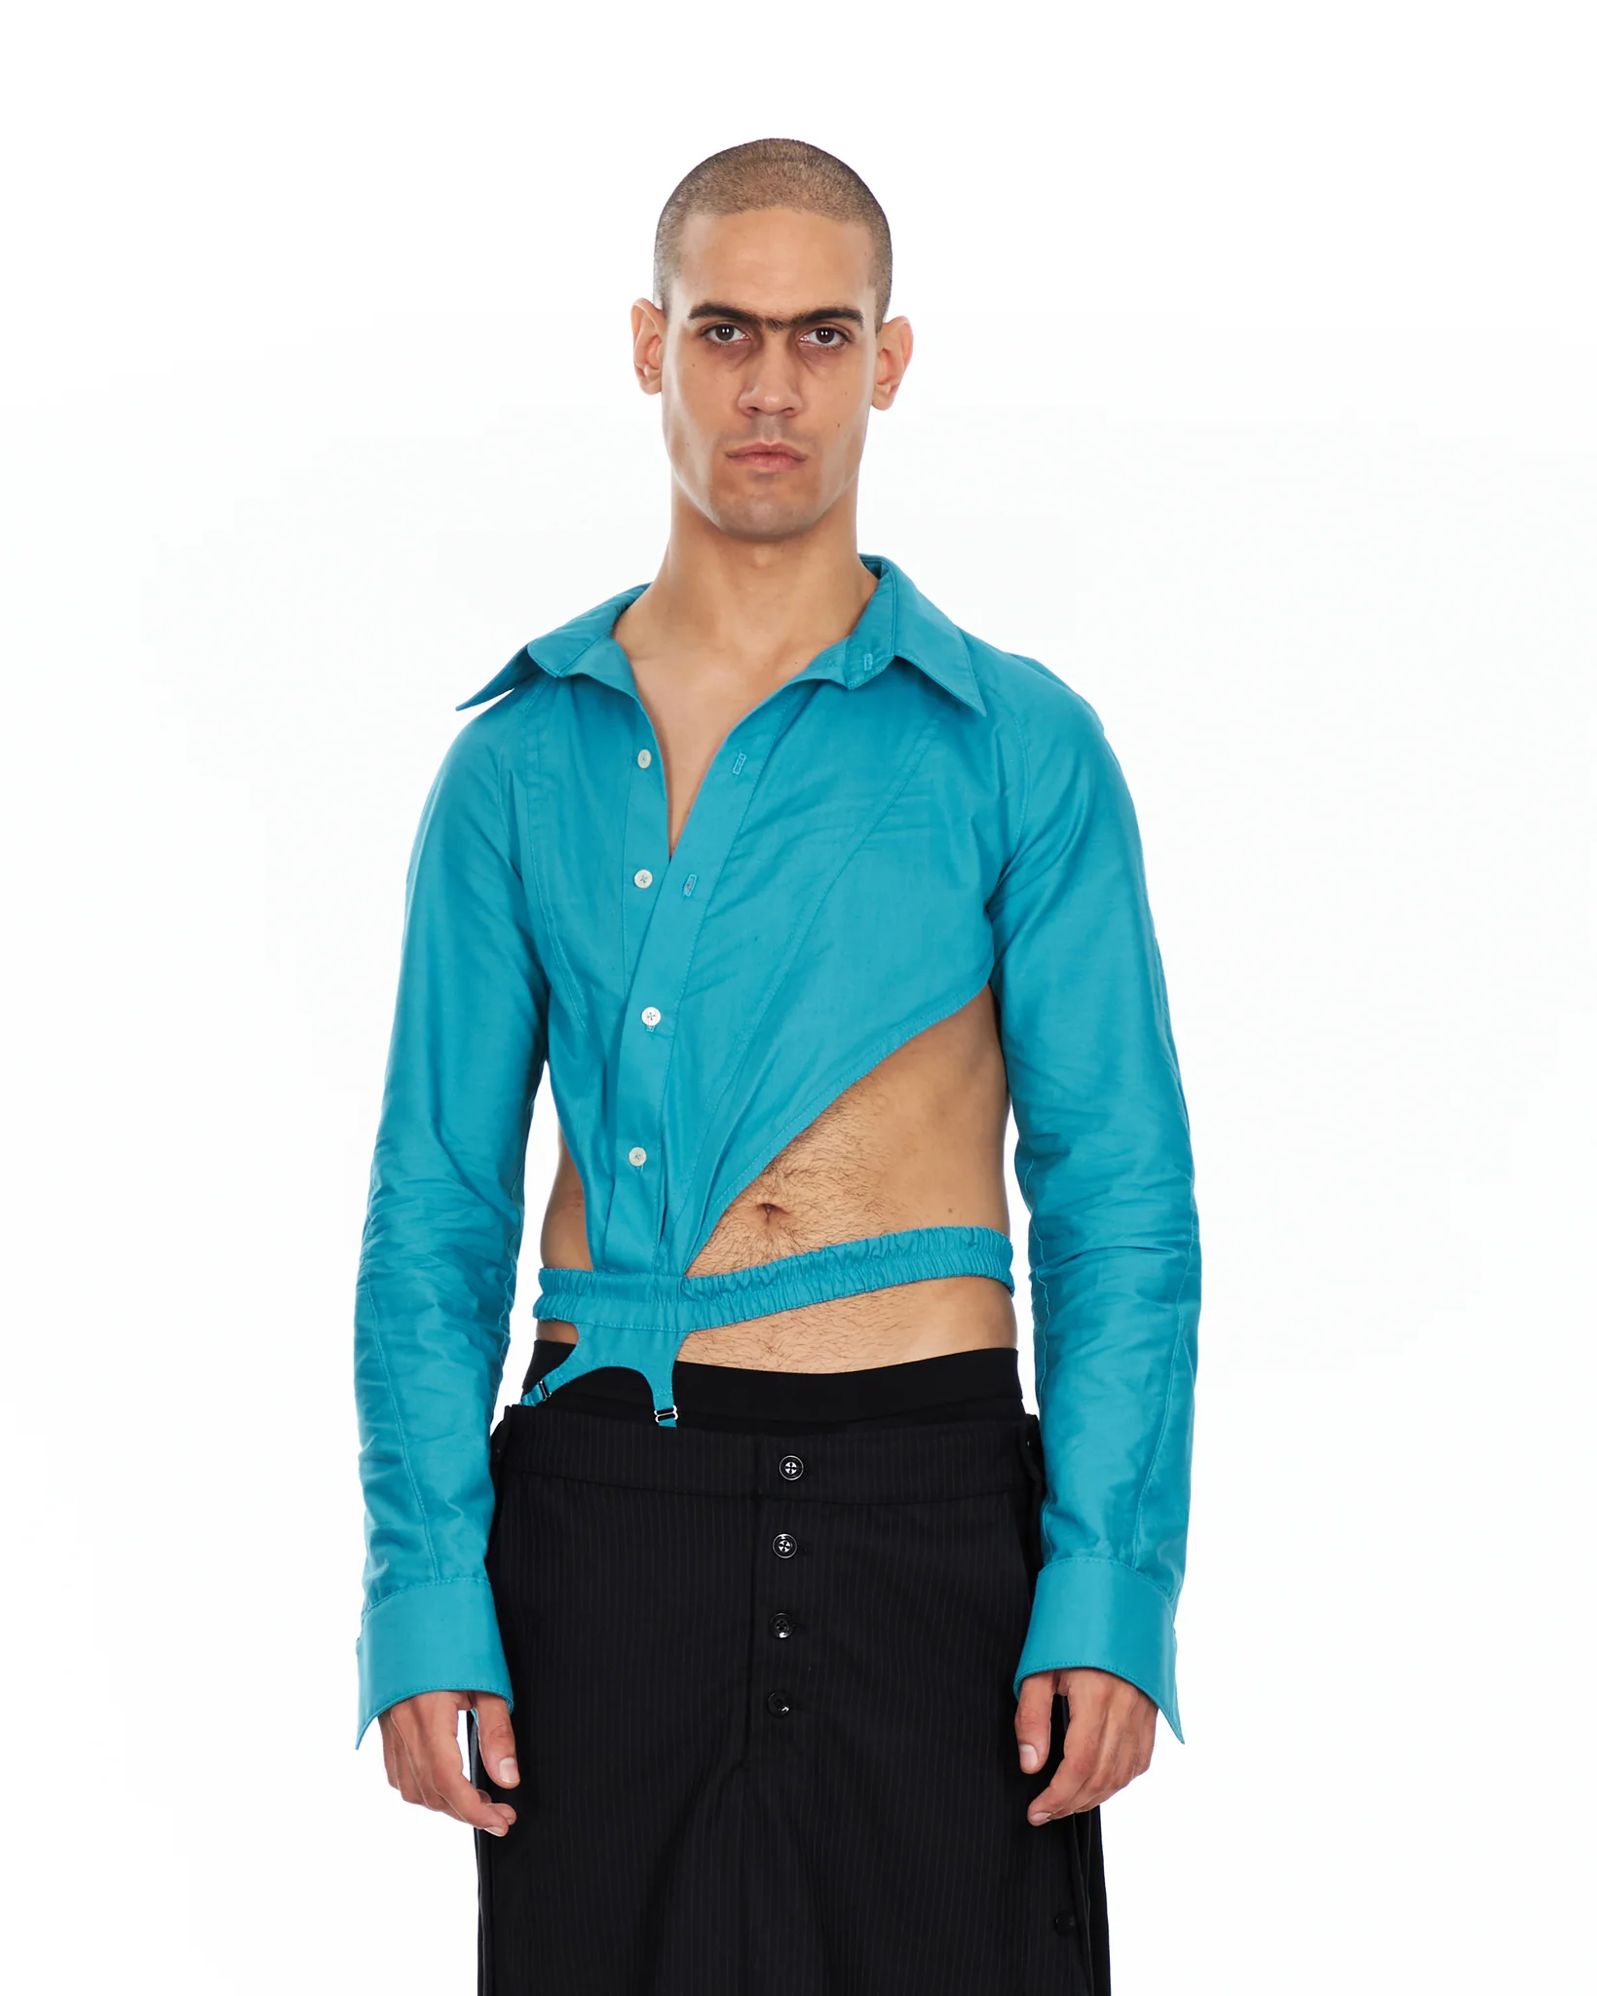
You started your project from RRSS, from there you went to EGO, like other young designers like Dominnico, whose role in national fashion is increasingly relevant. What do you have in mind for the future of Emeerree?
I would love for the brand to grow until I can make a living from it. With each collection I seek to renew the image of the brand and, at the same time, make the garments more unique, therefore, I am looking forward to seeing what we come up with for the next launch.

Slide 17
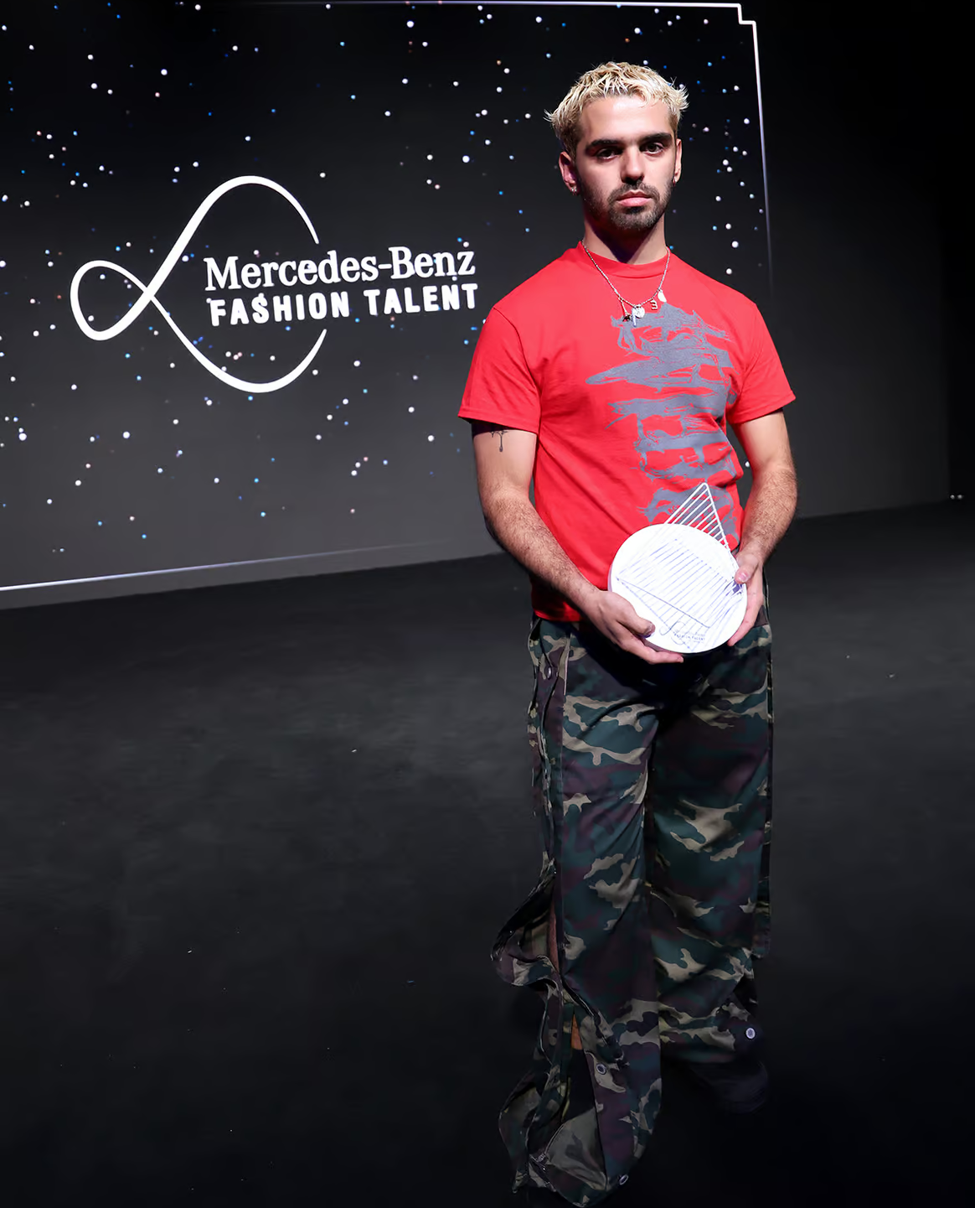
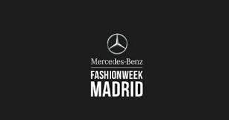
The new Emeerree collection called "Reunion", presented at the Mercedes-Benz Fashion Week 2024, is guided by the idea of family as a simile to the group of people who are closest to the brand. It aims to represent, through the patterns and fabrics, three phases that define the moments prior to a gathering of friends, this being the culmination.
“Reunión” aims to create an atmosphere of distraction that evokes the feeling of getting together with a group of people who are more like family than friends.

Slide 18
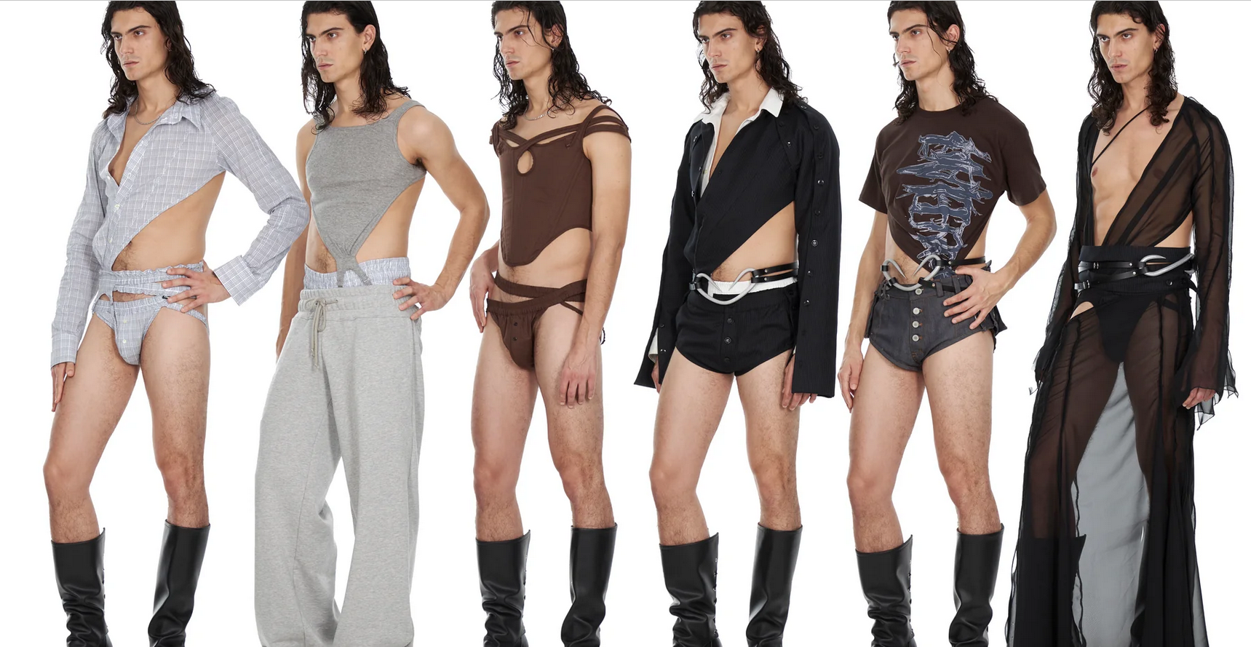
In this new collection, he initial moment represents a more docile mood where comfortable garments predominate.
They correspond to streetwear with linear designs, in cotton and other more rigid fabrics (twill and tartan).
In keeping with the brand's DNA, the lingerie and corsetry proposals appear. This intermediate phase introduces the final phase of the collection, which includes tailoring and evening wear, with more organic designs in more fluid fabrics (silk and wool).

