Slide 1
TRADITIONAL EASTER RECIPES IN ROMANIA
Connecting Cultures through Easter Holiday
(ID 136559)
Presentation made by 7th grade students
SCOALA GIMNAZIALA “I. L. CARAGIALE”
MEDGIDIA - ROMANIA

Slide 2
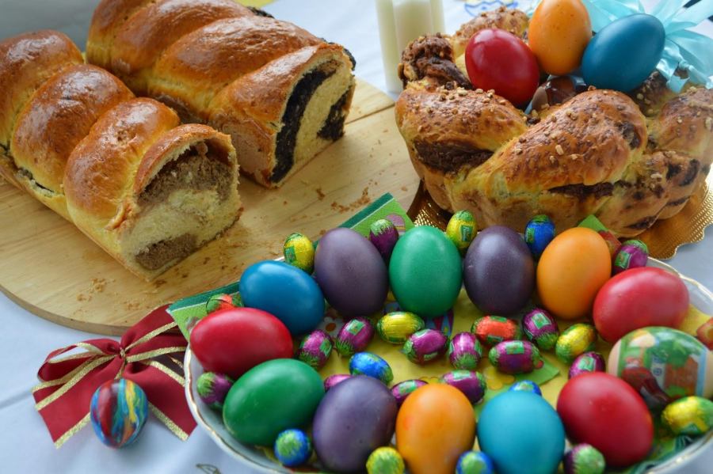
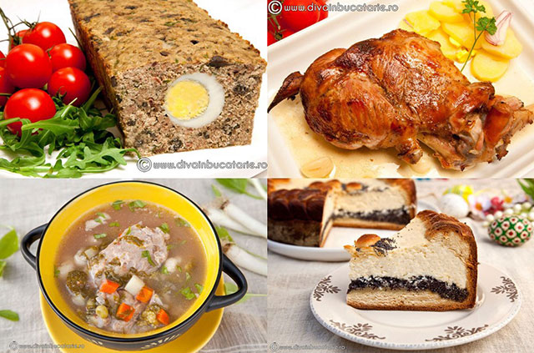
The main star of the dishes is lamb meat, which is served together with side dishes such as potatoes or prepared in traditional dishes such as “drob”.
Something that shouldn't be missing from the Easter table is the large variety of Easter bread and cakes. Known in Romania as "pască", this delicious bread can be made with cheese, cream, raisins, or even chocolate and cocoa.
Eggs painted red and/or decorated with traditional designs are not missing from the Easter table. People bump them saying “Hristos a inviat!" which means "Christ has risen!" and then answer with “Adevarat a inviat!" which means “Truly He has risen!"

Slide 3
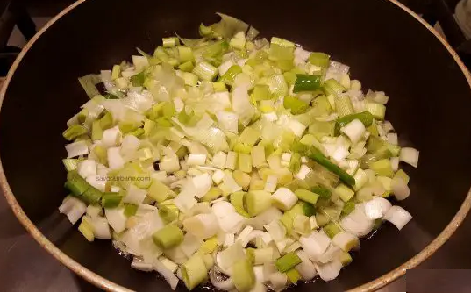
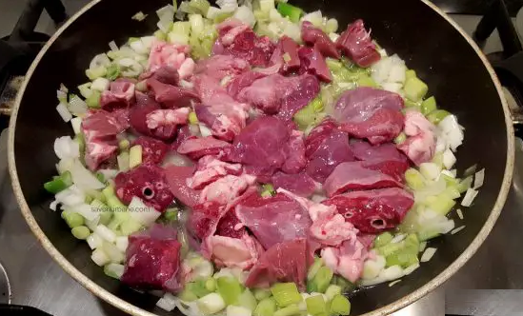
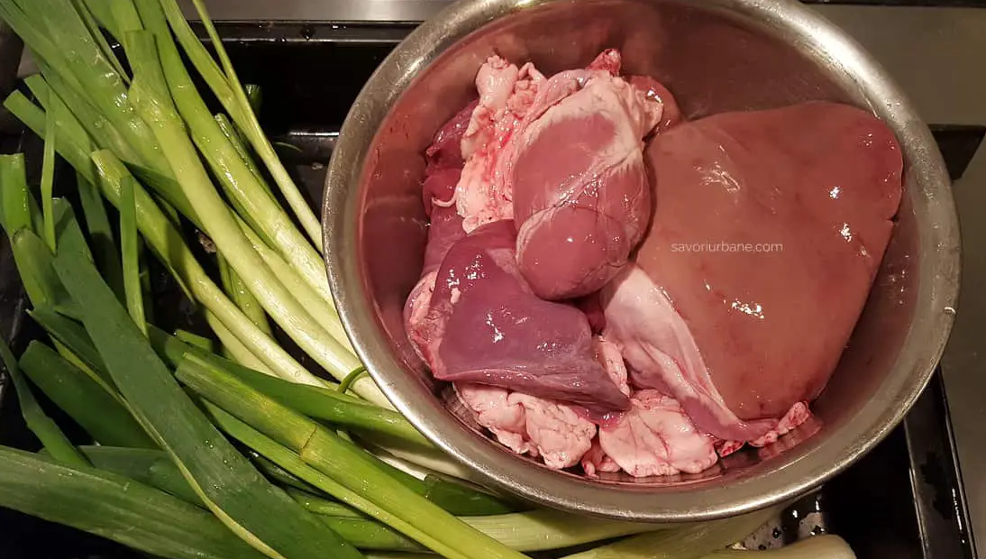
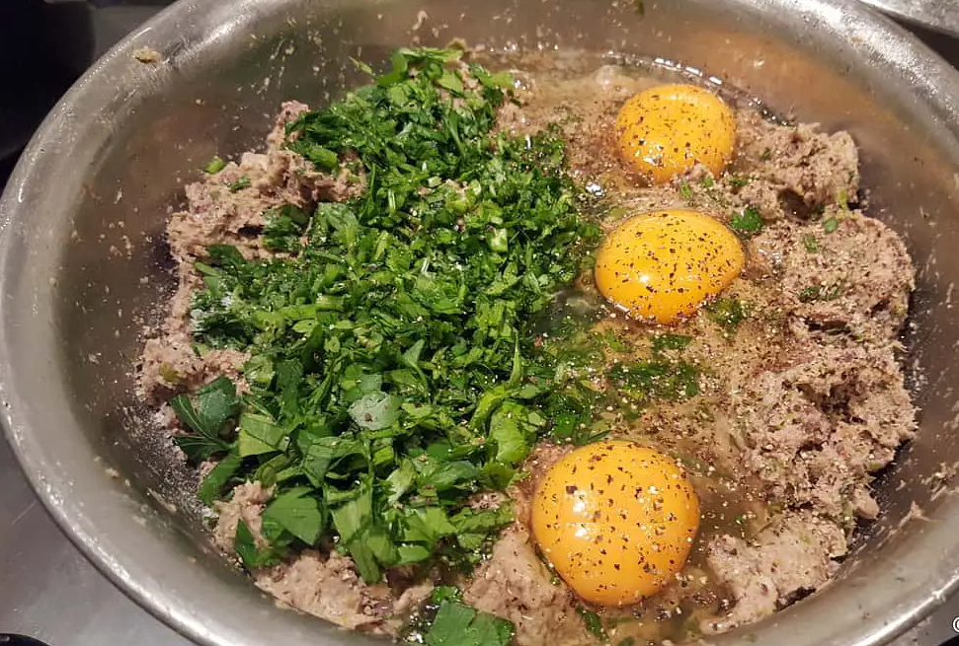
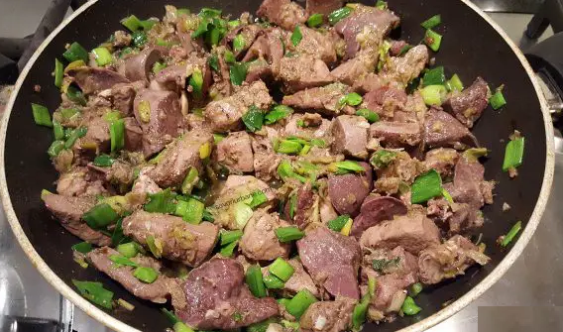
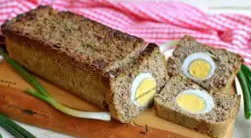
"DROB" is made from lamb organs, eggs, greens such as parsley, spring onion and garlic, and bread soaked in water or milk. The boiled and chopped ingredients are mixed and then seasoned with salt and pepper.
Ingredients:
600 g lamb organs
2 bunches of spring onion
1 bunch of spring garlic
50 ml of oil
Salt and pepper
2 slices of soaked and squeezed bread
a good lot of greens (parsley, dill)
1-2 raw eggs
Optional: 3-4 hard-boiled eggs
Procedure:
Chop the white part of the onion and garlic (leave the tails for the end) and put them into a large saucepan. Then pour the oil on top, cover with a lid, and let it simmer on medium heat for 3-4 minutes. After that add the finely chopped heart, lungs, and spleen and mix it well.
Let it simmer for 6-7 minutes, with the lid ajar.
DO NOT add salt because it will strengthen the organs!
Then add the kidneys and liver, cover the saucepan and let everything simmer for another 5 minutes with the lid on and 5 minutes without the lid. Add the green tails of onion and garlic and sauté everything for another 1 minute.
In the end, add salt, green pepper, and raw eggs and mix everything well, the composition must be soft and creamy. Pour everything into a cake form, lined with baking paper and put in the oven, at 180 degrees, for 40-45 minutes.

Slide 4
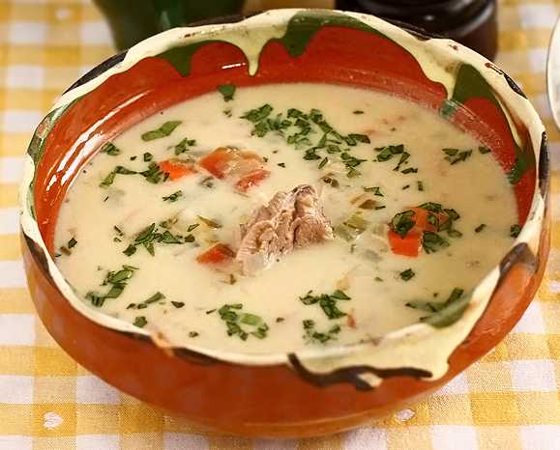
LAMB SOUP
2 medium-sized tomatoes, scalded and peeled
250 ml. borsch
2 fresh egg yolks
300 grams of heavy cream
1 good link of lovage
optional: 2 tablespoons of rice washed two times in cold water
salt and pepper
Ingredients:
1 kg of bone-in lamb meat
1 medium onion (75 g)
2 spring onions
2 suitable carrots (150 g)
1 sprig of parsley root
1 piece of celery (about 30-40 g)
1 small bell pepper
The meat is carefully cleaned of skin and excess fat and put to boil in a pot filled with cold water, enough to cover it. Add 1 teaspoon of salt from the beginning and remove the foam from the surface as it forms ( repeat the process as often as necessary).
Add carrots, bell pepper, parsley root, onion, and spring onion, all cleaned, washed, and chopped into suitable pieces (cubes of a maximum 1 cm).
Let everything boil until the meat is well cooked, at which point it is removed from the pot. Add the diced tomatoes and if you want to add rice, now is the time to add it.
In the mean time, you remove the bones from the meat, cut it into suitable pieces, and add it back to the pot. Separately, the borscht is brought to a boil, and only then is it poured into the soup pot. Bring the soup to a boiling point and immediately turn off the heat.
In a bowl, beat the cream thoroughly with the two egg yolks. Then add 1 full ladle of hot soup, mix it well, and pour everything into the soup pot. Add the well-washed and finely chopped lovage, adjust the taste with salt and pepper and the soup is ready to serve, with hot peppers.

Slide 5
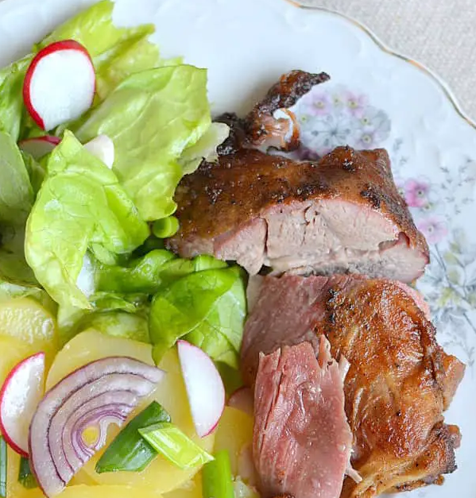
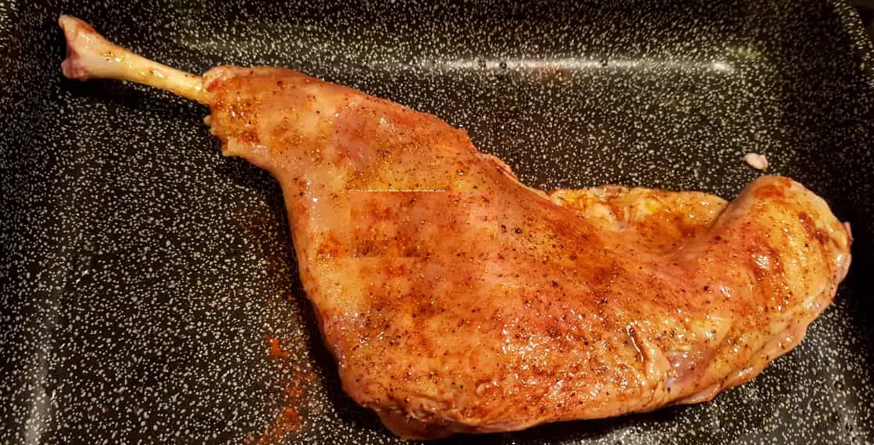
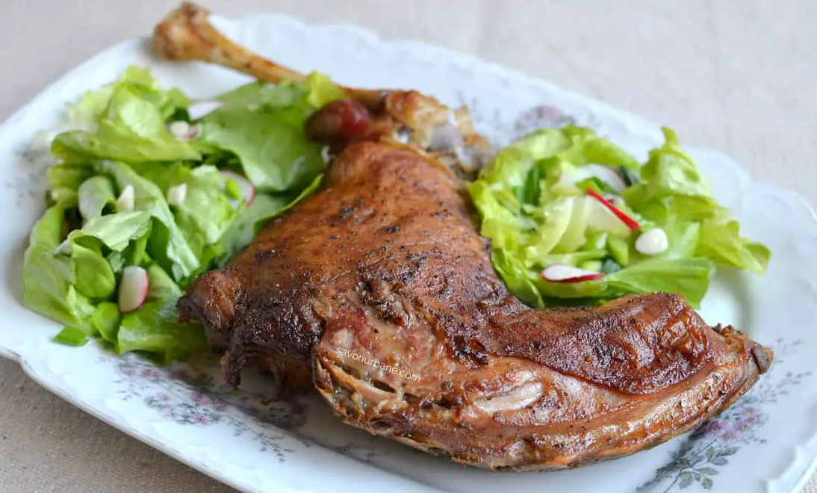
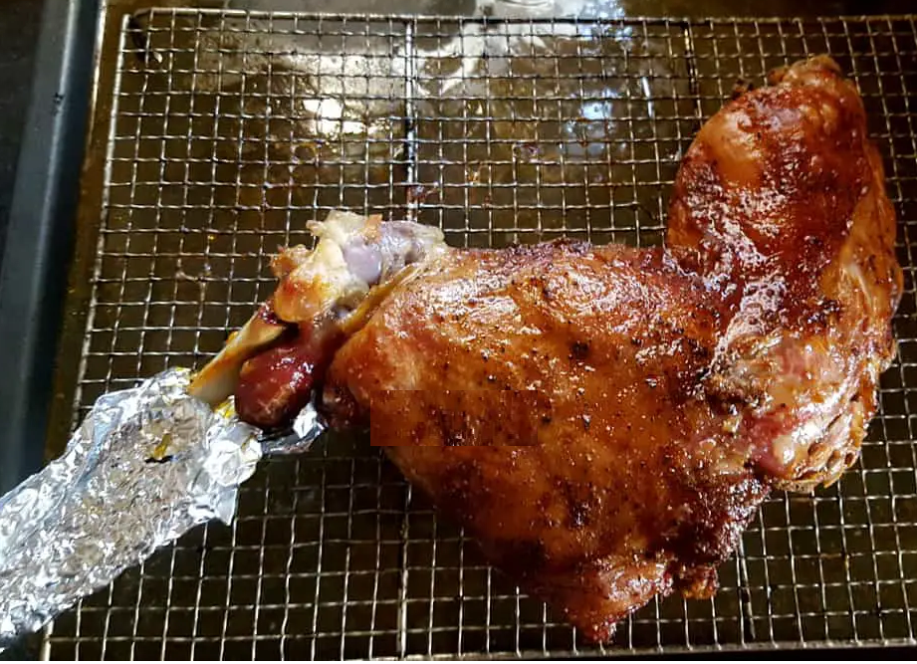
ROAST LAMB IN THE OVEN
Season the meat for at least 12 hours before baking. Here is the leg of lamb. In order not to excessively dry the meat on the shin, scrape it with a knife and push it up, towards the knee. The cleaned bone looks even better and the meat will not burn when cooked. Place the meat in a large tray.
Sprinkle it with salt and pepper, add garlic, coat it with 2-3 tablespoons of oil, and rub it thoroughly with your hands. Cover the tray with aluminium foil and leave it to cool in the refrigerator. The next day, take the tray out of the fridge and leave it on the kitchen table to warm up slowly and reach room temperature. Then place the meat on a grill and under the tray, put it in the pre-heated oven at 170 degrees, with ventilation (top and bottom heat), for 2 hours, turning it from time to time on one side and the other.
Ingredients:
a leg of lamb of 1.5-2 kg
salt
pepper
sweet paprika
garlic
2-3 tablespoons of oil
Garnish:
potato salad
lettuce

Slide 6
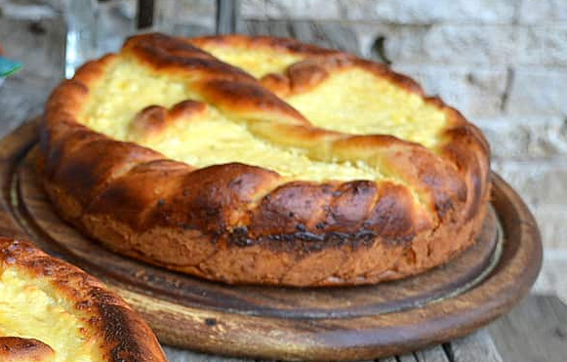
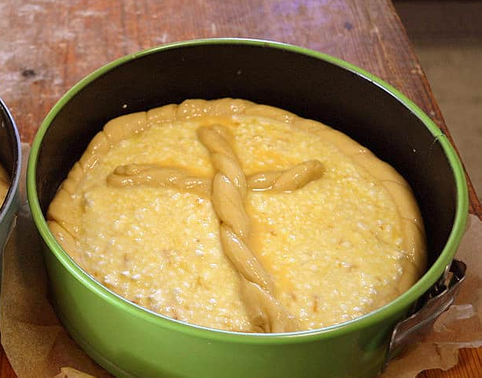
PASCA - a special kind of pastry with a sweet cheese filling and sometimes raisins
The yeast is added to 50 ml of warm milk and left for 5-7 minutes. Pour in the remaining 130 ml of milk, add the powdered and vanilla sugar, the grated lemon peel, and the egg yolks. Mix everything for 1 minute, then add half of the flour and salt. Knead for 5 minutes, then add the soft butter (at room temperature) and mix for another 1 minute. Finally, add the rest of the flour and knead the dough for another 5 minutes. The dough should be soft, not very sticky. It is detached from the walls of the bowl with the spatula and arranged in the middle of it.
Let the dough rise until it doubles in size. The fermentation time depends on the ambient temperature so it can vary from 45 minutes to 2 hours or even more. In the meantime, prepare the filling. In a large bowl, mix the well-drained cheese, cream, sugar, eggs, vanilla, grated lemon peel, raisins, and a good pinch of salt with a spoon. To get a slightly denser filling, add 30 g of semolina. It will puff up as it bakes and absorb some of the custard's moisture. Knead the leavened dough for a few more seconds and divide it into three unequal parts.
The part for the base (250 g) is spread in the form of a disc with a diameter of approx. 28 cm.
From the part for the border (300g) make 2 simple long cords (cylindrical) with a length of approx. 60-70 cm each, which twists together.
From the last part (100g) shape the cross for Easter. From 70 g of dough, make a twisted string, approx. 20 cm, and from the remaining 30 g one of about 10 cm (the arms of the cross).
Line the bottom of the form with baking paper. Insert the dough disc for the base, making sure that its edges go up about 2-3 cm on the walls of the form. Then place the braided crown (border) so that it sticks well to the edge of the form and the base of the dough.
Pour in the sweet cheese filling and level with a spatula. The cross is placed above. Brush the edge and the cross well with an egg beaten with a pinch of salt. Let everything rise for about 10-15 minutes until the oven heats up to 170 degrees. Bake for 45-50 minutes.
Ingredients:
For the dough:
300 g white flour 000
2 egg yolks
40 g powdered sugar
180 ml warm milk
60 g 82% soft butter
12 g fresh yeast or 4 g dry yeast
a good pinch of salt
a packet of vanilla sugar or ½ teaspoon of vanilla extract
grated rind from ½ lemon
For the filling:
300 g cottage cheese
50 g heavy cream with min. 20% fat
3 eggs
100-120 g of sugar
a good pinch of salt
a packet of vanilla sugar or vanilla extract
grated lemon peel
100 g raisins
30 g semolina
For decoration:
1 whisked egg

Slide 7
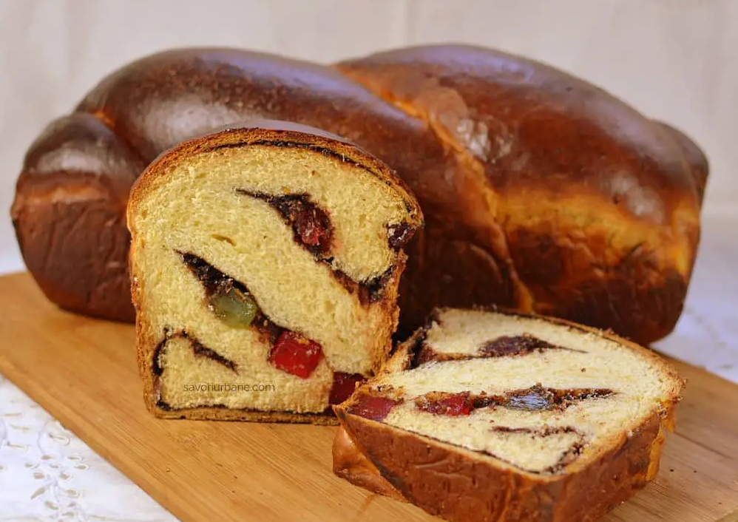
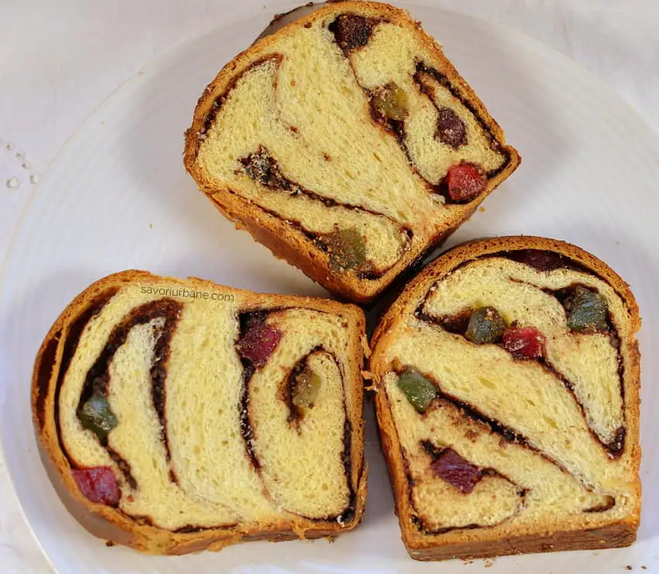
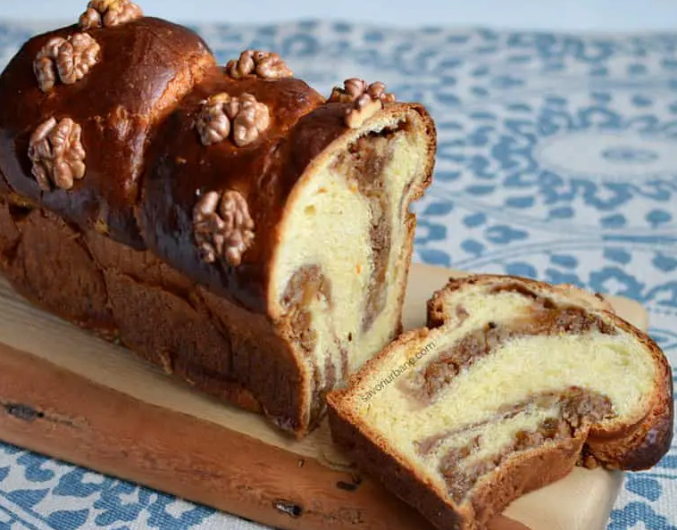
Cozonac
(a traditional dessert for Christmas or Easter holidays)
Dissolve the yeast in a small bowl together with a teaspoon of sugar and 100 ml of milk. Mix it thoroughly with a spoon and sprinkle a little flour. Leave it aside for 10 minutes to activate. In the bowl of the mixer (or in a large bowl), put 4 whole eggs, on top of them add rest of the sugar and the vanilla sugar. Mix everything for 5 minutes. The composition must become foamy and light in colour.
Replace the whisk with the mixing paddle (the triangular one or the wooden spoon if you work by hand) and add the first mixture - sourdough, the rest of the milk, the grated lemon and orange peel, and 500 g of flour. Everything is mixed approx. 5 minutes. The dough becomes thin, like pancakes.
Add the rest of the flour together with the salt and knead the dough well with the special kneading hook for 10 minutes. Then cover the bowl with a plastic foil and leave it to rest for 10 minutes, after which the kneading of the dough starts again, adding a little oil, in 3-4 turn. Do not pour the next portion until the previous one is incorporated! This kneading stage lasts approx. 20 minutes. In the end, the dough becomes elastic and smooth and non-sticky.
Place the bowl of dough in a large plastic bag, close it as best as possible. Pre-heat the oven to 50 C and then switch it off. Place the bowl with the dough in the warm oven and let it rise for 30-40 minutes.
Then, turn the dough over on the lightly oiled table and leave it stretched in the shape of a rectangle, with a thickness of 1 finger. First, fold the dough into 3, bringing the side edges over the middle third. A longer rectangle is obtained, the ends of which are again brought over the middle part. Cover the dough with plastic and let it rest for 10 minutes on the work table. Divide the dough into equal portions and shape each one into a ball, which is covered with plastic foil and leave it for a while.
Ingredients:
1 kg of flour 000
50 g fresh yeast or 14 g dry
350 ml (max. 400 ml) warm milk
250 g of sugar
4 eggs
150 ml of oil or 100 ml of oil and 100 g of melted butter
3 sachets of vanilla sugar or two teaspoons of extract or the core of a vanilla pod
grated peel from 2 lemons and an orange
10-12 g of salt (weighed!)
Filling:
300 g Turkish delight
150 g walnuts
100 g sugar
50 g of cocoa
Furthermore: 1 yolk,
50 ml of milk
Take one dough ball at a time and roll it into a rectangle (approx. 40 cm x 25 cm). Sprinkle 1/4 of the cocoa, sugar, and walnut mix and 1/4 of the Turkish delight on top. Then roll it, not very tight, forming a roll. Place 1 cm of dough on the left and right so that the filling remains inside. The obtained rolls are intertwined, not very tightly, in pairs and placed in the baking forms, lined with baking paper. These, covered with aluminium foil, are put back into the oven for approx. 1.5 hours. Then remove them from the oven, smear it with egg yolk, and bake again at 180 C for 20 minutes, then lower the temperature to 170 C and bake for another 25 minutes.

Slide 8
We hope you like our recipes and want to try them!
THANK YOU!

