Slide 1
Easter in Serbia
Dimitrije Jocic III/3

Slide 2
Introduction
Easter is one of the most important holidays in Serbia, celebrated by both Orthodox and Catholic Christians. The holiday is a time for family gatherings, traditional foods, and religious ceremonies.
In Serbia, Easter is celebrated according to the Julian calendar, which means that it usually falls on a different date than Easter in the Western world.

Slide 3
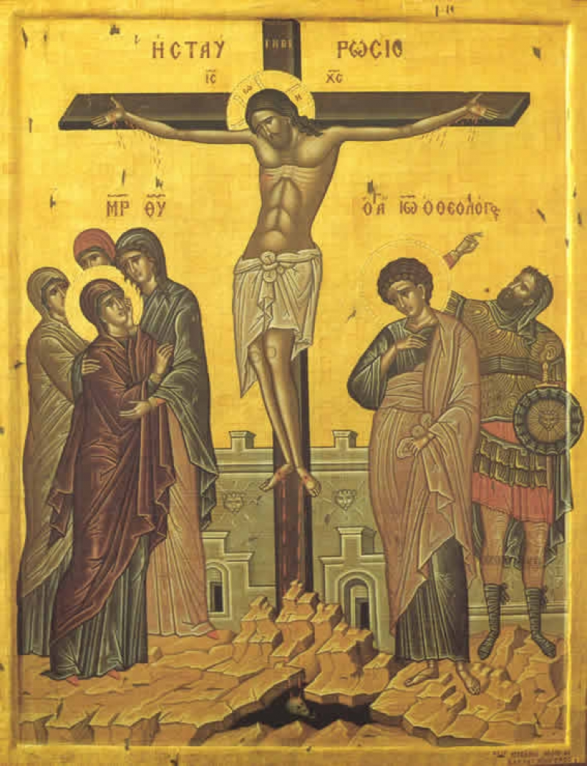
Good Friday
On that day, Jesus, whom believers call Christ, was taken from the priest Caiaphas' house to the Roman procurator Pontius Pilate. He condemned him to crucifixion on the cross. Jesus was crucified and died on Golgotha, a hill outside Jerusalem. Before his death, he said: Father, forgive them. They don't know what they are doing.
There are no liturgies on Good Friday, and it is a day of strict fasting, during which Christians do not consume fat, regardless of its origin, and all household chores are suspended.

Slide 4
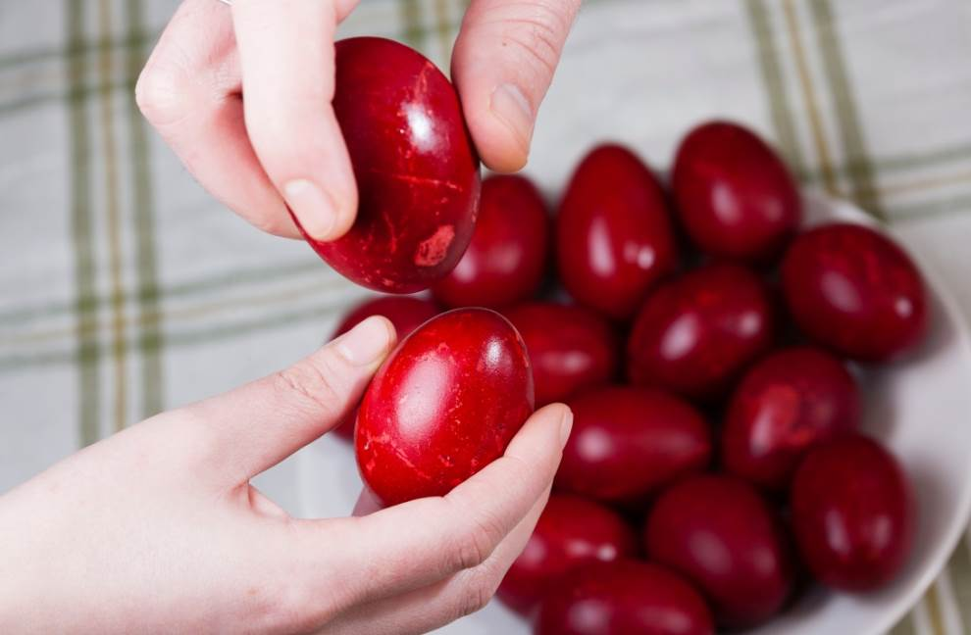
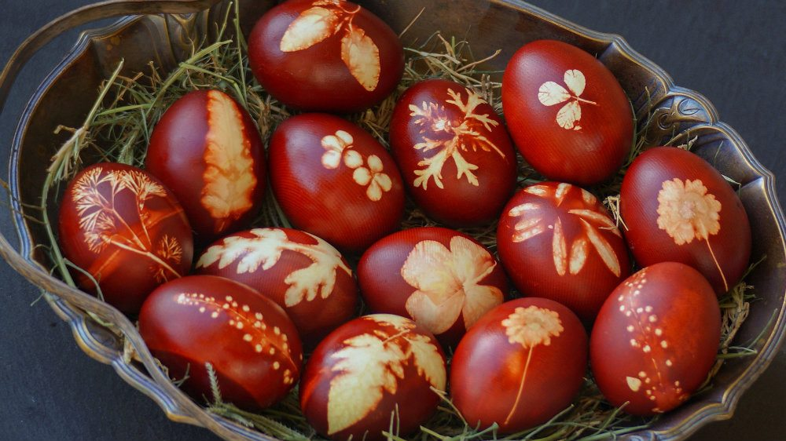
Egg dying
On Good Friday, Easter eggs are painted, mostly red, which symbolizes the blood of Jesus. Eggs are eaten, given as gifts and beaten (knocked) from Sunday.

Slide 5
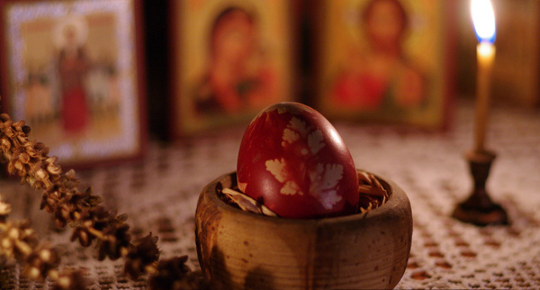
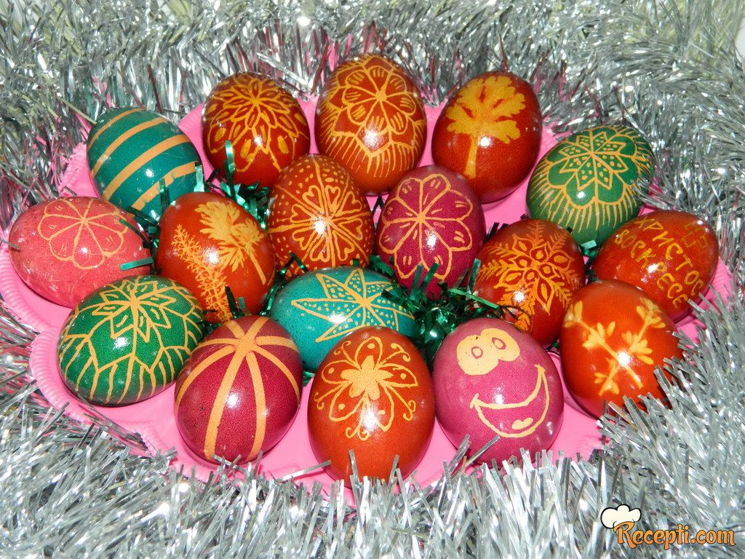
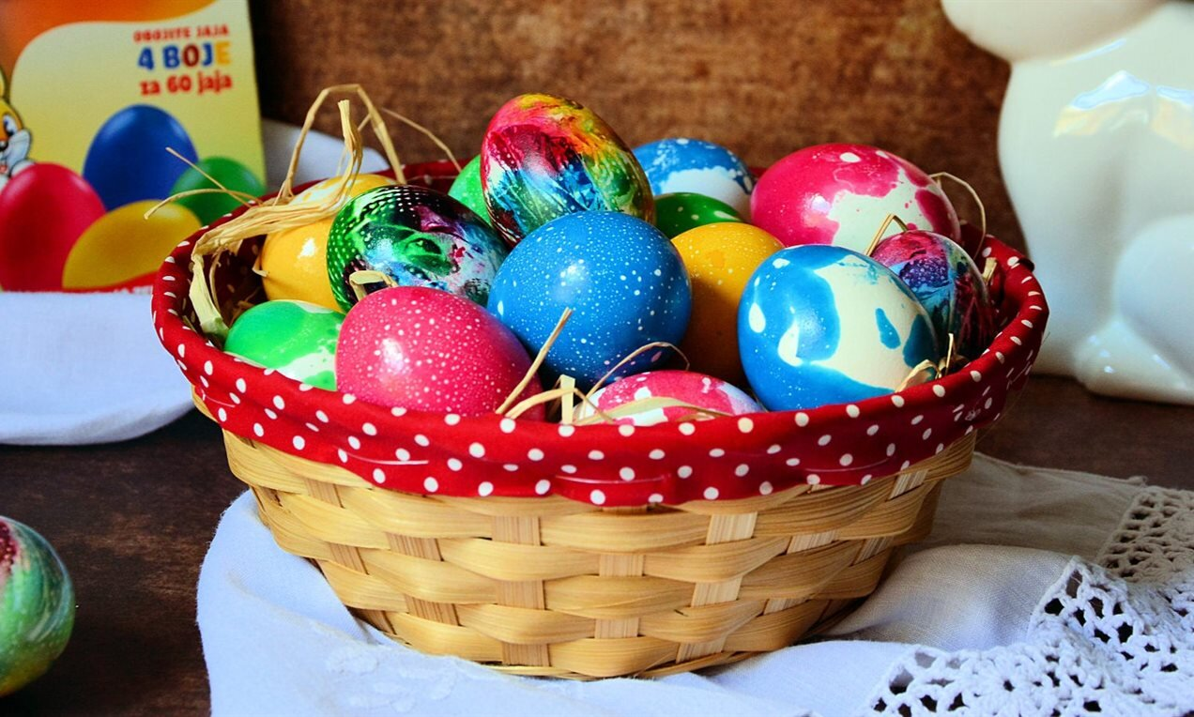
Egg dying
The first red egg to be painted is called the keeper's house. The colors used can be industrial, natural (petals and leaves of plants), and decorations, if any, vary from liquid paints to glitter, decorative foils and stickers.

Slide 6
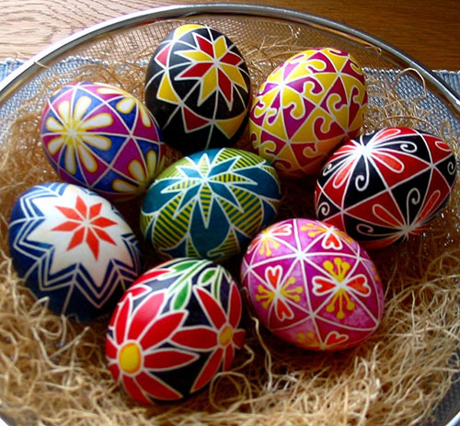
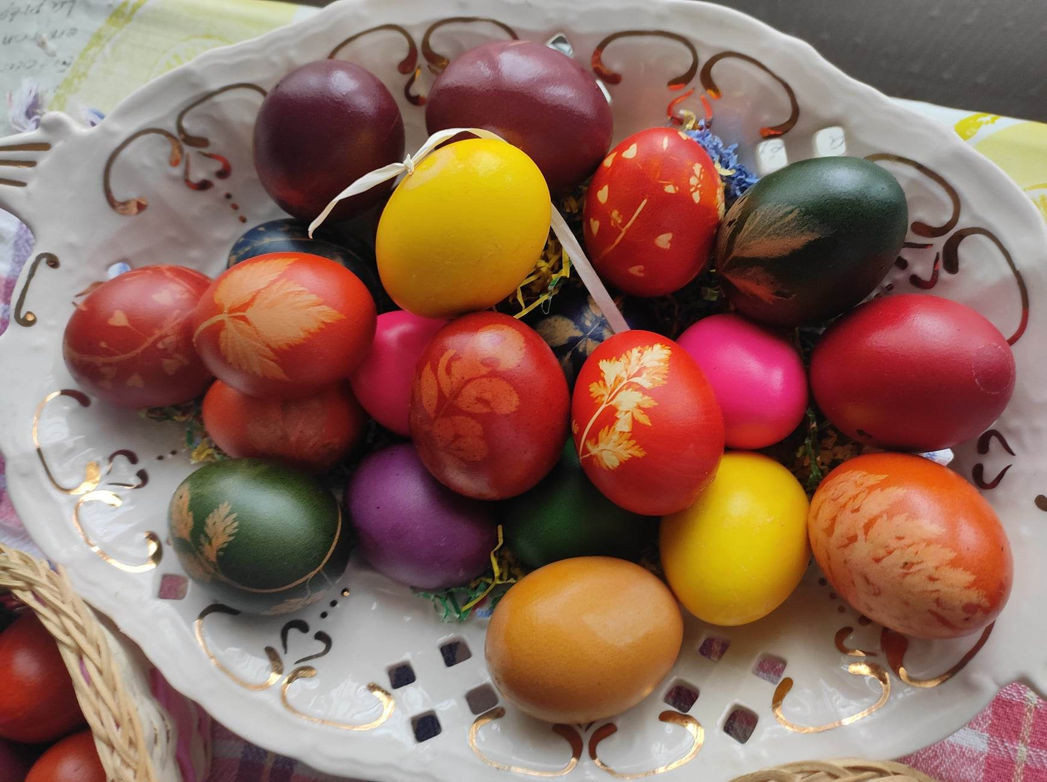
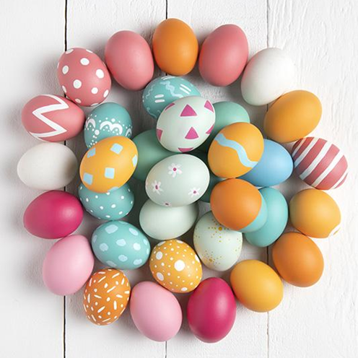
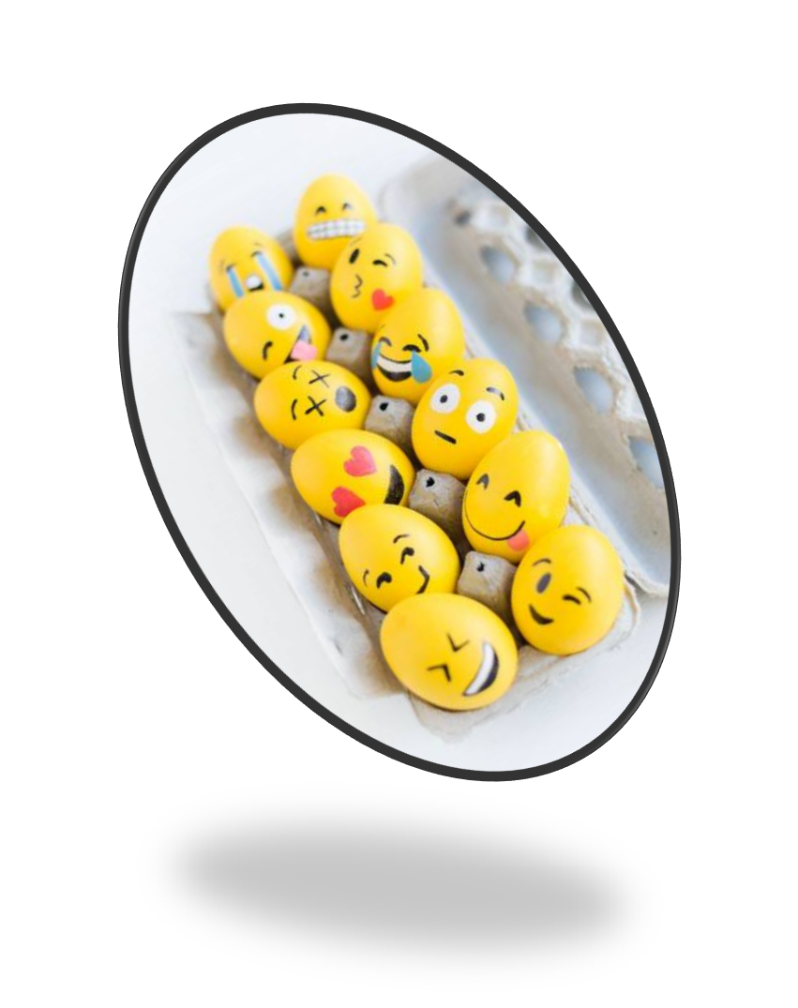
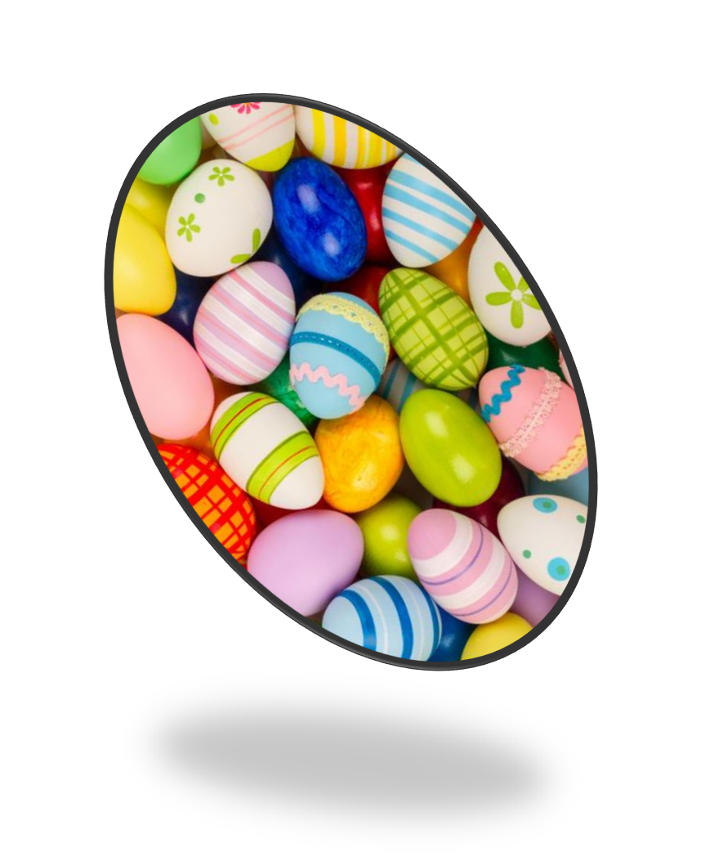
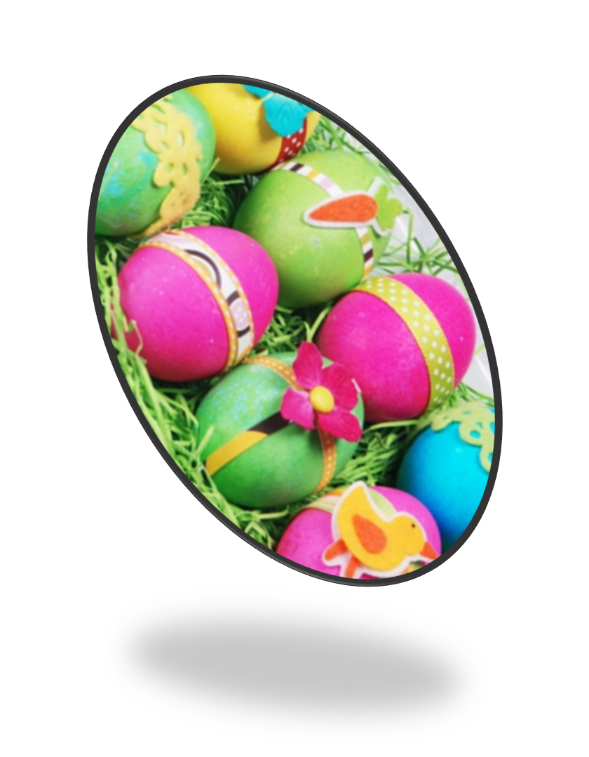
Examples of dyed eggs

Slide 7
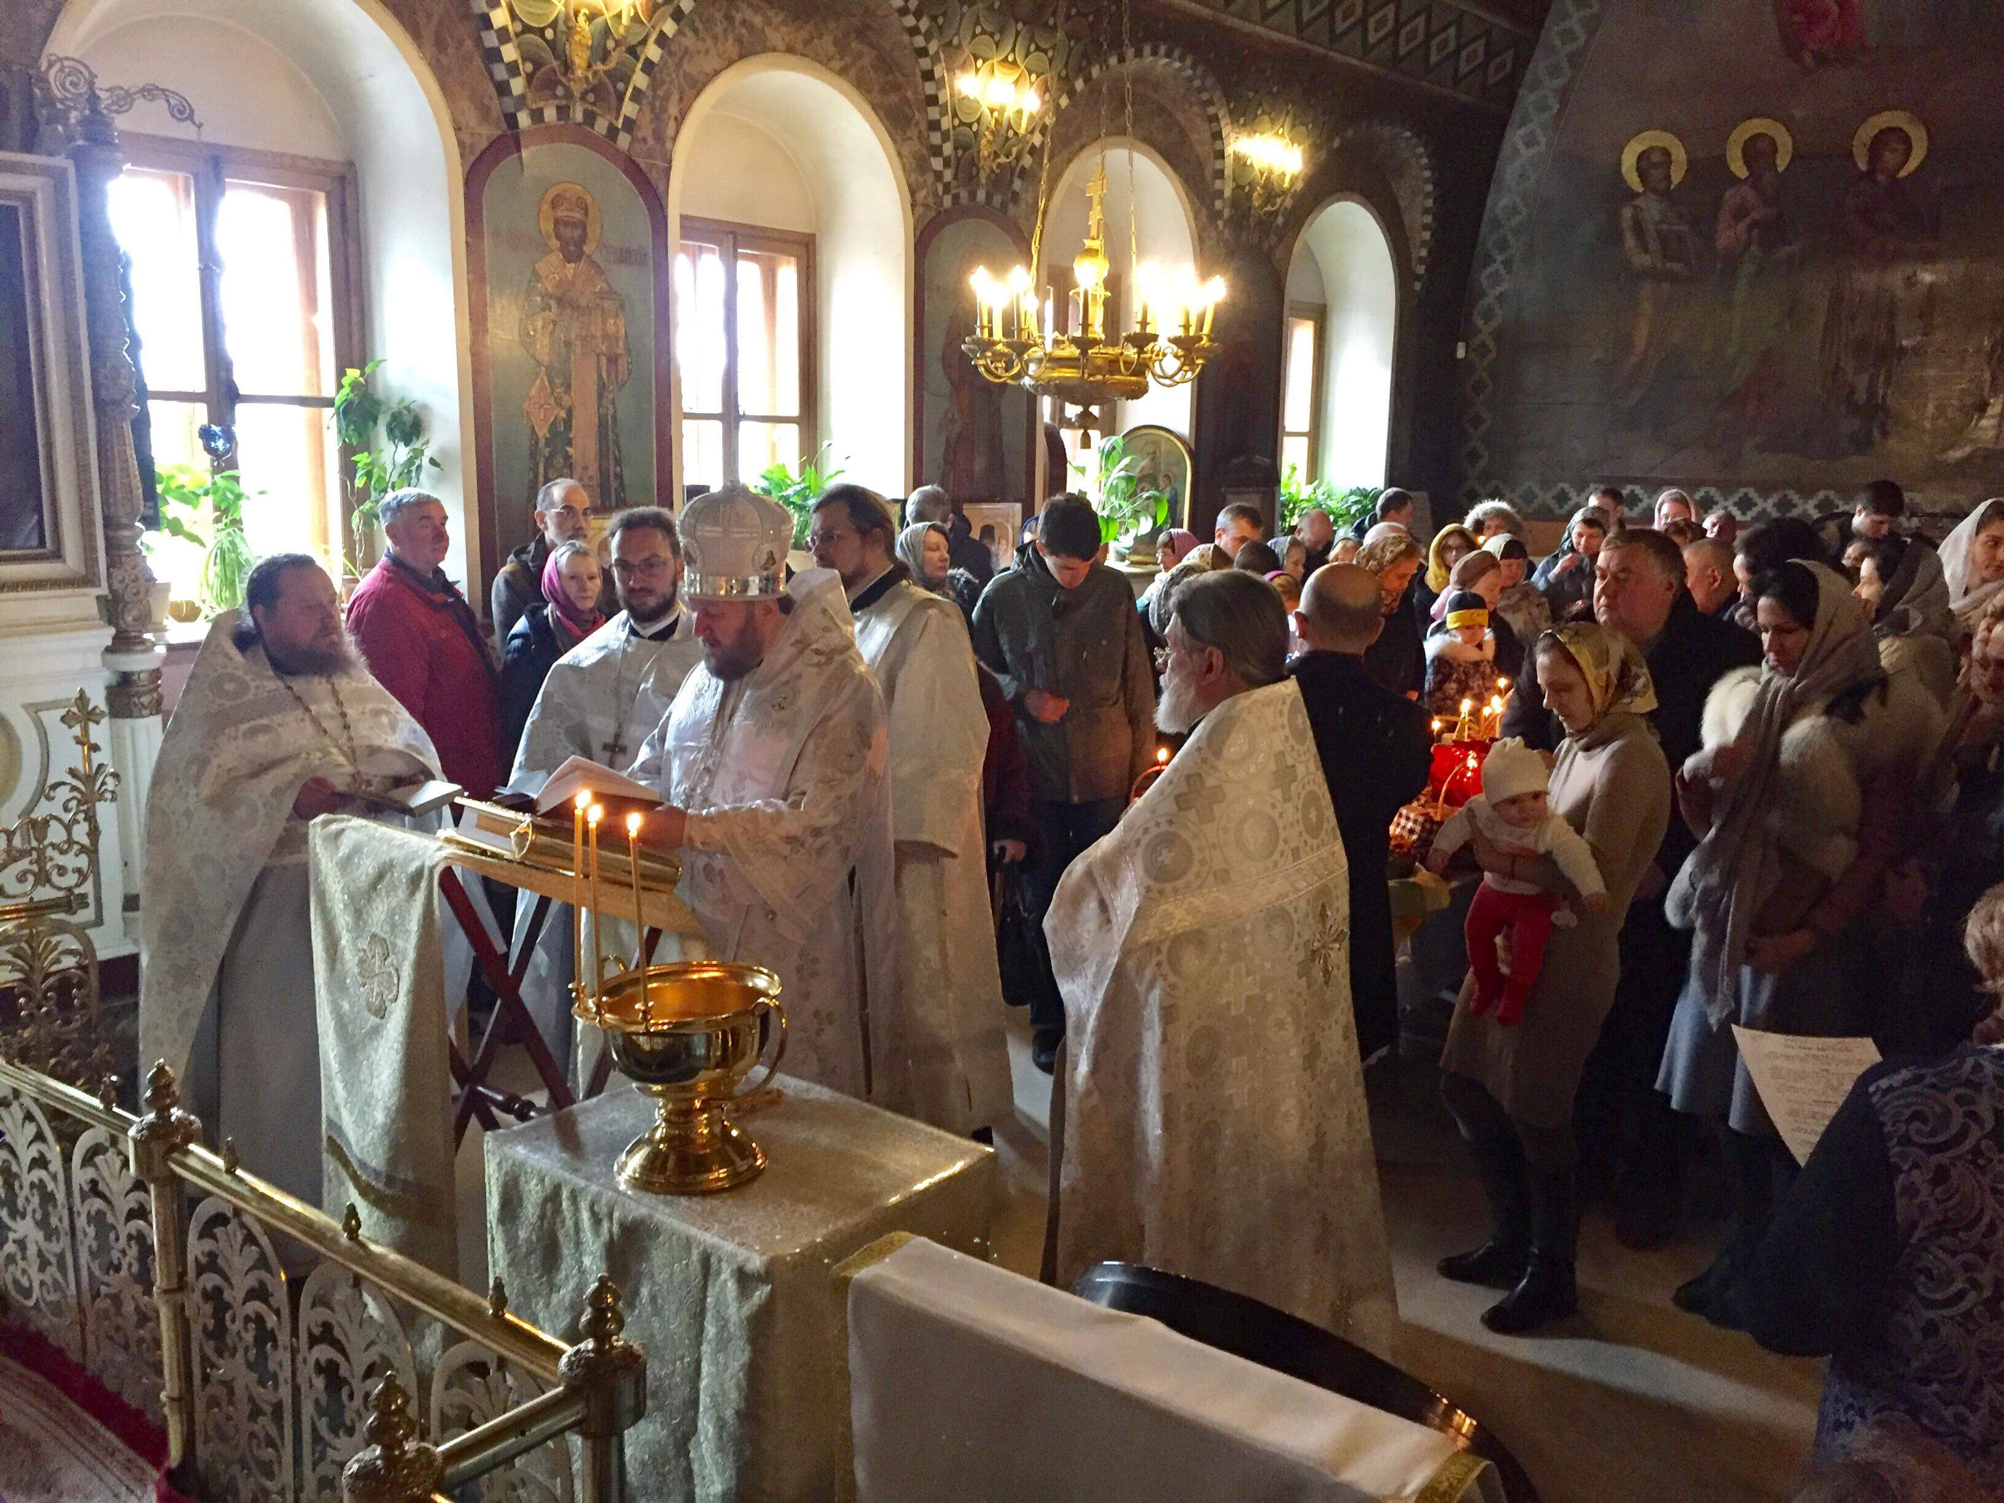
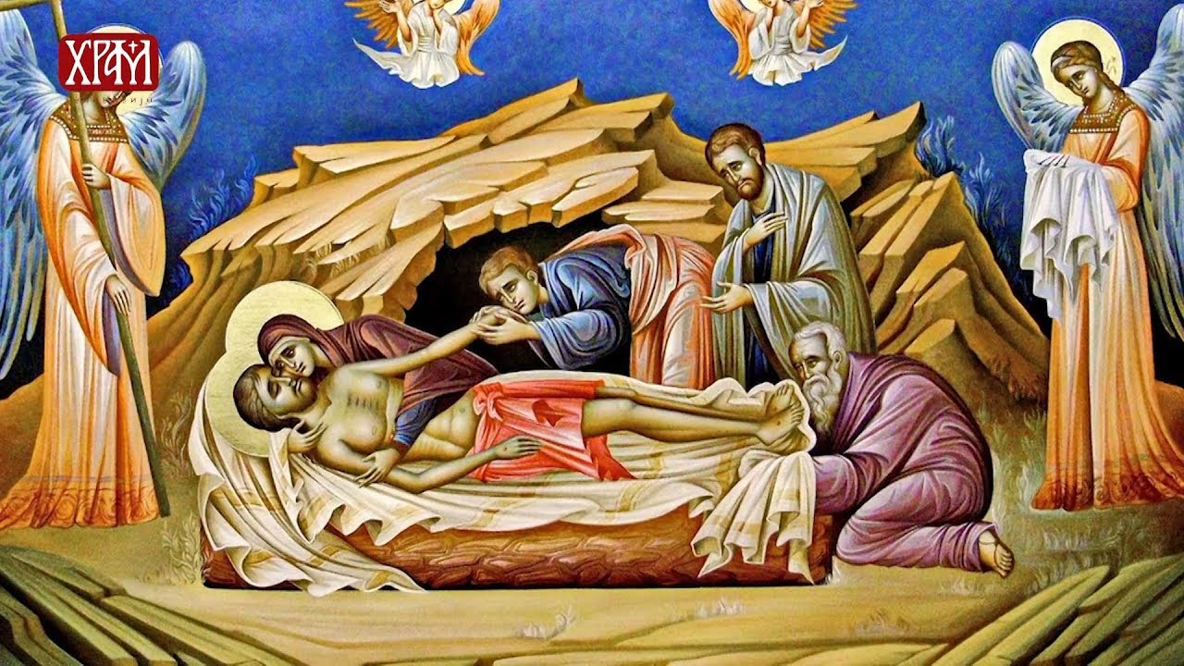
Good Friday is followed by Holy Saturday, the second day of Christian mourning. Christ spent that day in Hades, and believers mark it in prayer and silence. It is also the last day of the week of suffering and death. The midnight Easter liturgy ends the days of mourning and the feast of the Resurrection begins.

Slide 8
Easter Sunday
Sunday is the first day of Easter. On that day, Orthodox Christians in Serbia greet each other with the words "Christ is risen", to which the answer is "Truly he is risen". These are greetings taken from Serbo-Slavic.
On Easter Sunday, Serbian families gather together to celebrate. They begin the day with a special breakfast that includes the blessed foods from the previous day's church service.
After breakfast, many families attend church services where they participate in the traditional procession and lighting of candles.

Slide 9
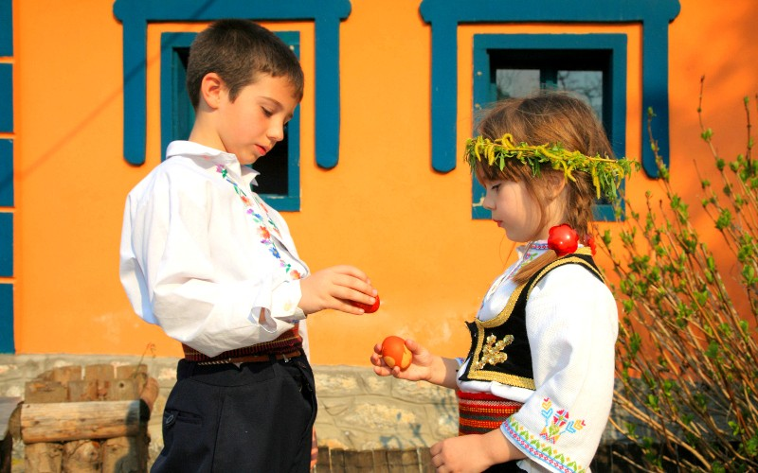
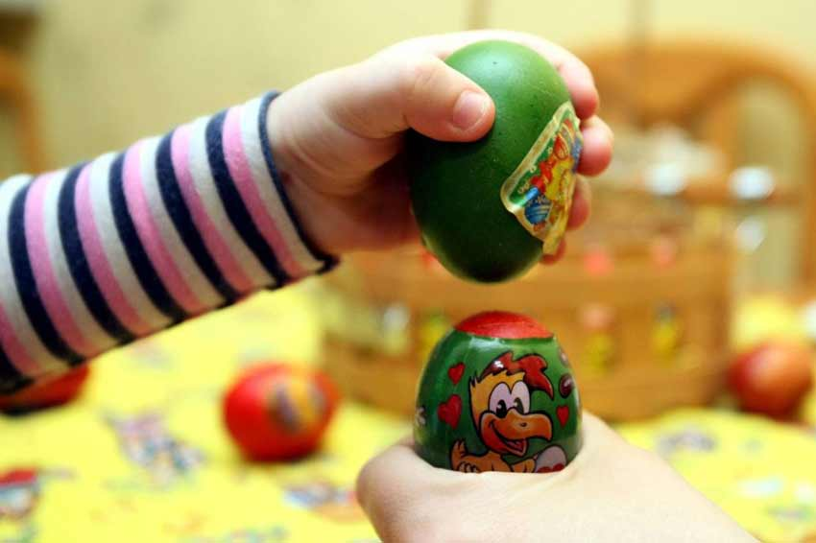
One of the most popular Easter traditions in Serbia is the game of egg tapping. Each person selects a colored egg and takes turns tapping them against each other. The person whose egg remains uncracked is considered the winner.

Slide 10
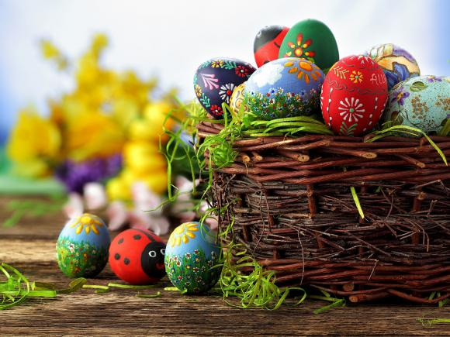
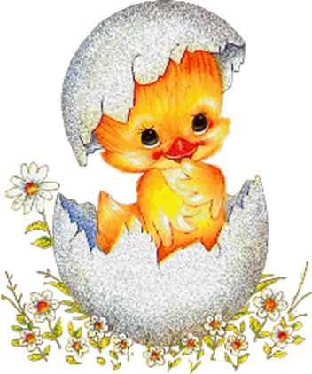
Sunday is the day Jesus resurrected. The second (Easter Monday) and the third day of Easter (Easter Tuesday) are also celebrated. By the way, that whole week is called Great, that is, Holy Week. Orthodox Christians celebrate Easter with the Holy Liturgy.

Slide 11
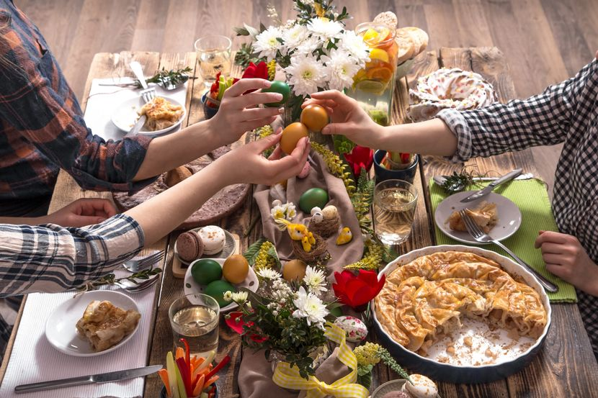
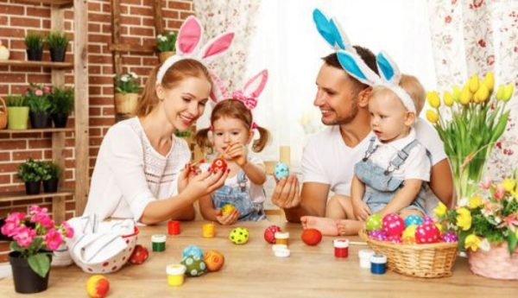
Conclusion
Easter in Serbia is a time for family, tradition, and celebration. From the preparations leading up to the holiday to the customs and traditions that continue to be passed down through generations, Easter holds a special place in Serbian culture.
Whether attending church services, playing traditional games, or enjoying the delicious food and company of loved ones, Easter in Serbia is a joyous occasion that brings people together.

Slide 12
Make Easter environmentally acceptable
Choose sustainable decoration products: Instead of buying plastic and disposable decorations, consider choosing natural materials such as wood, paper and fabric. You can also use items you already have at home and turn them into decorations.
Limit food consumption: Plan ahead and buy only what is needed. Prefer buying locally produced food and reduce the amount of food that ends up in the trash.
Recycle: Consider recycling packaging and materials used for Easter activities and decorations. Separate paper, glass, plastic and other recyclable materials and take them to the appropriate container.
Buy eco-friendly gifts: If you plan to buy gifts, consider buying eco-friendly products. You can choose products made from sustainable materials or those that are produced in a way that is friendly to the environment.
Store-bought paints are generally laced with chemicals that pollute freshwater ecosystems and damage natural waterways. Instead, try natural dyes that you can make from vegetables, spices and fruits in your kitchen.

Slide 13
Happy Easter!!!

